Slide 1
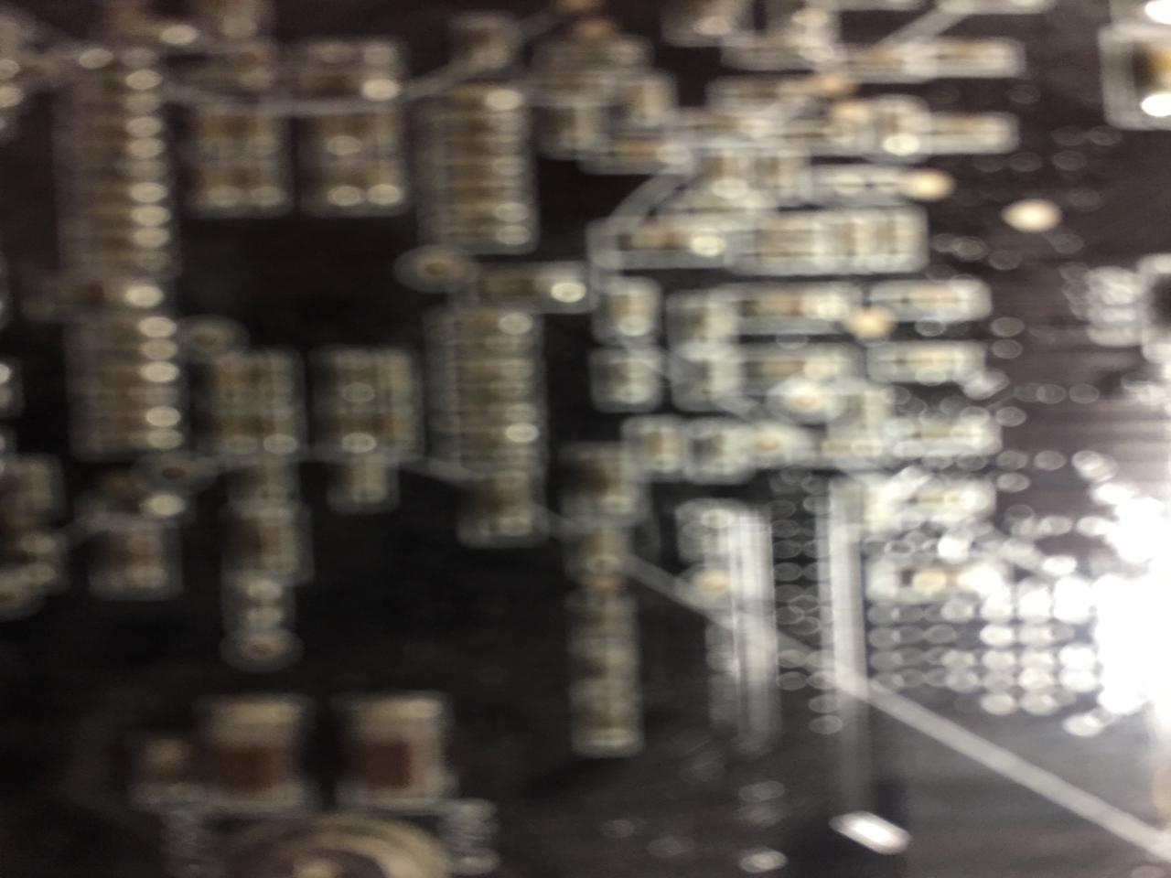

News of the Week
Talk 9
LAW 424 001
Communications Law
Allard School of Law, UBC
Spring, 2022
Jon Festinger Q.C.
Centre for Digital Media
QMUL School of Law (CCLS)
Whiteboard Law
http://commlaw.allard.ubc
@jonfestinger
jon_festinger@thecdm.ca

Slide 2

Group Presentations

Slide 3


Slide 4
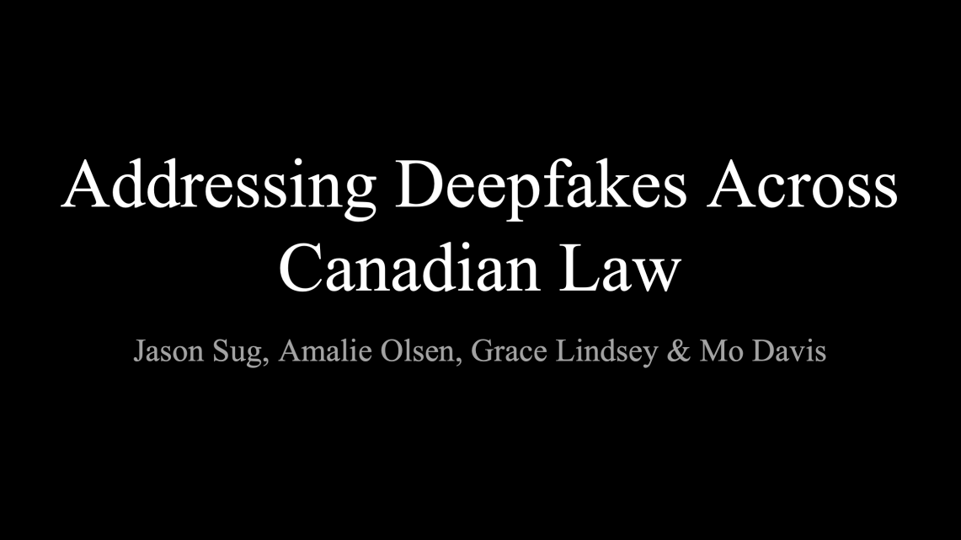

Slide 5
Logistics

Slide 6
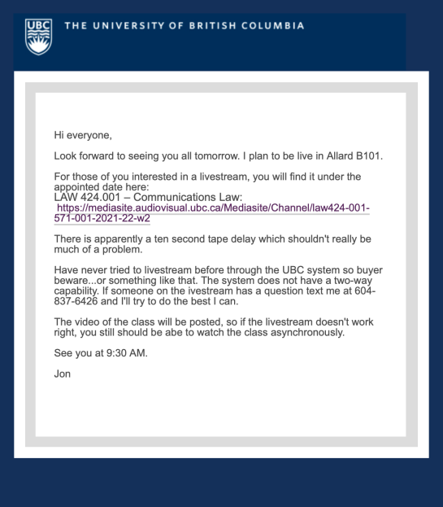
Jon’s Cell for questions: (604) 837-6426

Slide 7
Course Website
http://commlaw.allard.ubc.ca
There ARE Issues:
Downloading video?
Misattributions

Slide 8
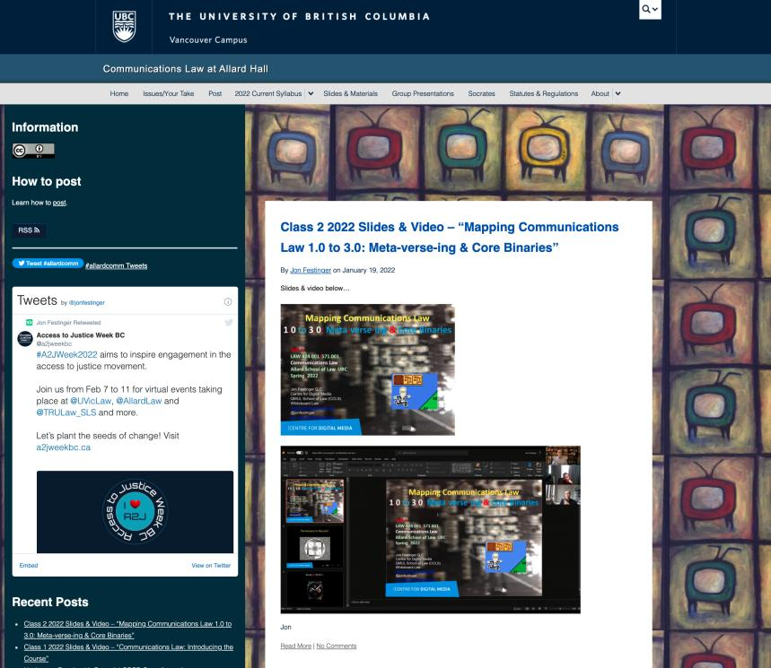

Slide 9
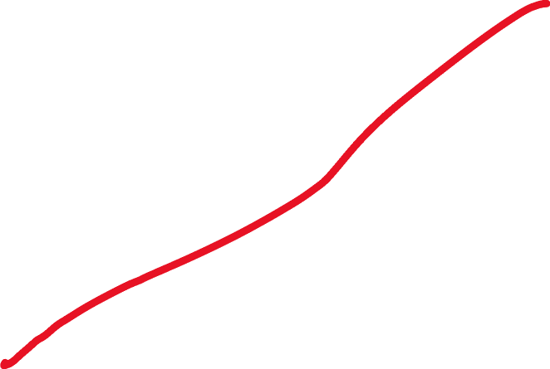
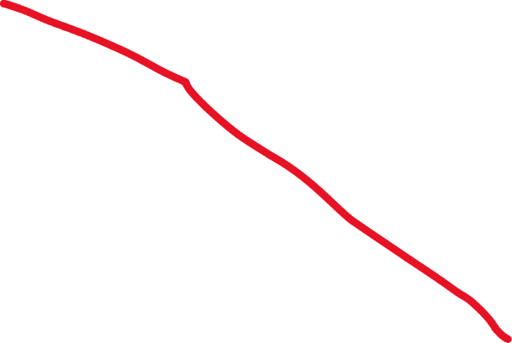
For full privileges on the website
1. Please create an account at http://cms.ubc.ca/ using your CWL.
2. Once you create an account and sign in at http://cms.ubc.ca/ you can click your name in the top right. Halfway down the following page will be your WordPress email address.
3. Send me your WordPress email address at jfestinger@telus.net or at jon@fblawstrategy.com
4. Then, I will invite you to participate with authoring privileges via your WordPress email address.

Slide 10
Most everyone should be registered!!!
Please double-check and let me know if there is a problem.

Slide 11

Why post?
Engaging and engaging others is the key.
Because you don’t love speaking up in class.
Because you just saw something and you’ll never remember it unless you post it now.
If you : #allardcomm

Slide 12
Tips:
Don’t feel your blogs have to be perfect. Engaging and engaging others is the key.
Please tweet #allardcomm

Slide 14

Anything & everything can be done via email if you prefer

Slide 15

Office “Hours”: Ideally Tuesdays after class but am flexible…
Email me : jon.festinger@ubc.ca
Skype: jon.festinger
Phone:
o. 604-568-9192
c. 604-837-6426

Slide 16
EVALUATION
Term paper = 60% of the final grade.
5000-word paper
The paper is due on the last day of the exam period at 4:00 p.m.
Class Participation = 40% of the final grade
25% of the mark will be based on group preparation of a Class Discussion, with a Discussion Outline provided to the class—preferably by posting on the course website—a week before.
15% for student participation in other course activities including seminar discussions etc.

Slide 17
Paper Confessional
(or what I learned one winter holiday)
Legal/normative reasoning/argument including footnote/bibliography support & Contribution/Move forward → 60%
Presentation including layout, headings, grammar, language/writing skills, “tightness” → 25%
Topic/Originality/Degree of Difficultly → 15%
THIS IS NOT A RUBRIC. IT IS A SELF ASSESSMENT.

Slide 18
Group Presentations
4-6 (ideally) per group if a group
5 minutes per person general rule
Sign-up confirmation @ break
Any topic – not constrained by what I’m talking about that week
Can consult with me re the topic you want to take on
Post one thing you want us to read or watch

Slide 19
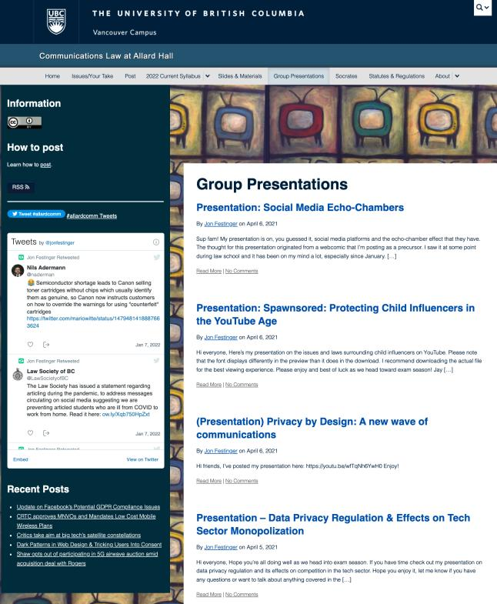

Slide 20
Evaluation Tips
Term paper topics need not be discussed with me, but often helpful to you if you do.
Term paper can be on your presentation topic.
Term papers: Avoid the purely descriptive
Participation: In-class or other contributions, including attendance.
Group presentation need not be on that week’s topic

Slide 21
LLMCL Students Additional Task
750 – 1000 word post (or email) Applies only to those registered in LLMCL 500 section, not to those in JD section
All LLMCL students exempted from class average requirement

Slide 22
Grades (primarily)
Paper → Quality
Participation → Effort

Slide 23
Will read: drafts…outlines…synopsis……abstracts…etc.
As late as I can…
Due last day of exams by 4:00 PM.
Send in papers by email.
Make sure you get acknowledgment of receipt.

Slide 24
Navigating the Course
1. Old lectures on-line could be referenced.
2. Always recorded.
3. No attendance sign-up sheet.
4. Increased flexibility on group (or individual) projects re how, what & when.
5. Directed Study-ish goal.

Slide 25
QUESTIONS?
THOUGHTS?
DISCUSSION?

Slide 26

Pause

Slide 27
News of
the Week

Slide 28
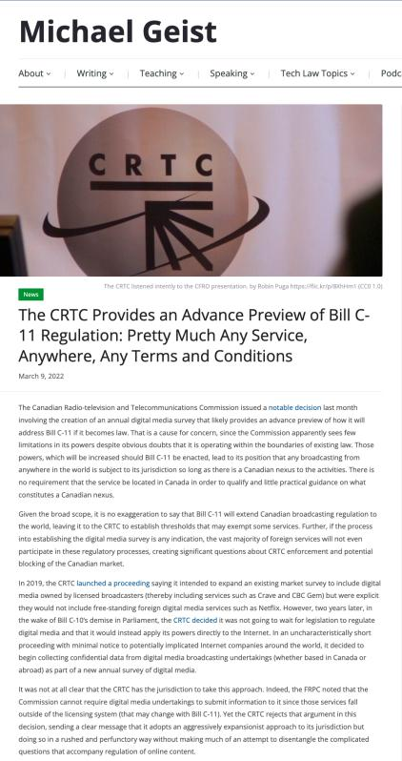

Slide 29
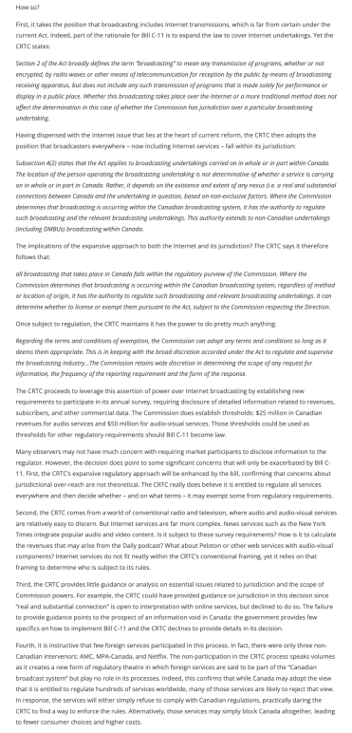

Slide 30
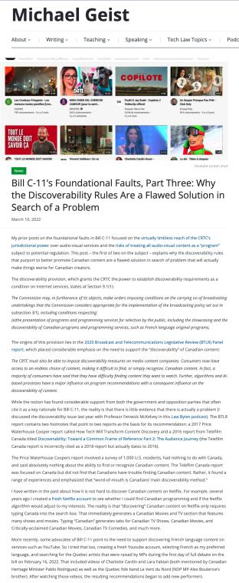

Slide 31
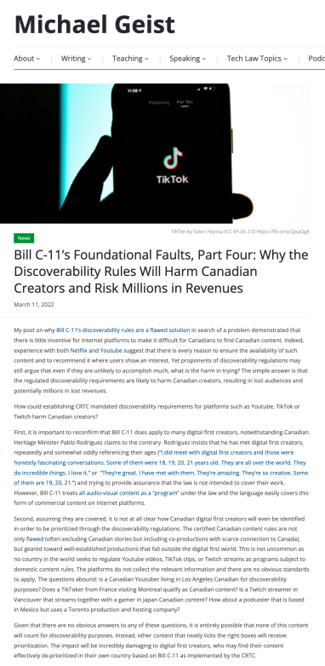

Slide 32
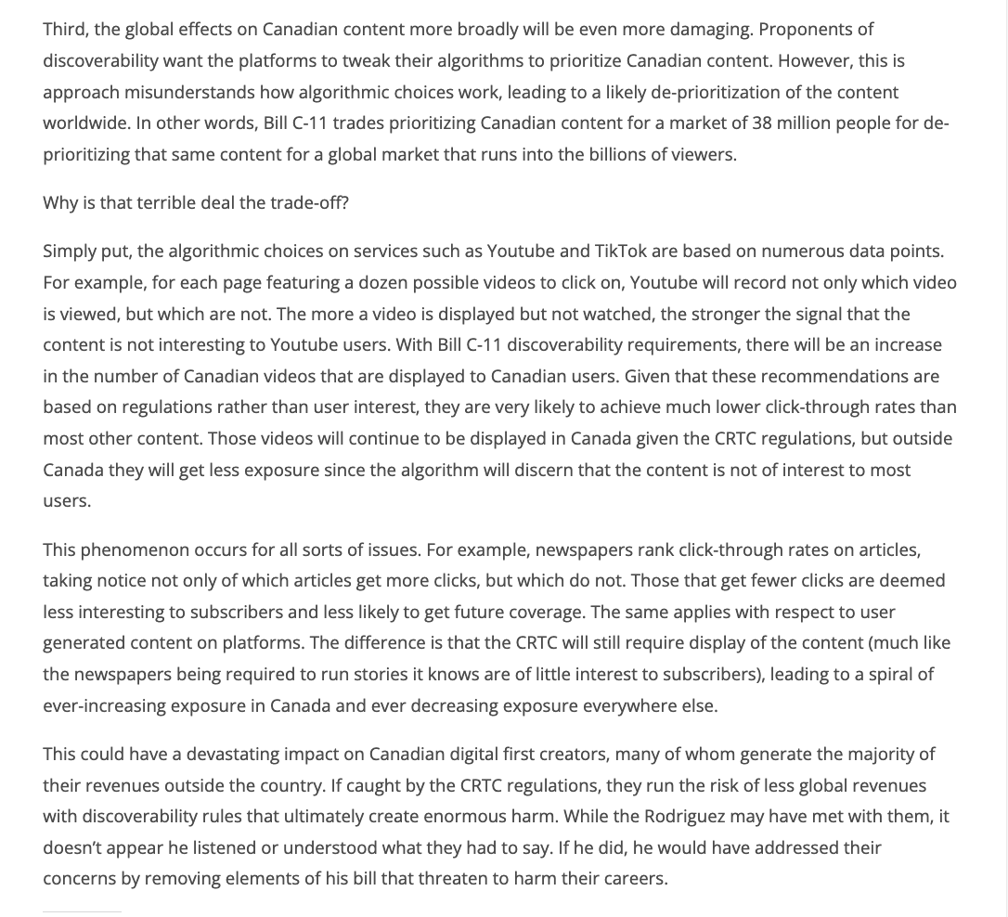

Slide 33
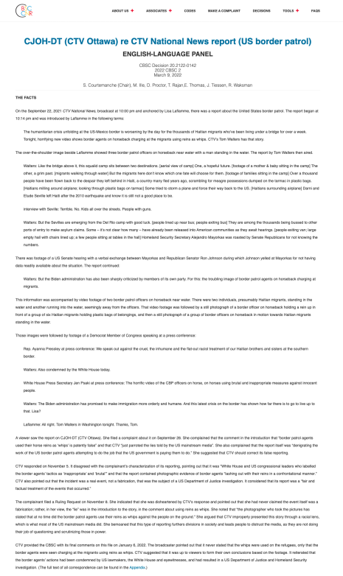

Slide 34
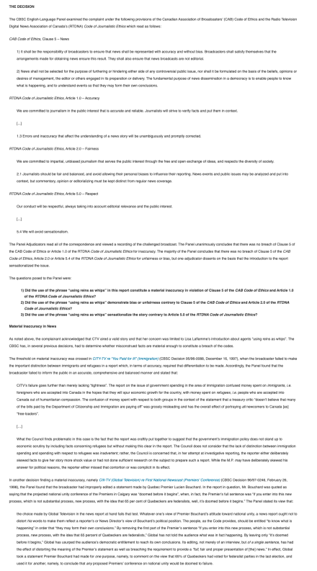

Slide 35
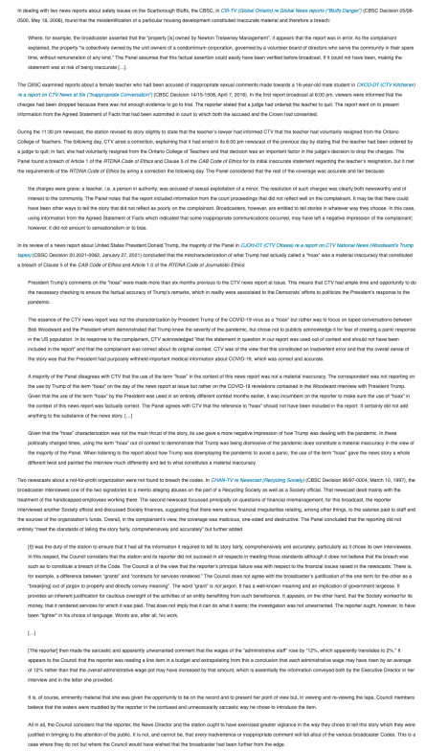

Slide 36
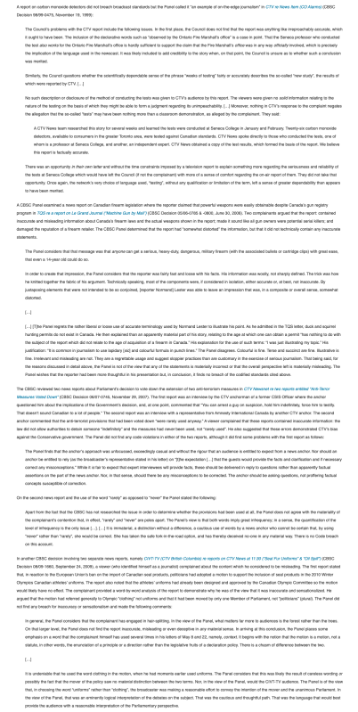

Slide 37
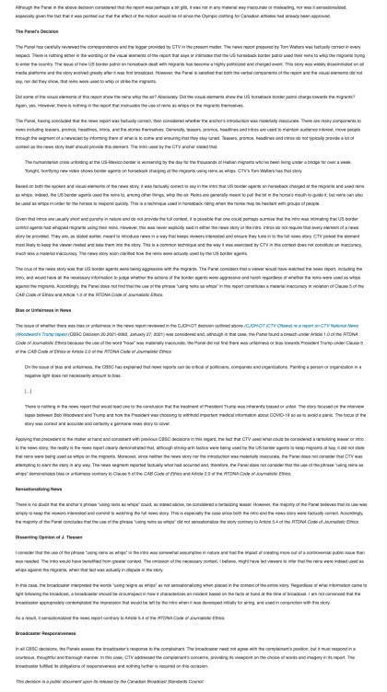

Slide 38
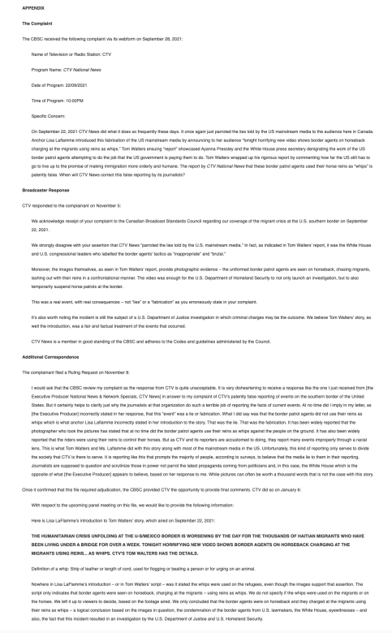

Slide 39
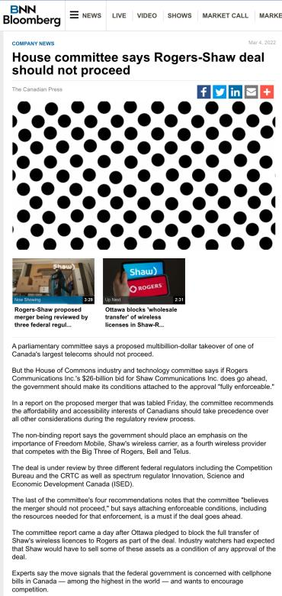

Slide 40


Slide 41
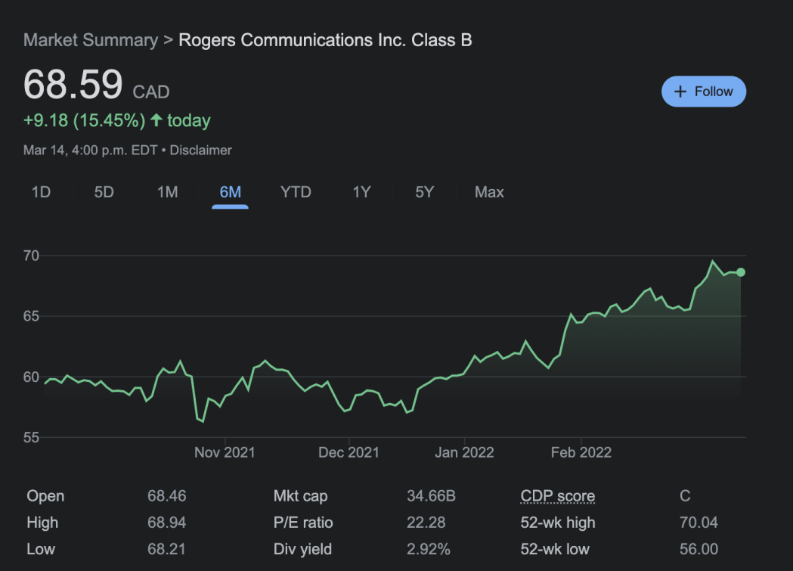

Slide 42
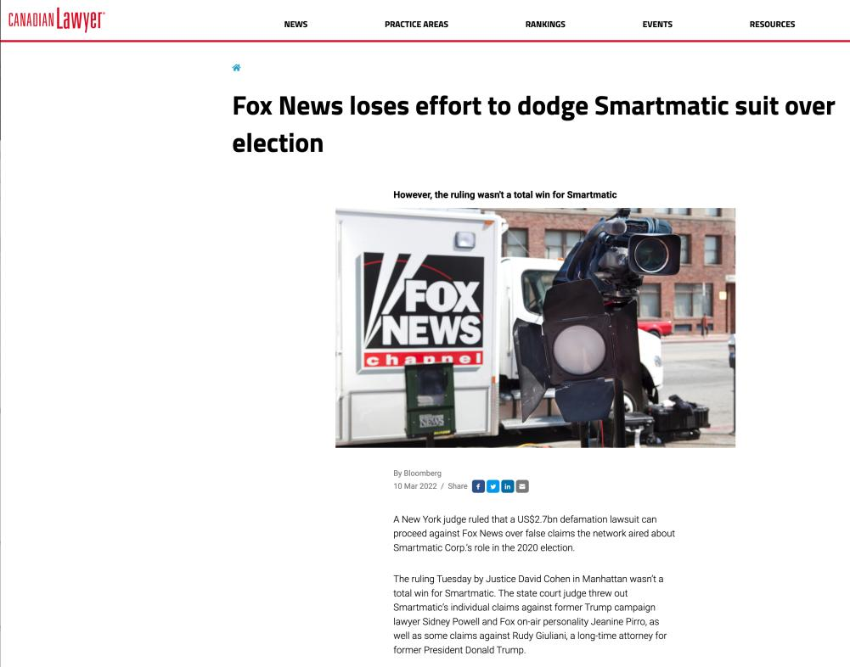

Slide 43
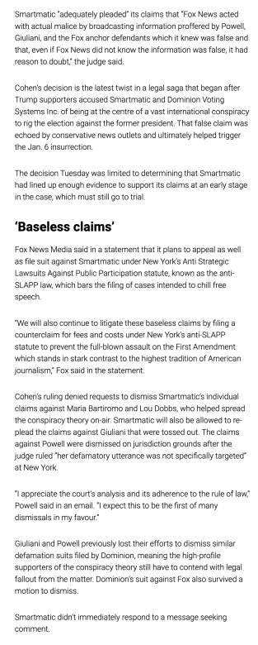

Slide 44
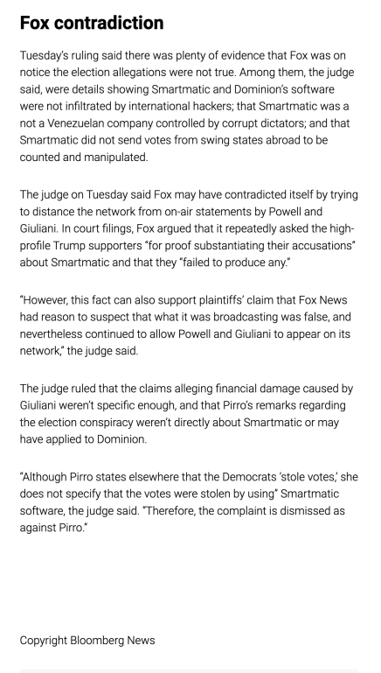

Slide 45
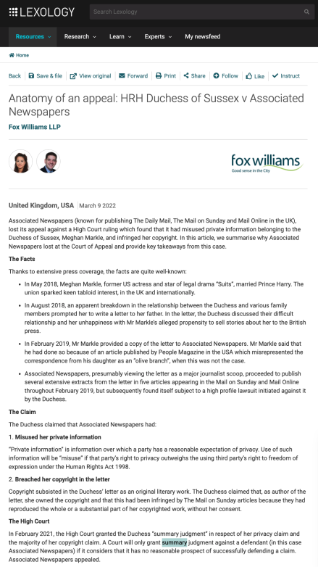

Slide 46
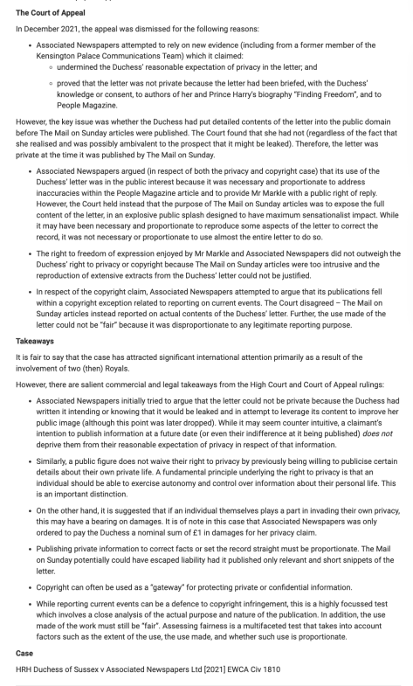

Slide 47
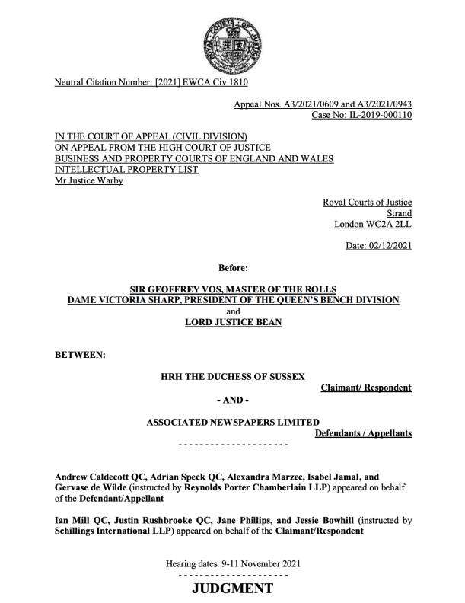

Slide 48
“1. The central question in these appeals is whether the judge (Mr – now Lord - Justice Warby) was right to make orders for summary judgment in favour of the claimant, Meghan, Duchess of Sussex (the Duchess or the claimant) against the publishers of the Mail on Sunday newspaper and the MailOnline, Associated Newspapers Limited (Associated Newspapers or the defendant). Summary judgment was granted in respect of the Duchess’s claims for misuse of private information and infringement of copyright. The claims relate to the publication in a number of Mail articles (the Articles) of about half the contents of a 5-page handwritten letter (the Letter) which the Duchess had sent on 27 August 2018 to her father, Mr Thomas Markle (Mr Markle)…

Slide 49
3. In his judgment of 11 February 2021, the judge also held that the Duchess was entitled to summary judgment on the issues of subsistence and infringement of copyright in the Letter, but that the issue remained of whether a Mr Jason Knauf (Mr Knauf), a former member of the Kensington Palace Communications Team, was a co-author. After the judgment, it became clear that Mr Knauf had not co-authored the Letter and claimed no copyright in it, and the judge gave final summary judgment on the copyright claim in a further judgment of 12 May 2021…
9. As to copyright, Associated Newspapers’ two main grounds of appeal are that (i) the judge failed properly to evaluate the interference with article 10, saying that this was not one of the rare cases in which freedom of expression would outweigh copyright in the absence of a fair dealing defence, and (ii) the judge failed properly to evaluate the fair dealing defence, bearing in mind the limited scope of the copyright in the Letter and the wide scope of the concept of reporting current events.

Slide 50
Daddy, [1] It is with a heavy heart that I write this, not understanding why you have chosen to take this path, turning a blind eye to the pain you’re causing. The last time we spoke was 7 days before our wedding when Harry and I called you. This was followed by a turbulent and confusing week where we called you multiple times a day to try to understand what was happening. [2] From my phone alone, I called you over 20 times and you ignored my calls, opting instead to solely speak to tabloids - leaving me in the days before our wedding worried, confused, shocked, and absolutely blindsided. [3] Post wedding you then made a choice to begin an onslaught of media interviews, which are still ongoing. Your actions have broken mv heart into a million pieces - not simply because you have manufactured such unnecessary and unwarranted pain, but by making the choice to not tell the truth as you are puppeteered in this. Something I will never understand. [4] You’ve told the press that you called me to say you weren’t coming to the wedding - that didn’t happen because you never called. You’ve said I’ve never helped you financially and you’ve never asked me for help which is also untrue; you sent me an email last October that said, “if I’ve depended too much on you for financial help then I’m sorry but please if you could help me more, not as a bargaining chip for mv loyalty. You already have that whether you realize it or not.” [5] And while I still refuse to read any press, it was shared with me what you said about … [Here, the claimant complained that her father had been unjust in what he wrote about a relative, and the claimant’s behaviour towards that relative. She provided a detailed rebuttal]. [6] I have only ever loved, protected, and defended you, offering whatever financial support I could, worrying about your health be it your … [Here, the claimant referred to a number of health problems encountered by her father] …, and always asking how I could help. [7] So the week of the wedding to hear about you having a heart attack through a tabloid was horrifying. I called and texted you and desperately tried to find out about the medical treatment you would need and where you would be. I begged you to accept help - we sent someone to your home, tried to have them drive you to the hospital, to get the best care and protection for you, and instead of speaking to me to accept this or any help, you stopped answering your phone and chose to only speak to tabloids. I will never understand why especially with you knowing I have always looked out for your health. … [Here, the claimant wrote about the nature and content of conversations with her father over the past 10 years] [8] … in the last two years your obsession with tabloid media only exacerbated my worry for you, which is why I pleaded with you to stop reading the tabloids. On a daily basis you fixated and clicked on the lies they were writing about me, especially those manufactured by your other daughter, who I barely know. … [9] [The claimant wrote about her upbringing, her half-sister and their relationship] … Though you feel you did your best to stop her while you watched me silently suffer at the hand of her vicious lies, I crumbled inside. … [… The claimant described her feelings about her father’s health …] … [10] I … urged you day after day to stop reading the tabloids. But you couldn’t ­ and your fascination grew into paranoia (and then rage) of how you were being portrayed. You know how much anguish tabloid press has caused – lies simply for click bait. So to suffer through this media circus created by you is all the more devastating. You continue to be manipulated by the press, who are likely promising you the world to keep churning out these fictitious stories, yet still ridiculing you. The lies you have been paid to share about me, about our help for you, … [Reference was made to support the claimant says her father received] … - is staggering and confusing. [… Reference was made to the contents of correspondence sent by Mr Markle …] [11] We all rallied around to support and protect you from day one and this you know. So to hear about the attacks you’ve made at Harry in press, who was nothing but patient, kind, and understanding with you is perhaps the most painful of all. I will truly never understand it. [12] For some reason you choose to continue fabricating these stories, manufacturing this fictitious narrative, and entrenching yourself deeper into this web you’ve spun. The only thing that helps me sleep at night is the faith and knowing that a lie can’t live forever. [13] My hope is that you can take a moment to reflect on this. To remember our conversation seven days before the wedding when we asked you if the claims of you working with the paparazzi and press were true and told you if we tried to protect you from the story running (something we've never attempted to do for anyone - ourselves included) that we wouldn't be able to use that strength to protect our own children one day. Even knowing that, you said it wasn’t true. [14] I believed you, trusted you, and told you I loved vou. The next morning the CCTV footage came out. You haven’t reached out to me since the week of our wedding, and while you claim you have no way of contacting me, my number has remained the same. This you know. No texts, no missed calls, no outreach from you – just more global interviews you’re being paid to do to say harmful and hurtful things that are untrue. [15] If you love me, as you tell the press you do, please stop. Please allow us to live our lives in peace. Please stop lying, please stop creating so much pain, please stop exploiting mv relationship with mv husband, and please stop taking the bait from the press. I realize you are so far down this rabbit hole that you feel (or may feel) there is no way out, but if you take a moment to pause I think you’ll see that being able to live with a clear conscience is more valuable than any payment in the world. I ask for nothing other than peace, and I wish the same for you. Meg

Slide 51
The copyright claim
59. At [130]-[152] the judge dealt with the essential legal principles, the issues, originality and infringement, before turning to the fair dealing for the purpose of reporting current events and the public interest defences at [153]-[158], which are the subject of this appeal.
60. On fair dealing, the judge said that his previous analysis led “ineluctably to the conclusion that this defence could not succeed”. The defendant’s case identified 5 current events, broadly summarised, as: (i) the claimant’s relationship with her father, (ii) the People Article disclosing the existence of the Letter, (iii) Mr Markle’s reaction to the People Article, (iv) Mr Markle’s dispute with the version put into the public domain, and (v) his dispute with the version of the claimant’s conduct towards him. (ii)-(v) arguably qualified as public events. The only requirement of the defence which was satisfied was the acknowledgment of the author. Summary judgment dismissing fair dealing defences had been given in Hyde Park Residence Ltd v. Yelland [2001] Ch 143 (Hyde Park), Ashdown v. Telegraph Group Ltd [2001] EWCA Civ 1142 (Ashdown), and HRH Prince of Wales v. Associated Newspapers Ltd [2008] Ch 57. Guidance was to be found in Ashdown at [70] (approving an extract from Laddie, Prescott and Vitoria, The Modern Law of Copyright and Designs):
  … by far the most important factor is whether the alleged fair dealing is in fact commercially competing with the proprietor’s exploitation of the copyright work, a substitute for the probable purchase of authorised copies, and the like. If it is, the fair dealing defence will almost certainly fail. If it is not and there is a moderate taking and there are no special adverse factors, the defence is likely to succeed, especially if the defendant’s additional purpose is to right a wrong, to ventilate an honest grievance, to engage in political controversy, and so on. The second most important factor is whether the work has already been published or otherwise exposed to the public. If it has not, and especially if the material has been obtained by a breach of confidence or other mean or underhand dealing, the courts will be reluctant to say this is fair. However this is by no means conclusive, for sometimes it is necessary for the purposes of legitimate public controversy to make use of ‘leaked’ information. The third most important factor is the amount and importance of the work that has been taken. For, although it is permissible to take a substantial part of the work (if not, there could be no question of infringement in the first place), in some circumstances the taking of an excessive amount, or the taking of even a small amount if on a regular basis, would negative fair dealing.

Slide 52
61. The judge said that the Letter was not intended for commercial exploitation, but the defendant knew it was unpublished. Communicating the Letter to the defendant here may have been unlawful. The copying of large parts of the original literary content of Judgment the Letter infringed the claimant’s privacy rights and was irrelevant and disproportionate to any legitimate reporting purpose. The reproduction was essentially for the purpose of reporting the contents of the Letter, which was not a current event. The use made was not fair.
62. On public interest and article 10, section 171(3) of the Copyright Designs and Patents Act 1988 (CDPA) preserved the common law defence. The court refuses to allow its process to be used for purposes that are contrary to the public interest (see Hyde Park at [43]). The protection of freedom of speech under article 10 was one aspect of the public interest: “[f]reedom of expression would prevail, in the public interest, in “those rare cases where this right trumps” those conferred by the CDPA: Ashdown [58]”. The judge said that such cases will be few because: (i) copyright was itself a right protected by article 1 of the First Protocol to the ECHR, (ii) the protection of copyright was a legitimate aim capable of justifying an interference with freedom of expression, and the court had to strike a fair balance, (iii) it would be very rare for the public interest to justify the copying of the form of a work to which copyright attaches: Ashdown [59], and (iv) the fair dealing defence will normally itself properly reflect the public interest in freedom of expression: Ashdown [66].
63. The judge thought that this was not one of the rare cases referred to in Ashdown. There was “no basis on which the court could conclude that, although the copying of the work was not fair dealing for news reporting purposes, the public interest [required] the copyright to be overridden” for the reasons given under the heading of fair dealing.

Slide 53
Dealing with the issues
96. The public interest/article 10 copyright issue: Did the judge fail properly to evaluate the interference with article 10? 96. I am taking the article 10 defence first, because Mr Adrian Speck QC, who argued this part of the case for Associated Newspapers, put it first. Mr Speck criticised the judge for relying on Ashdown without mentioning the key differences between that case and this: there the justification for quoting from Mr Ashdown’s memorandum was to establish authenticity and to prove that the journalist actually had it in his possession, whereas there was no such issue here. Moreover, the Letter was not obtained improperly as it had been in Ashdown, so that the defendant did not need to show this to be a rare case as the judge had thought at [157]. The judge lumped freedom of speech together with fair dealing, and used his arguments on privacy to reject both, without even considering Mr Markle’s own right to free speech. The judge had also failed to evaluate the extent or weight of the copyright, in the sense of the intellectual creativity in the Letter. Had he done so, he would have realised that the Letter had a low level of copyright protection to put in the balance against the article 10 rights. It was wrong also to assume that using large parts of the Letter was more objectionable than using less, since using more allows fairer evaluation.
97. It is true that the judge dealt with the article 10 defence shortly at [157]-[158], having rejected the fair dealing defence broadly for the reasons that he rejected the defences to the privacy claim. It is true also that the balancing exercise between a copyright, which is a property right, on the one hand and freedom of speech on the other hand is not identical to the balancing exercise that the judge had undertaken between article 8 and article 10 rights. It is also true that the Letter contained some pre-existing facts which were not themselves protected by copyright.

Slide 54
98. In my judgment, however, the judge understood that “the nature and degree of the originality involved in a work can affect the availability of defences such as fair dealing, public interest, and … freedom of expression” [139]. Secondly, nothing advanced by Mr Speck suggested that there was any triable issue that would look different after a trial. The balancing exercise that had to be undertaken was between the claimant’s copyright in the Letter on the one hand and the article 10 rights of Mr Markle and Associated Newspapers. Whilst it is true that the judge did not expressly mention Mr Markle’s article 10 rights, that was the context to the exercise he was undertaking. Thirdly, I think that Mr Speck’s criticisms of the judge’s references to Ashdown were overstated. Indeed, at [39], Lord Phillips CJ said in Ashdown that: “in most circumstances, the principle of freedom of expression will be sufficiently protected if there is a right to publish information and ideas set out in another’s literary work, without copying the very words which that person has employed to convey the information or express the ideas. In such circumstances it will normally be necessary in a democratic society that the author of the work should have his property in his own creation protected”. At [58], Lord Phillips said “[w]e prefer the conclusion of Mance LJ [in Hyde Park at [82]] that the circumstances in which public interest may override copyright are not capable of precise categorisation or definition. Now that the Human Rights Act 1998 is in force, there is the clearest public interest in giving effect to the right of freedom of expression in those rare cases where this right trumps the rights conferred by the [CDPA]”. These dicta were relevant to what the judge had to decide, even bearing in mind the different factual context in Ashdown. Fourthly, I cannot see that the defendant has seriously impugned the balancing exercise that the judge carried out in what was a careful and detailed decision. I do not think it is a valid criticism to suggest that he did not set out all the arguments again under this heading, when he correctly explained the exercise he had to undertake and reached a clear conclusion. In the result, I also agree with the conclusion he reached.

Slide 55
7. The fair dealing copyright issue: Did the judge wrongly rely on his privacy analysis to reject the fair dealing defence?
  99. Associated Newspapers adopted similar arguments on the fair dealing defence to those advanced under article 10. As I said at [61] above, the judge’s main reason for rejecting the fair dealing defence was that the reproduction of the Letter was essentially for the purpose of reporting its contents, which were not a current event, and that the use made of the Letter was not fair.
  100. In Pro Sieben Media v. Carlton UK Television [1999] 1 WLR 605 (Pro Sieben), Robert Walker LJ explained at page 614 that: “Criticism or review” and “reporting current events” are expressions of wide and indefinite scope. Any attempt to plot their precise boundaries [was] doomed to failure. They [were] expressions which should be interpreted liberally…”. The judge identified 4 topics at [153] that he considered current events (the People Article’s description of the Letter, Mr Markle’s reaction to the People Article and his dispute with it and with the claimant’s view of her conduct towards him), and accepted that some other events might also arguably qualify. But the judge did not comment on the defendant’s pleading that the Letter and the claimant’s Judgment views had entered the public domain by wide reporting. It was, the defendant argued, impossible to evaluate the fairness of the publication summarily. Moreover, the judge failed to understand how liberally the concept of fair dealing was to be interpreted and elided the question of fairness with the question of what was, in the context, reporting current events. According to Mr Speck, the judge simply took too narrow a view of the public interest in the current events surrounding the estrangement of the claimant and Mr Markle. And the Articles did report some of the events that the judge had himself accepted were current events.

Slide 56
101. My reasons for rejecting this ground of appeal are similar to those expressed above in relation to the public interest defence. The judge did understand the nature and degree of the originality involved in the Letter, and that it could affect the fair dealing defence.
102. Secondly, once again, Mr Speck did not point to a triable issue in relation to fair dealing, save to say that the evaluation of fairness should be done after a trial. I cannot see why. The judge could evaluate the copyright in the letter and balance it with what the People Article had made into current events, so as to take a view about what those current events were and the fairness of allowing publication of what was reproduced in the Articles. The judge accepted the existence of the Letter and its description of its contents had been put into the public domain by the People Article. The extract he cited at [154] from Laddie, Prescott and Vitoria made clear that that the defence would often succeed if the defendant’s purpose was to right a wrong or to ventilate an honest grievance. The liberal reporting of current events adumbrated by Pro Sieben might, for completeness, have been mentioned by the judge, but does not really impact his reasoning at [155] and [156] to the effect that the defendant knew it was dealing with an unpublished work, it copied a large and important proportion of the work’s original literary content, most of which infringed the claimant’s privacy rights and was disproportionate to any legitimate reporting purpose. The fairness of the reproduction was, therefore, very limited. Most importantly, perhaps, the use made of the Letter was unfair, because it was not about reporting current events, but reporting the actual contents of the Letter to make the splash of publication already referred to.
103. Thirdly, I cannot see that the defendant has been able here, any more than under article 10, seriously to impugn the balancing exercise that the judge carried out between the copyright protection on the one hand and the fairness of publication on the other hand in the context of his determinations as to what were current events. In essence all that could be, and was, properly undertaken by reference to the People Article, the Letter and the Articles. I repeat that the judge’s decision, looked at as a whole, was careful and detailed.”

Slide 57
Conclusions
104. For the reasons I have given, I would admit the new evidence filed by both parties, and dismiss Associated Newspapers’ appeal on all the grounds for which permission was given.
105. I should not leave this case without reiterating the narrowness of the issues we have had to decide. The appeal was against the judge’s decision that it could be seen mainly on the basis of the central documents in the case (viz the People Article, the Letter, and the Articles themselves) that the claimant’s reasonable expectation of privacy and copyright in the Letter had been infringed. After careful consideration of his judgment, I agree with the views the judge expressed on these very confined, mostly factual, questions.
106. Essentially, whilst it might have been proportionate to disclose and publish a very small part of the Letter to rebut inaccuracies in the People Article, it was not necessary to deploy half the contents of the Letter as Associated Newspapers did. As the Articles themselves demonstrate, and as the judge found, the primary purpose of the Articles was not to publish Mr Markle’s responses to the inaccurate allegations against him in the People Article. The true purpose of the publication was, as the first 4 lines of the Articles said: to reveal for the first time [to the world] the “[t]he full content of a sensational letter written by [the Duchess] to her estranged father shortly after her wedding”. The contents of the Letter were private when it was written and when it was published, even if the claimant, it now appears, realised that her father might leak its contents to the media.

Slide 58
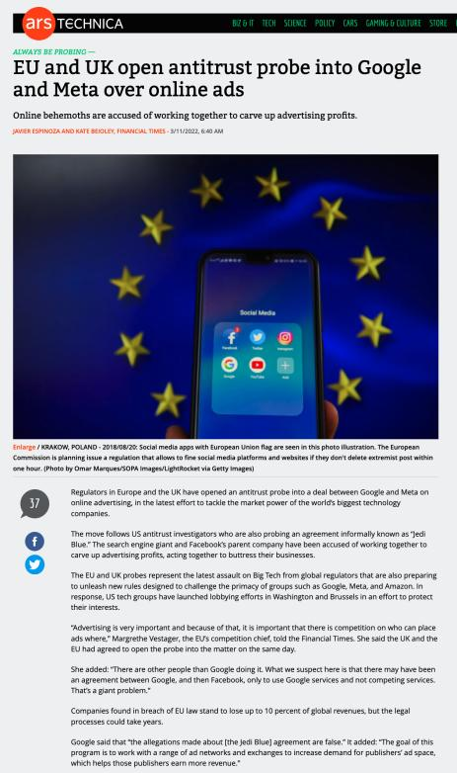

Slide 59
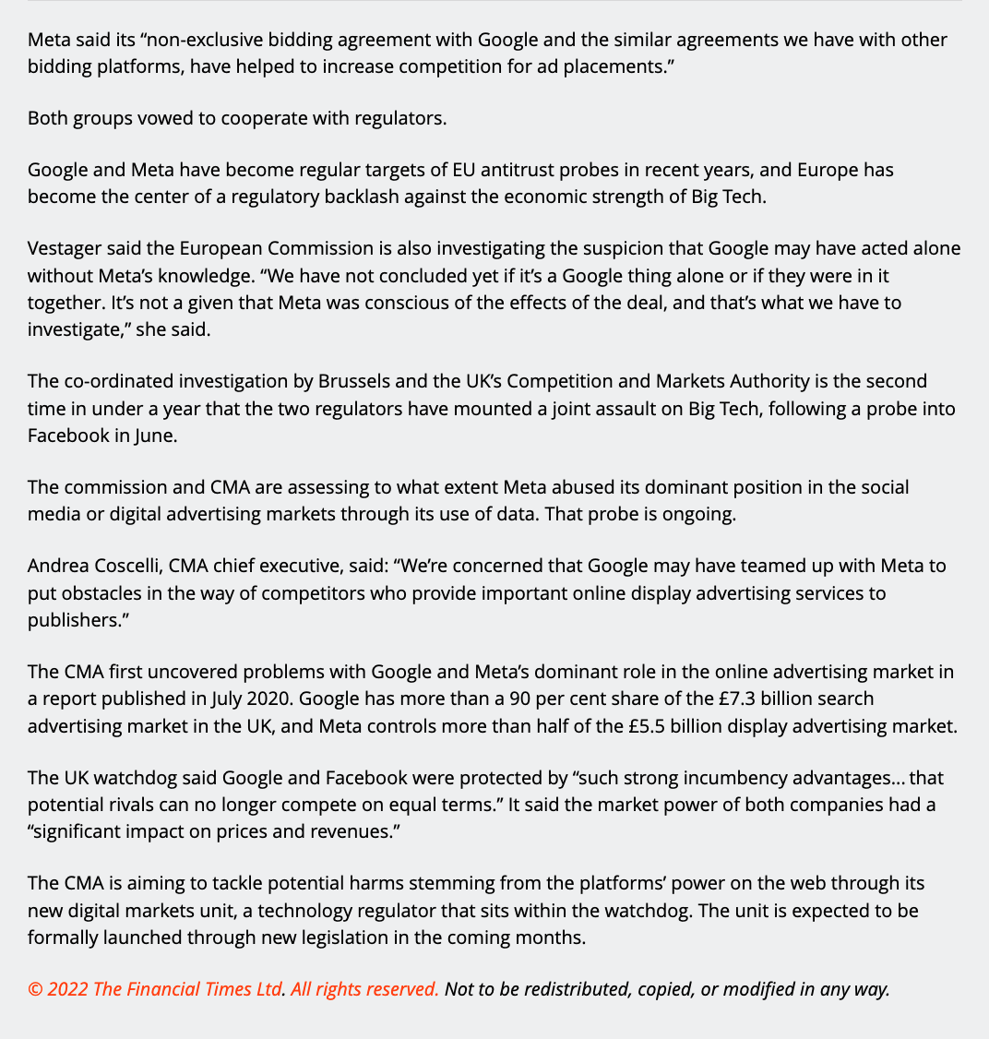

Slide 60
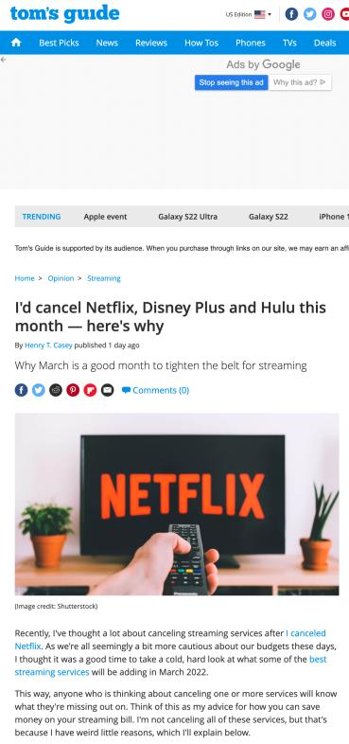

Slide 61
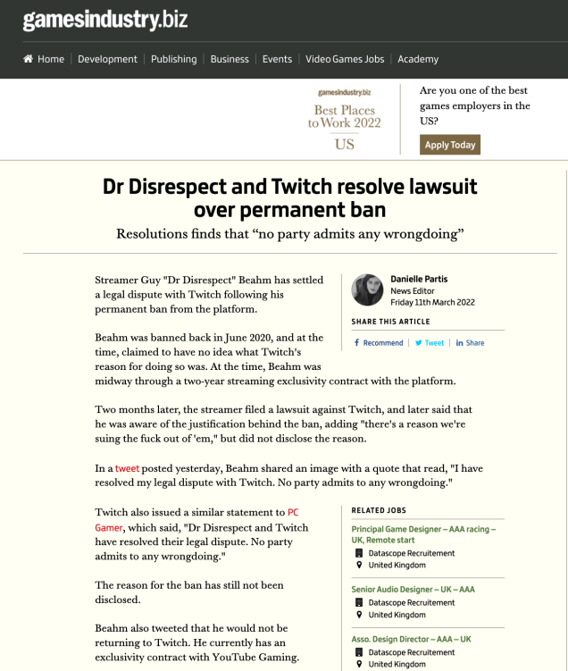

Slide 62
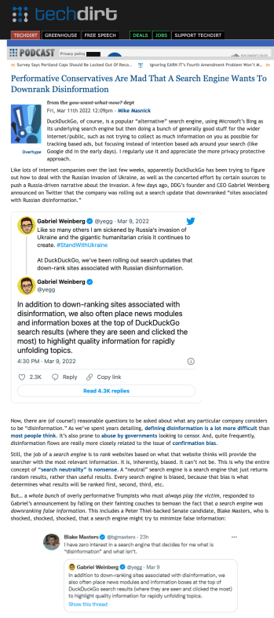

Slide 63
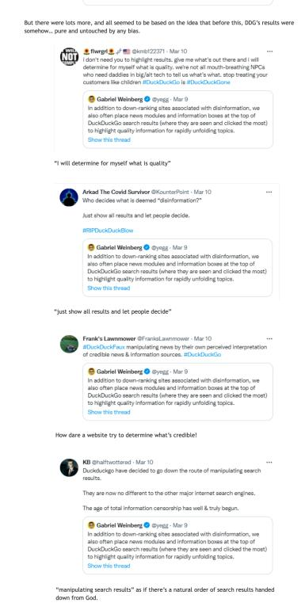

Slide 64
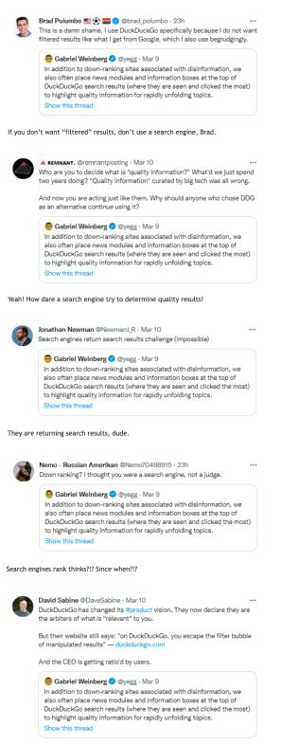

Slide 65
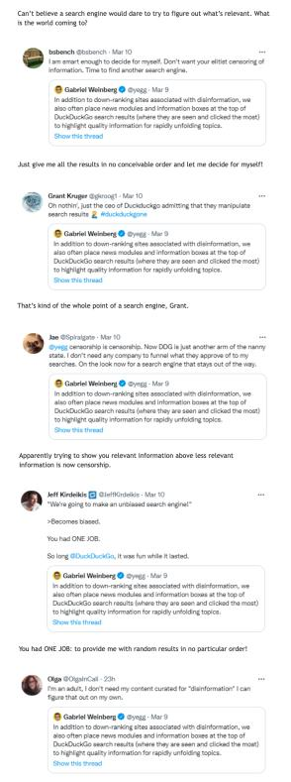

Slide 66
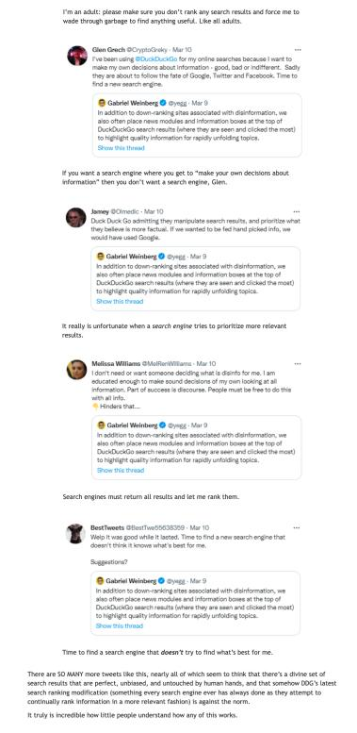

Slide 67
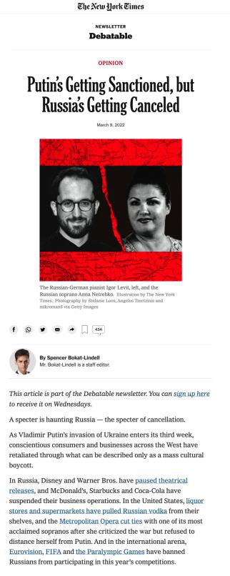

Slide 68
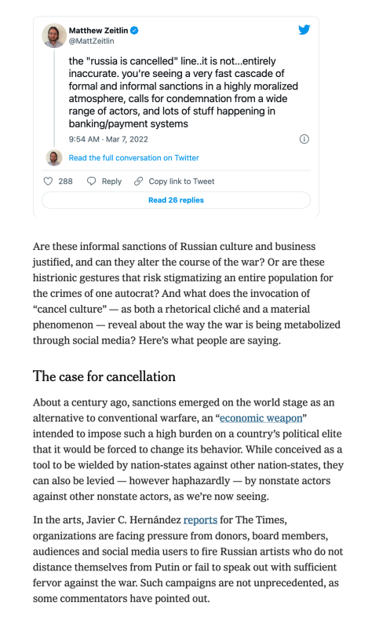

Slide 69
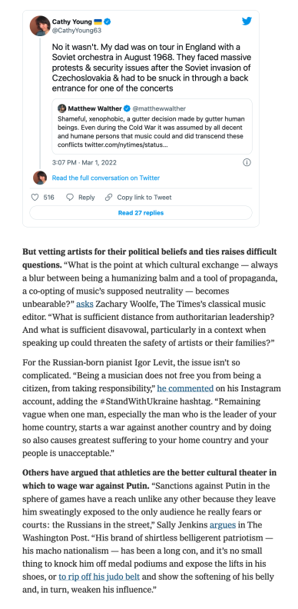

Slide 70
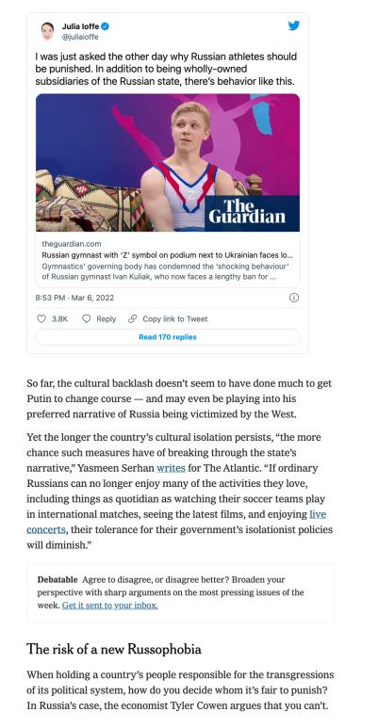

Slide 71
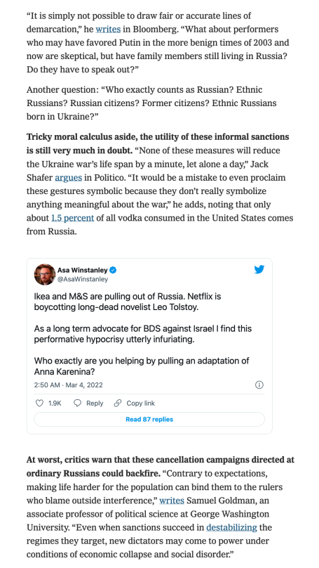

Slide 72
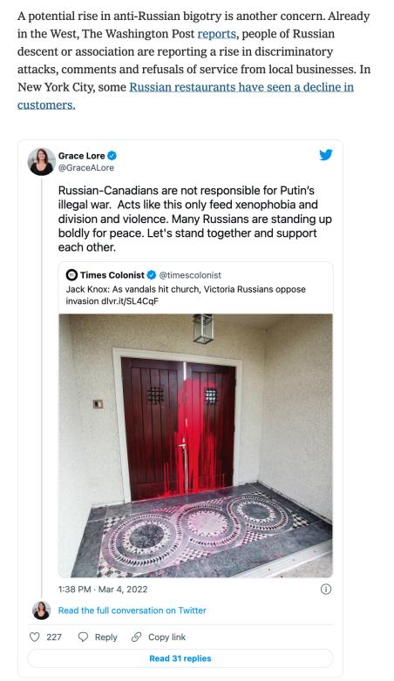

Slide 73
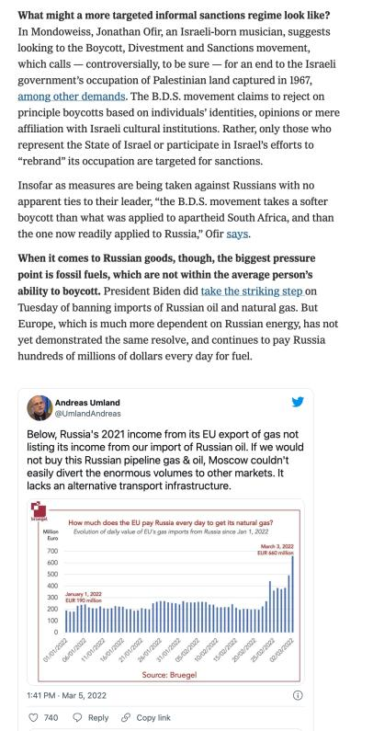

Slide 74
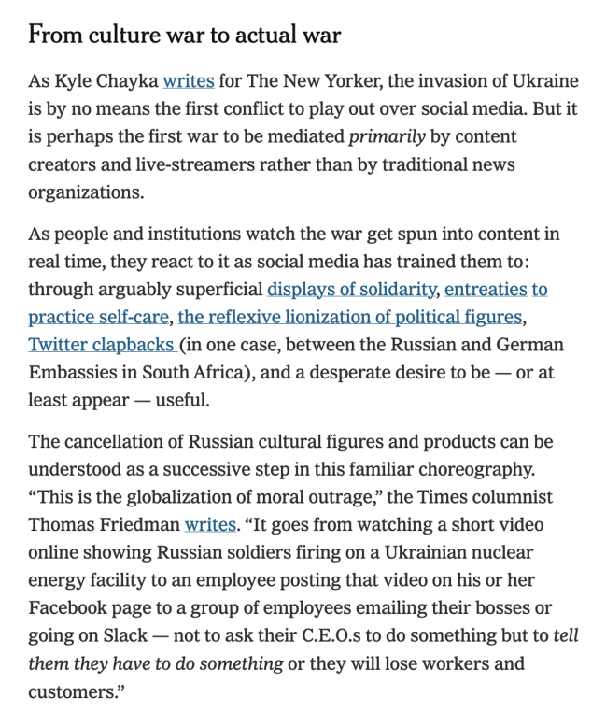

Slide 75
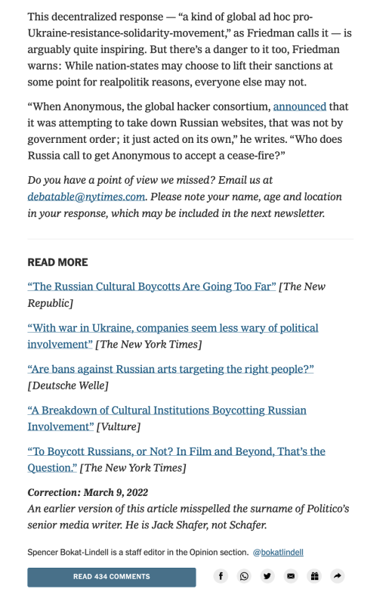

Slide 76
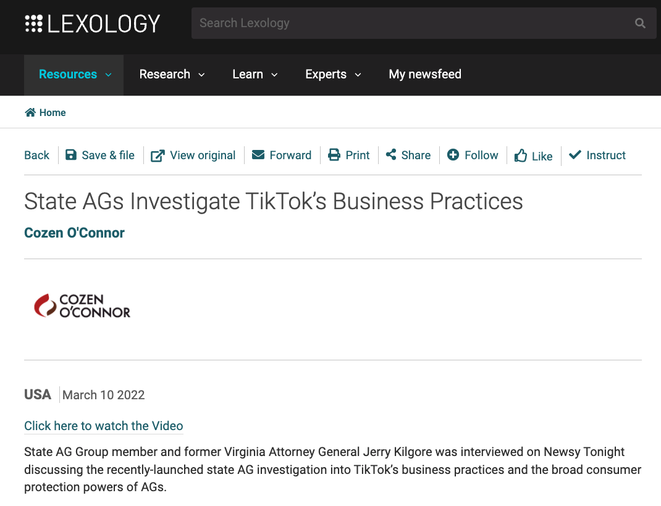

Slide 77


Slide 78
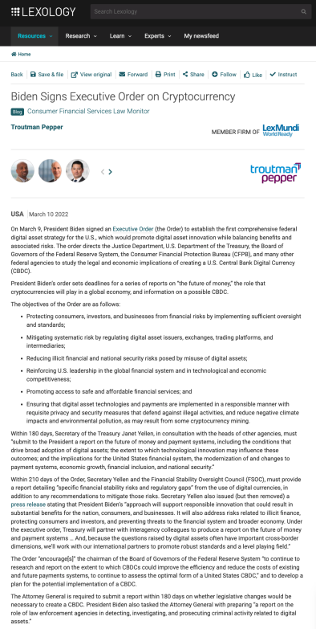

Slide 79
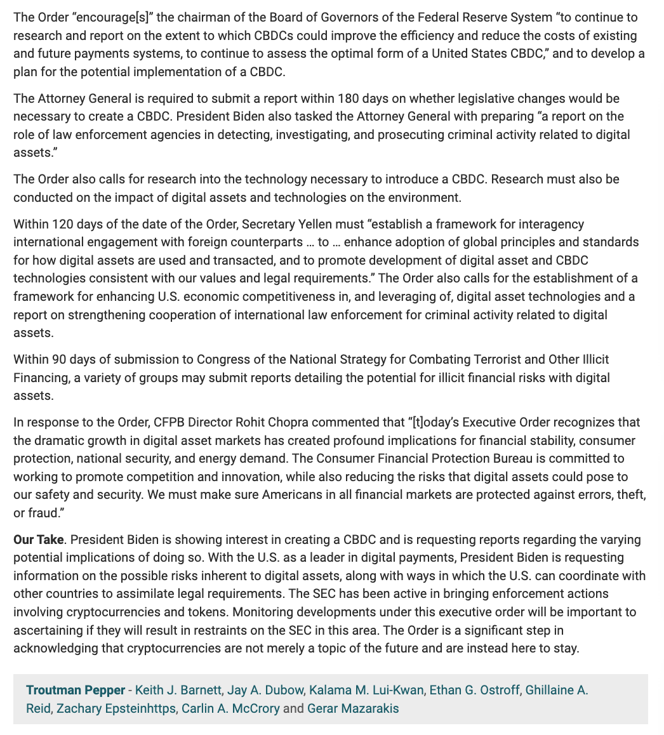

Slide 80
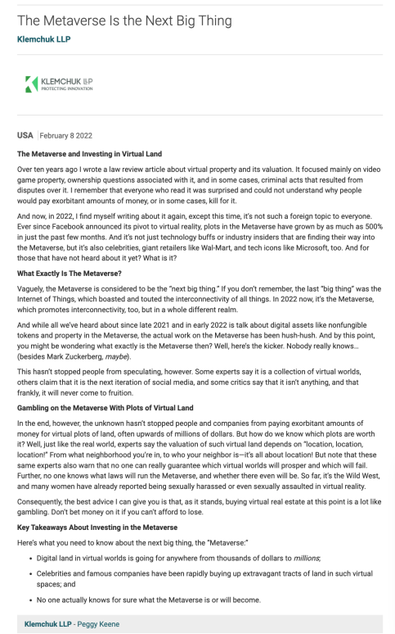

Slide 81
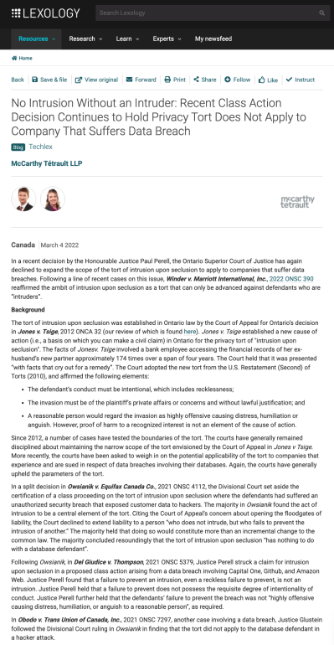

Slide 82
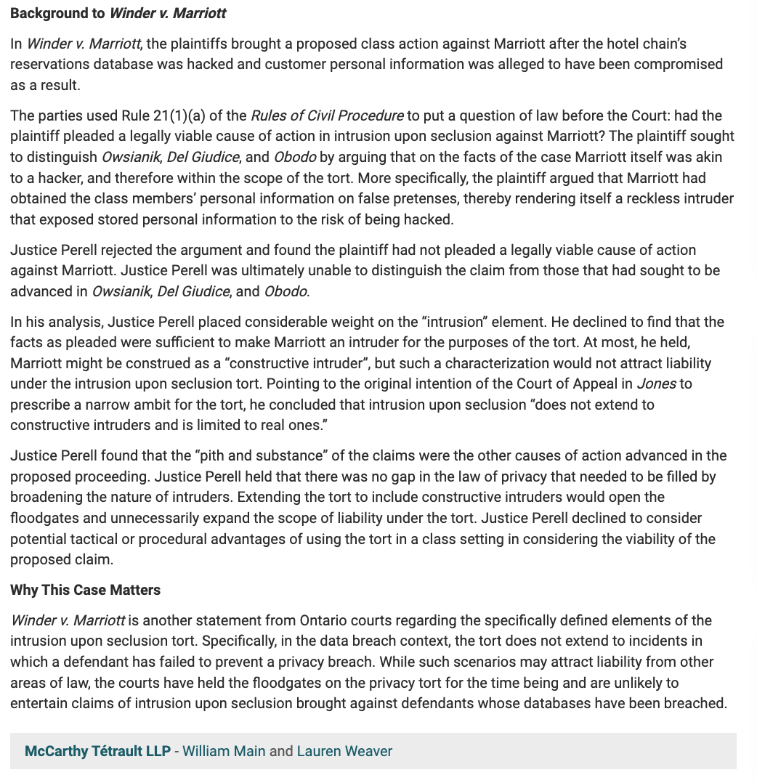

Slide 83


Slide 84


Slide 85


Slide 86


Slide 87


Slide 88


Slide 89


Slide 90


Slide 91
Yours?

Slide 92


Slide 93

Coming Soon
“Bill C-11 Review”

Slide 94


A MATTER OF PERSPECTIVE

Slide 95

Conclusion

Slide 96
UNTIL
NEXT WEEK!

Slide 97

Always include a cat picture

Slide 98
In learning you will teach
And in teaching you will learn
Phil Collins' Son of Man (1999)

Slide 99
Our Academic Partners

