Slide 1


Broadcasting & Telecommunications:
Origins, Policies & Law - Part 5
Talk 12
LAW 424 001
Communications Law
Allard School of Law, UBC
Spring, 2022
Jon Festinger Q.C.
Centre for Digital Media
QMUL School of Law (CCLS)
Whiteboard Law
http://commlaw.allard.ubc
@jonfestinger
jon_festinger@thecdm.ca

Slide 2
Course Evaluations for
Law 424 001 & Law 571 001
Starting 3.25.22 until 4.10.22
“The Student Experience of Instruction (SEI) survey…will be available online for the dates listed below. During the survey period, students will receive email and periodic reminders directing them to the Canvas SEI Surveys page to access the surveys.”

Slide 3

Presentations?

Slide 4

Francis Ontoyin

Slide 5
Logistics

Slide 6
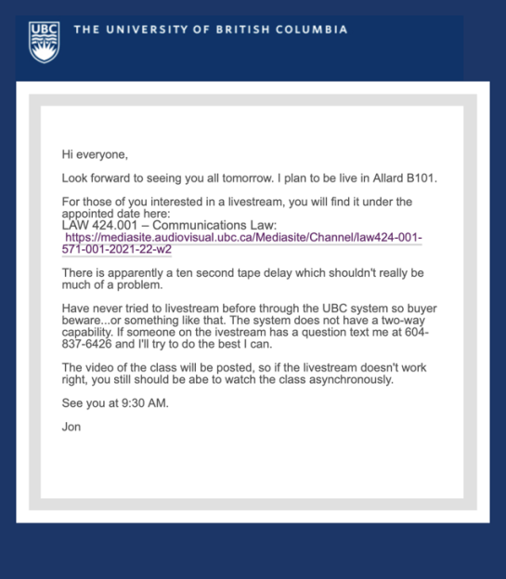
Jon’s Cell for questions: (604) 837-6426

Slide 7
Course Website
http://commlaw.allard.ubc.ca
There ARE Issues:
Misattributions

Slide 8
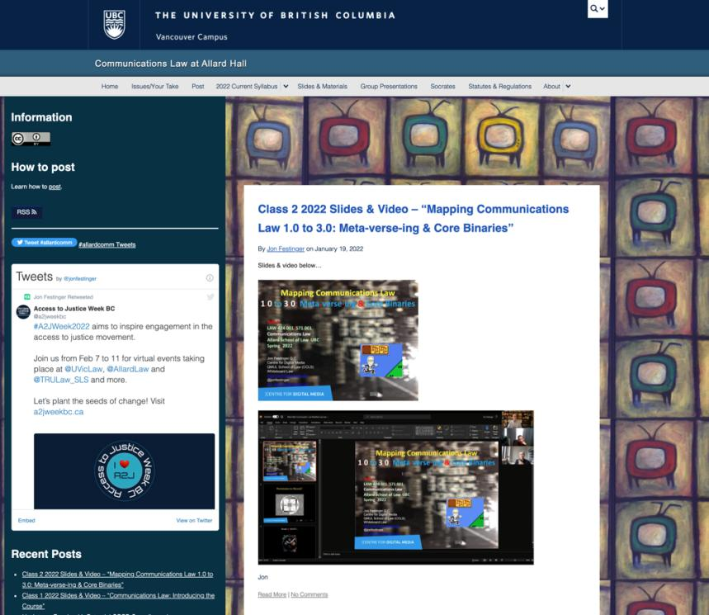

Slide 9


For full privileges on the website
1. Please create an account at http://cms.ubc.ca/ using your CWL.
2. Once you create an account and sign in at http://cms.ubc.ca/ you can click your name in the top right. Halfway down the following page will be your WordPress email address.
3. Send me your WordPress email address at jfestinger@telus.net or at jon@fblawstrategy.com
4. Then, I will invite you to participate with authoring privileges via your WordPress email address.

Slide 10
Most everyone should be registered!!!
Please double-check and let me know if there is a problem.

Slide 11

Anything & everything can be done via email if you prefer

Slide 12

Office “Hours”: Ideally Tuesdays after class but am flexible…
Email me : jon.festinger@ubc.ca
Skype: jon.festinger
Phone:
o. 604-568-9192
c. 604-837-6426

Slide 13
EVALUATION
Term paper = 60% of the final grade.
5000-word paper
The paper is due on the last day of the exam period at 4:00 p.m.
Class Participation = 40% of the final grade
25% of the mark will be based on group preparation of a Class Discussion, with a Discussion Outline provided to the class—preferably by posting on the course website—a week before.
15% for student participation in other course activities including seminar discussions etc.

Slide 14
Paper Confessional
(or what I learned one winter holiday)
Legal/normative reasoning/argument including footnote/bibliography support & Contribution/Move forward → 60%
Presentation including layout, headings, grammar, language/writing skills, “tightness” → 25%
Topic/Originality/Degree of Difficultly → 15%
THIS IS NOT A RUBRIC. IT IS A SELF ASSESSMENT.

Slide 15
Group Presentations
4-6 (ideally) per group if a group
5 minutes per person general rule
Sign-up confirmation @ break
Any topic – not constrained by what I’m talking about that week
Can consult with me re the topic you want to take on
Post one thing you want us to read or watch

Slide 16
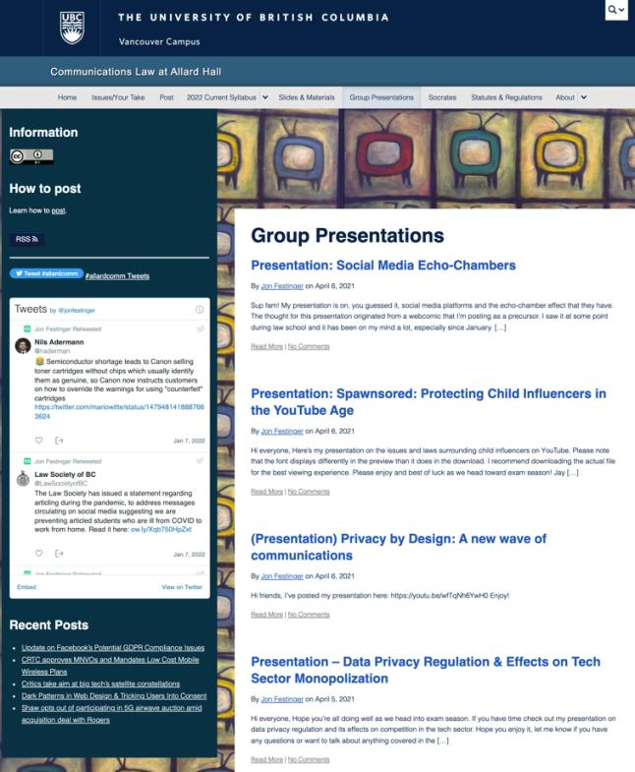

Slide 17
Evaluation Tips
Term paper topics need not be discussed with me, but often helpful to you if you do.
Term paper can be on your presentation topic.
Term papers: Avoid the purely descriptive
Participation: In-class or other contributions, including attendance.
Group presentation need not be on that week’s topic

Slide 18
LLMCL Students Additional Task
750 – 1000 word post (or email) Applies only to those registered in LLMCL 500 section, not to those in JD section
All LLMCL students exempted from class average requirement

Slide 19
Grades (primarily)
Paper → Quality
Participation → Effort

Slide 20
Will read: drafts…outlines…synopsis……abstracts…etc.
As late as I can…
Due last day of exams by 4:00 PM.
Send in papers by email.
Make sure you get acknowledgment of receipt.

Slide 21
Navigating the Course
1. Old lectures on-line could be referenced.
2. Always recorded.
3. No attendance sign-up sheet.
4. Increased flexibility on group (or individual) projects re how, what & when.
5. Directed Study-ish goal.

Slide 22
QUESTIONS?
THOUGHTS?
DISCUSSION?

Slide 23

Pause

Slide 24
News of
the Week

Slide 25
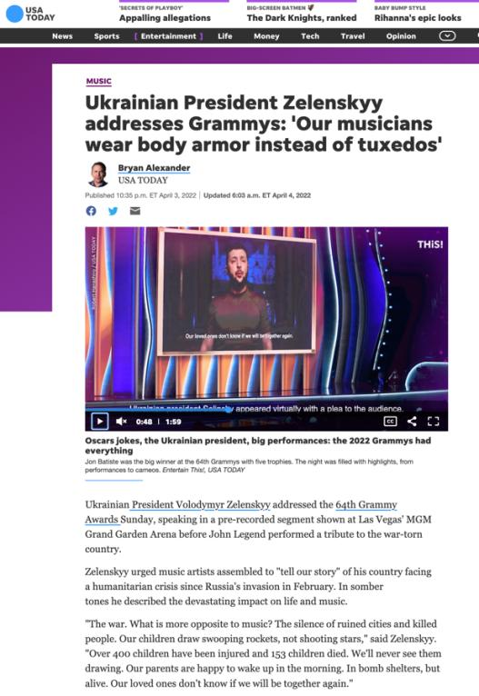

Slide 26
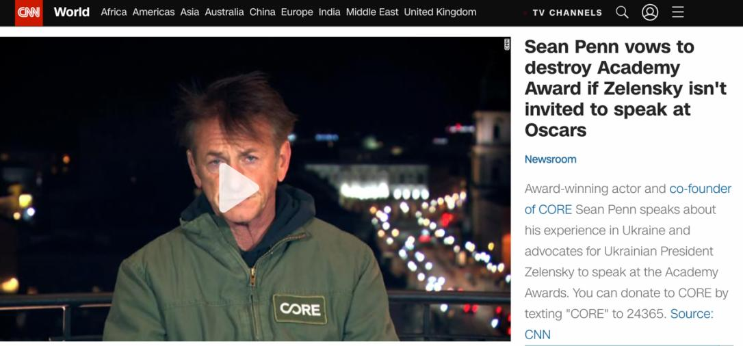
Have Sean’s Oscar’s Been Smelted?

Slide 27
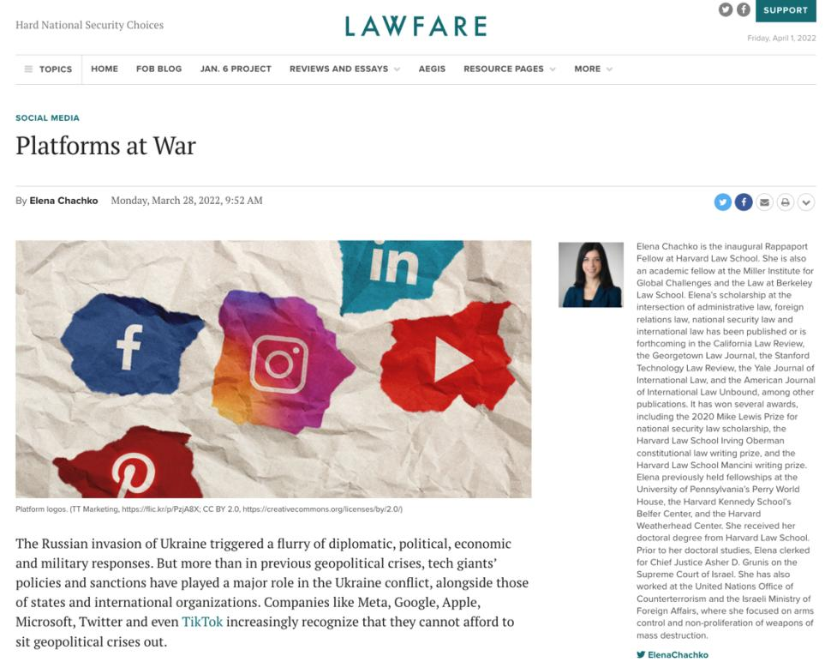

Slide 28
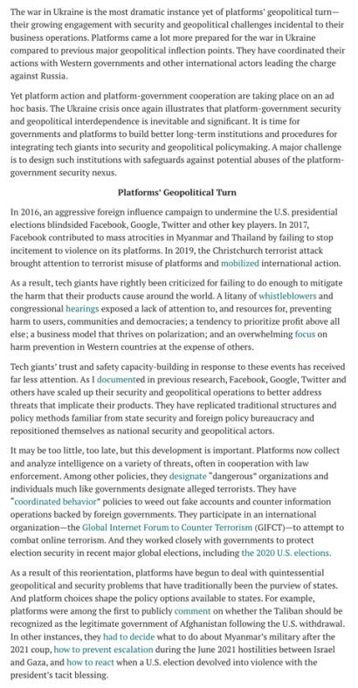

Slide 29
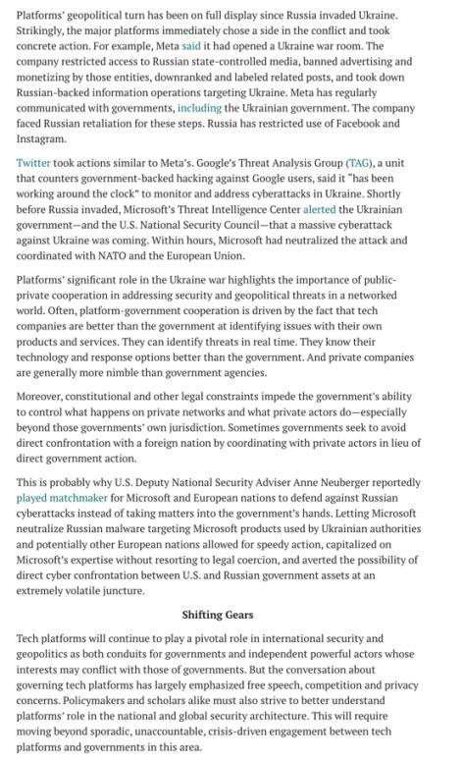

Slide 30
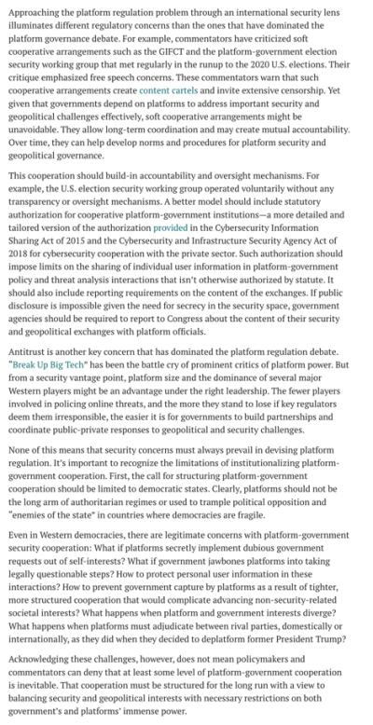

Slide 31
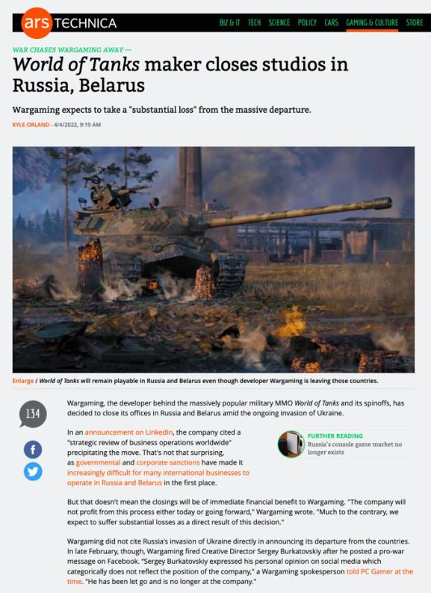

Slide 32
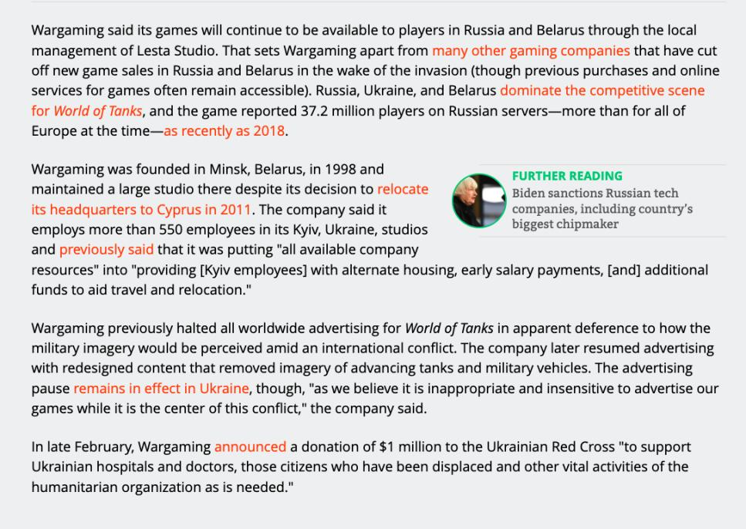

Slide 33
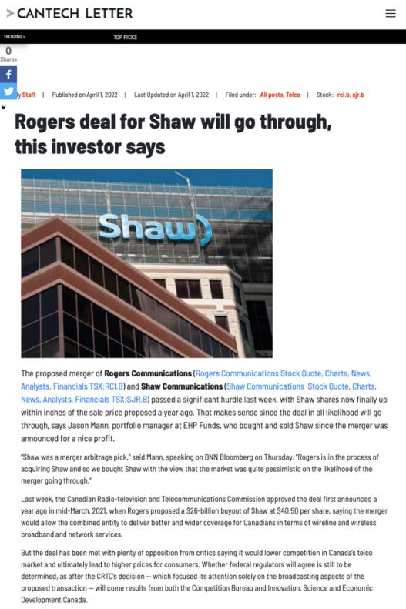

Slide 34


Slide 35
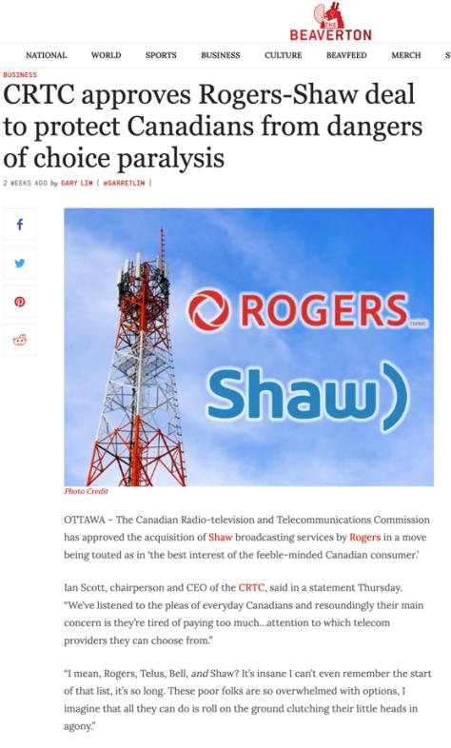

Slide 36
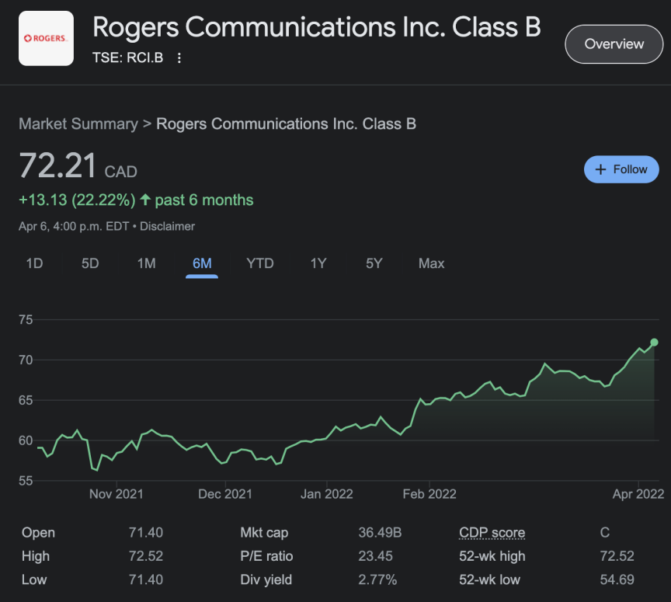

Slide 37
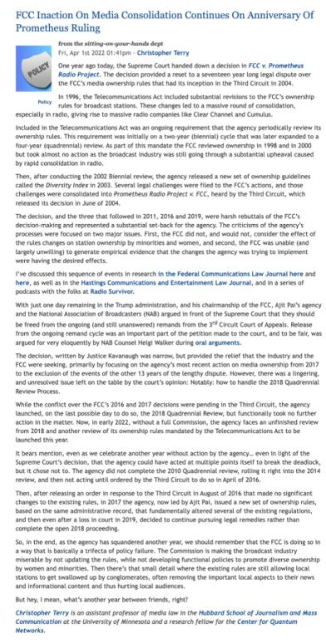

Slide 38
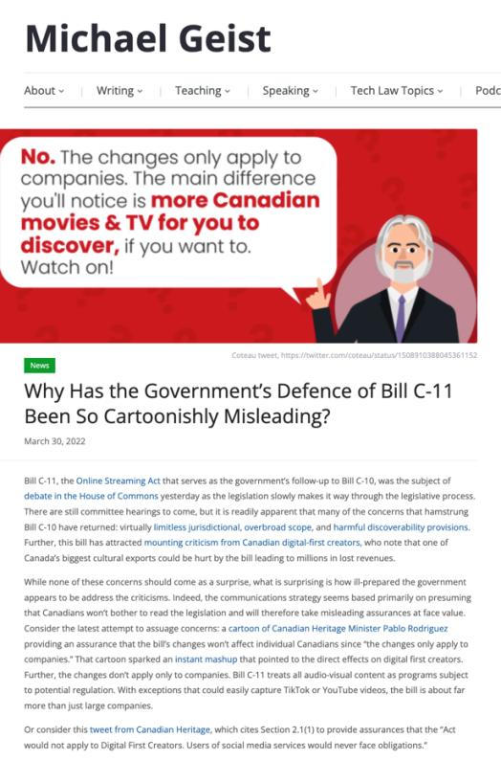

Slide 39
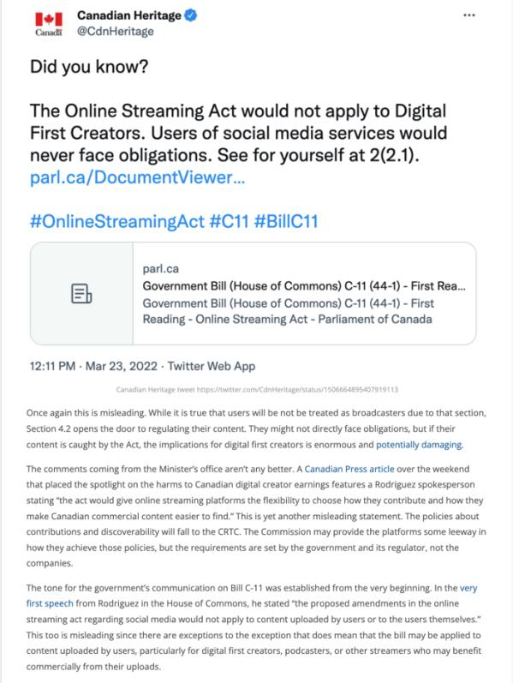

Slide 40
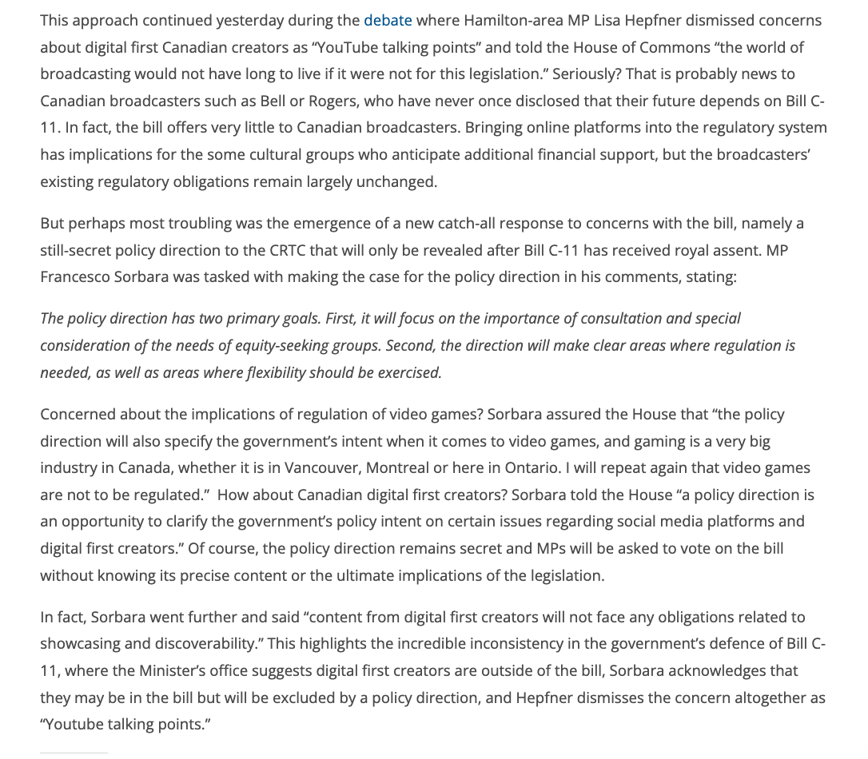

Slide 41
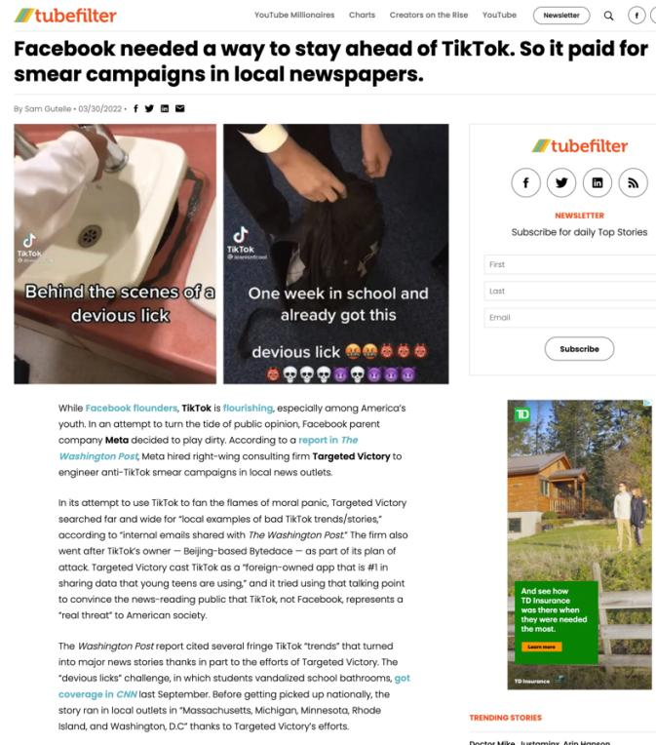

Slide 42
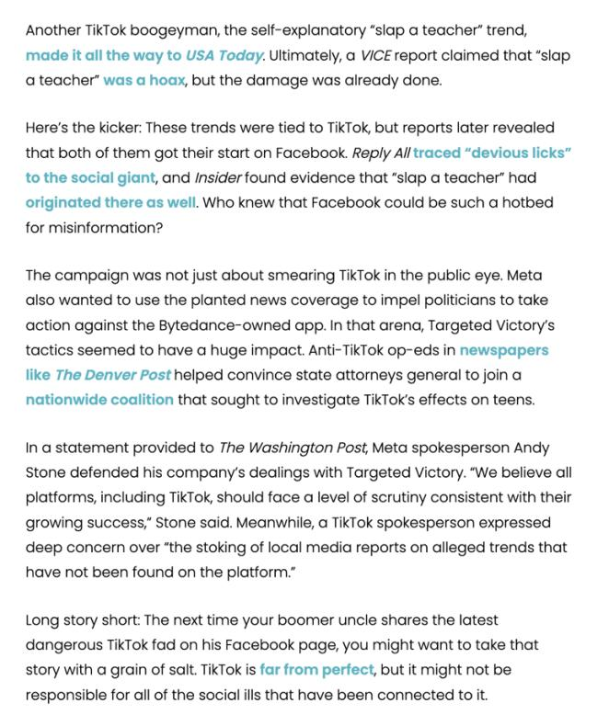

Slide 43


Slide 44
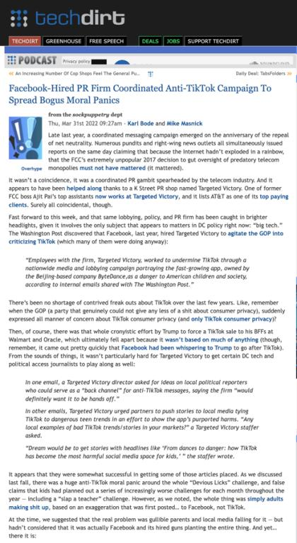

Slide 45
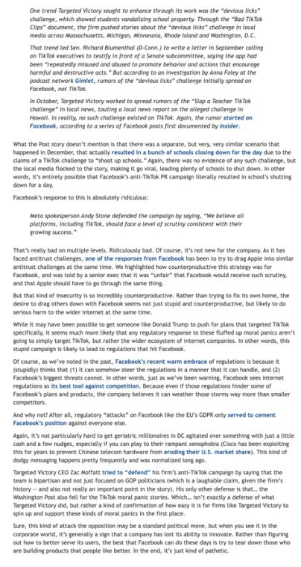

Slide 46
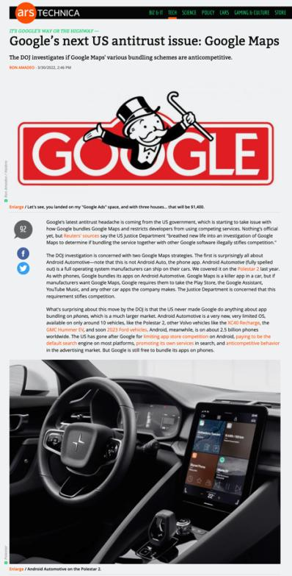

Slide 47
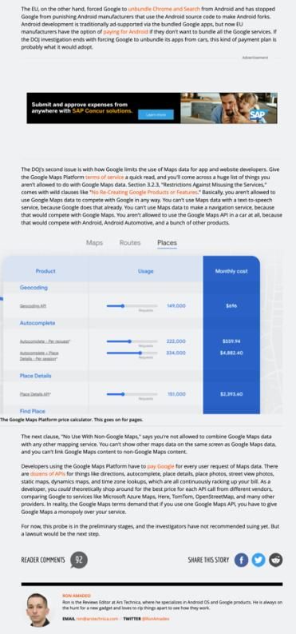

Slide 48
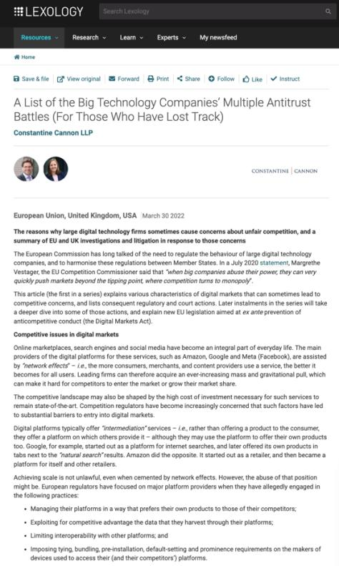

Slide 49
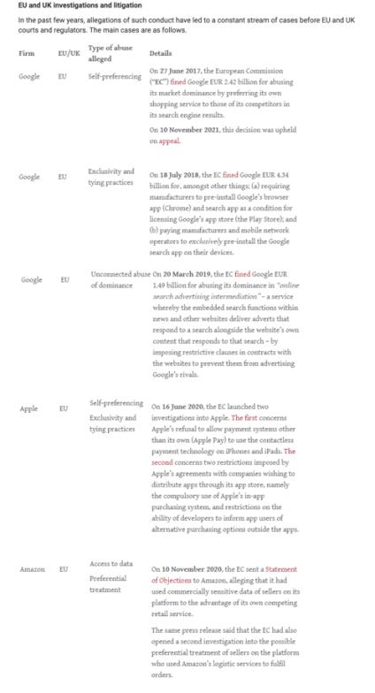

Slide 50
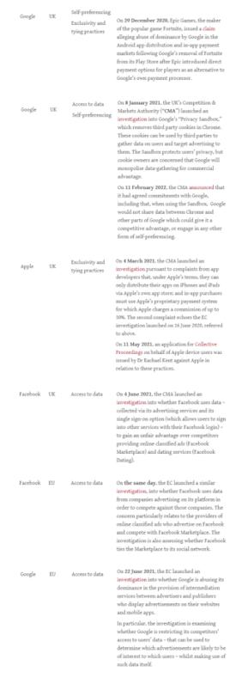

Slide 51
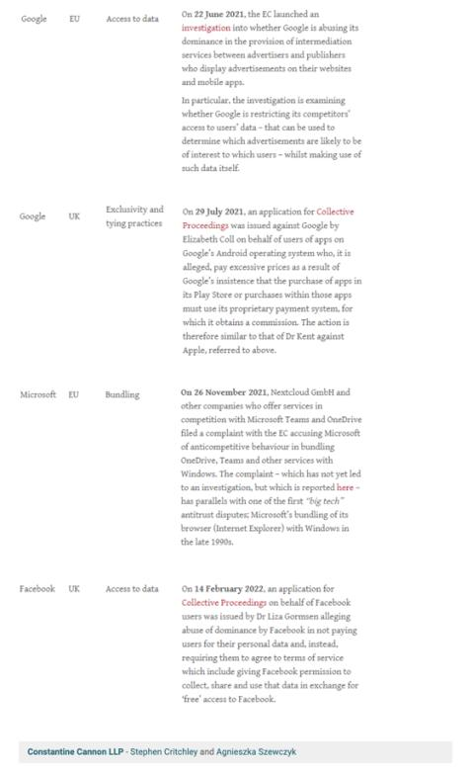

Slide 52
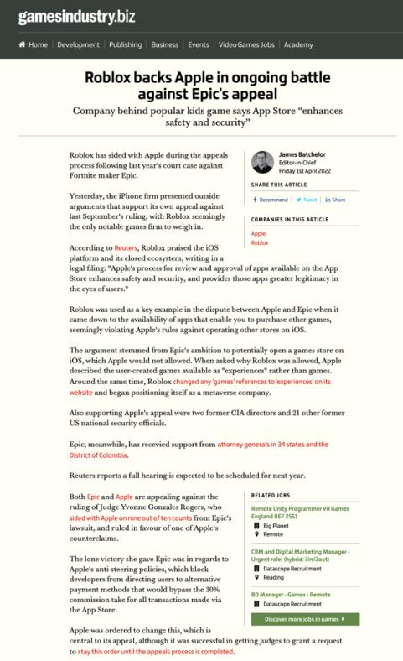

Slide 53
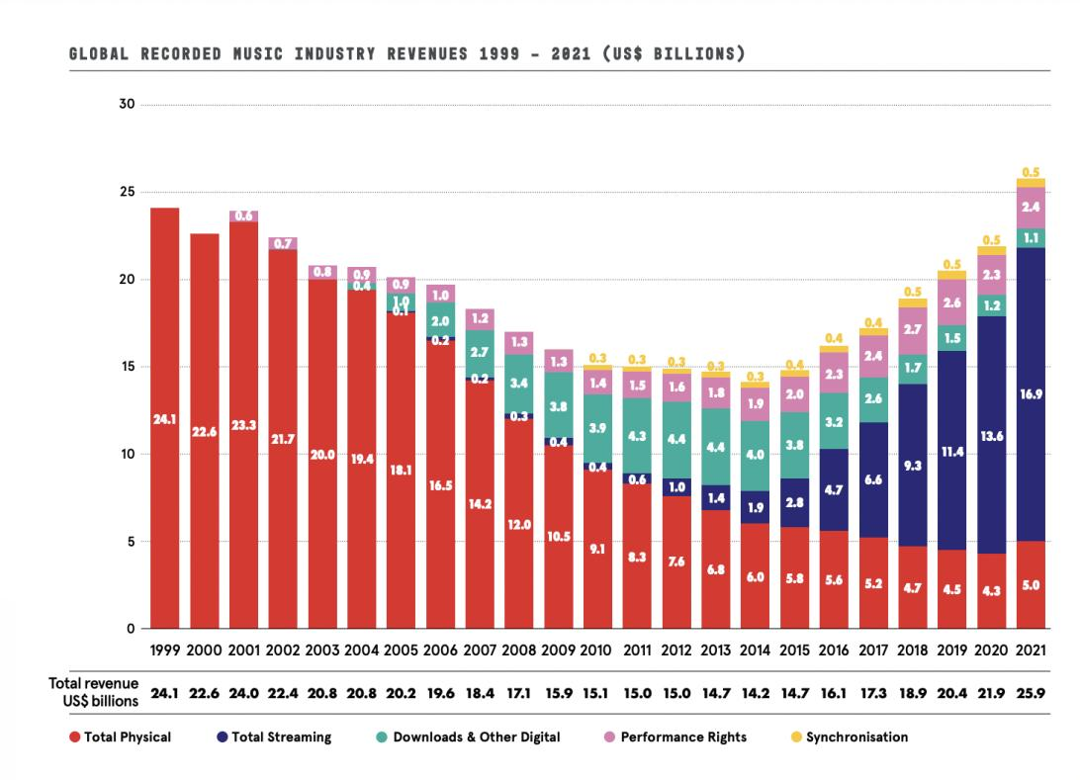

Slide 54
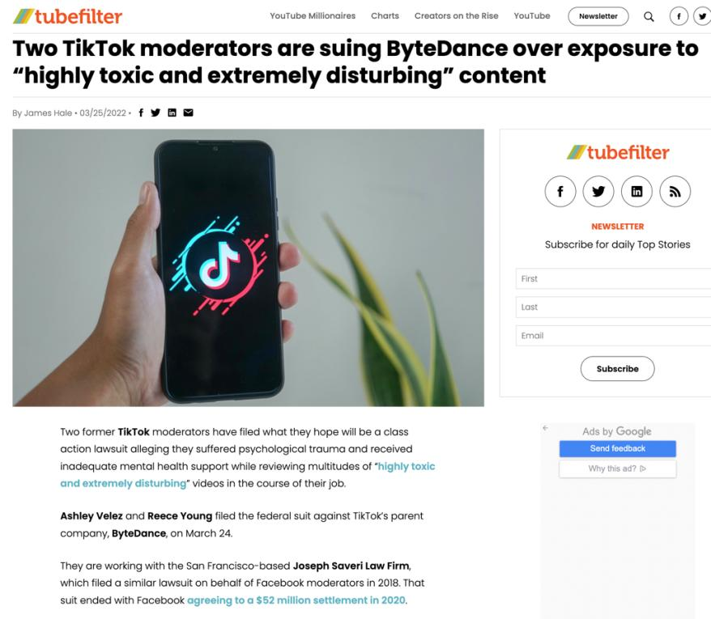

Slide 55
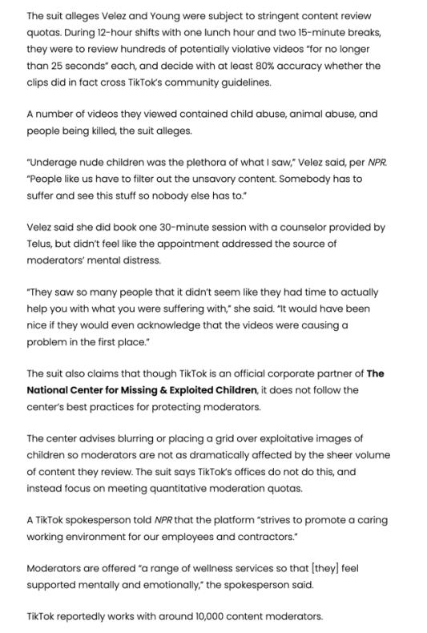

Slide 56


Slide 57
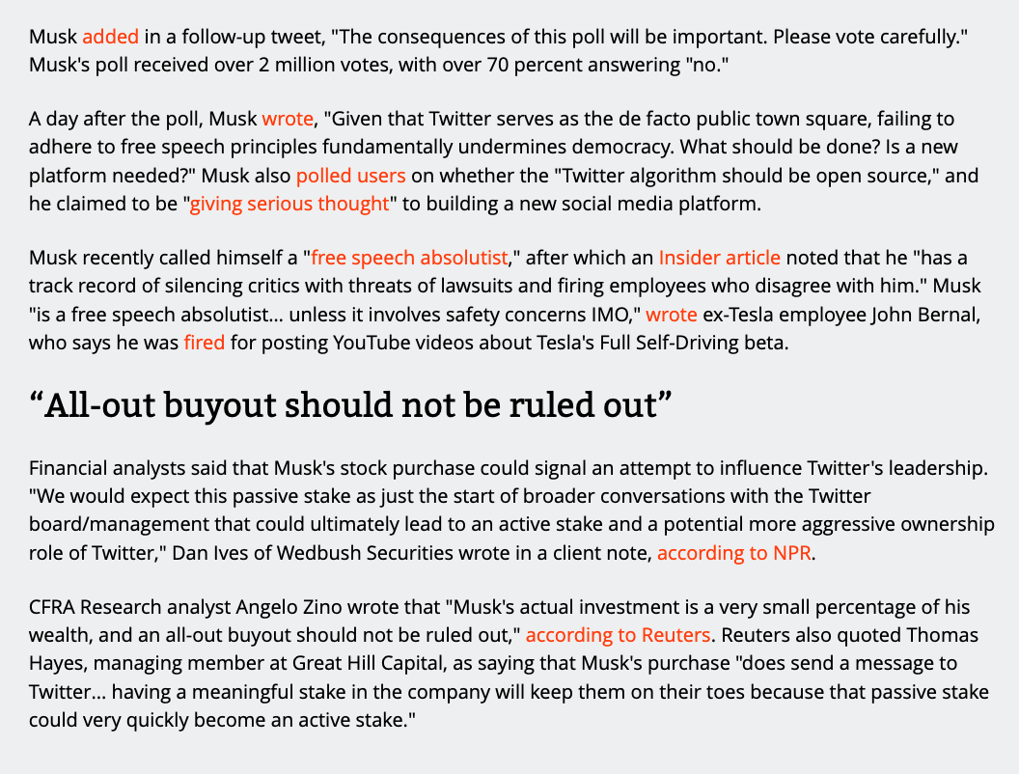

Slide 58
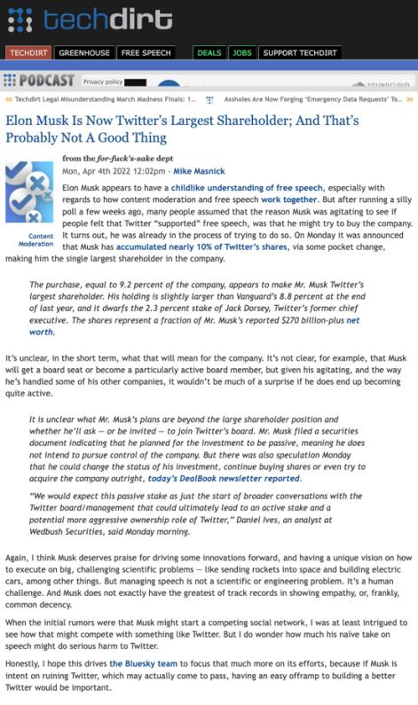

Slide 59
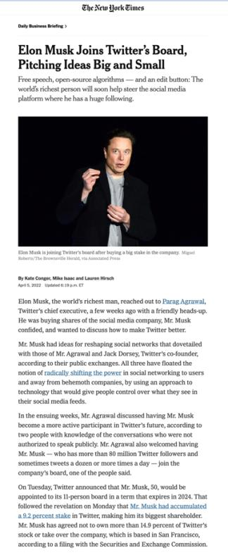

Slide 60


Slide 61
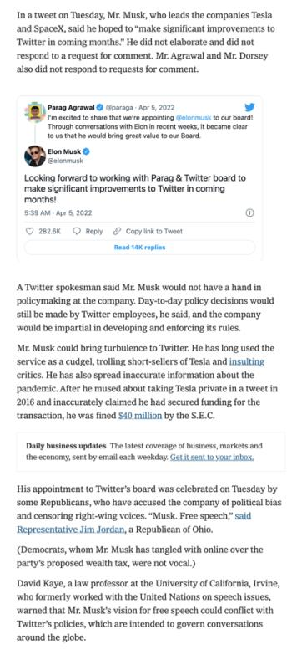

Slide 62
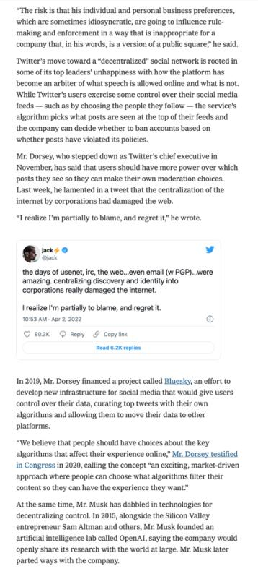

Slide 63
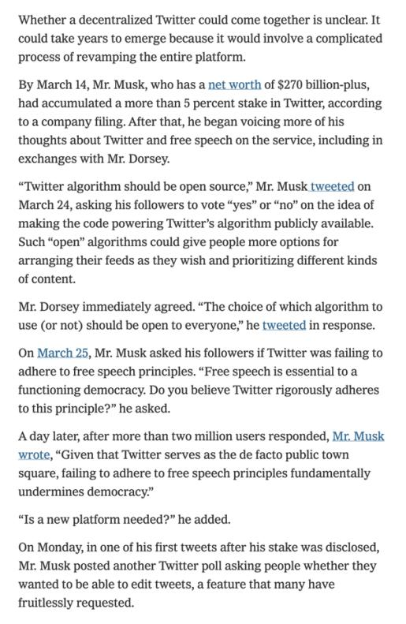

Slide 64
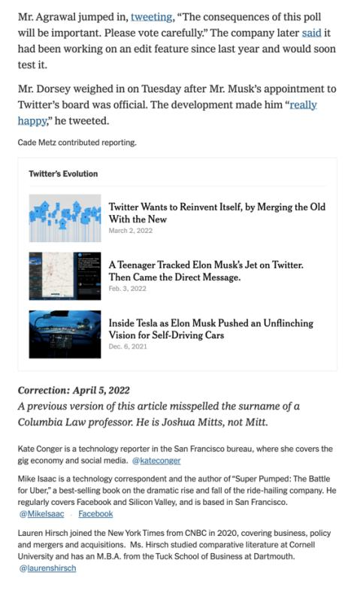

Slide 65
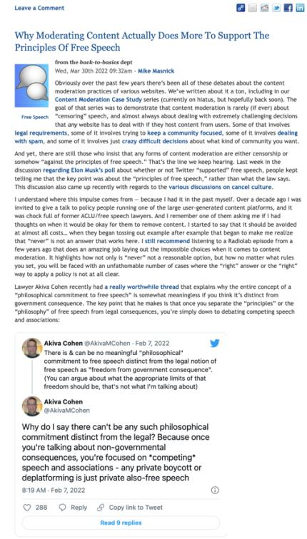

Slide 66
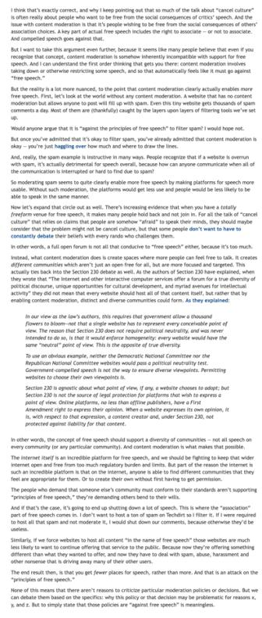

Slide 67
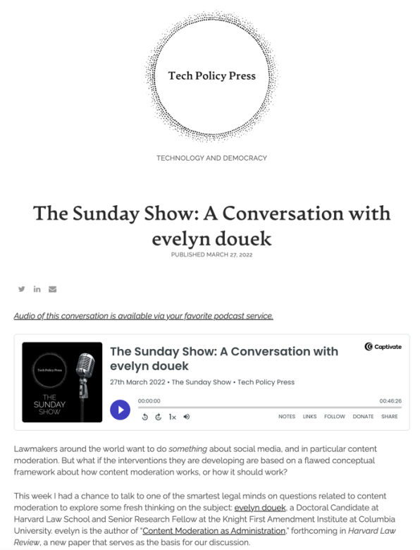

Slide 68
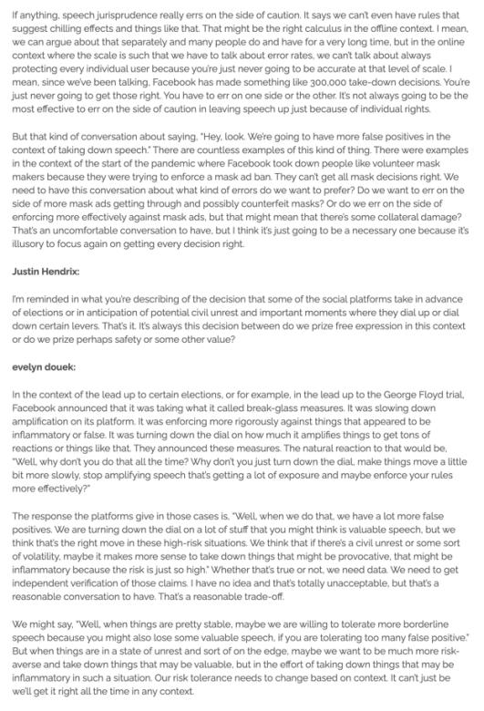

Slide 69
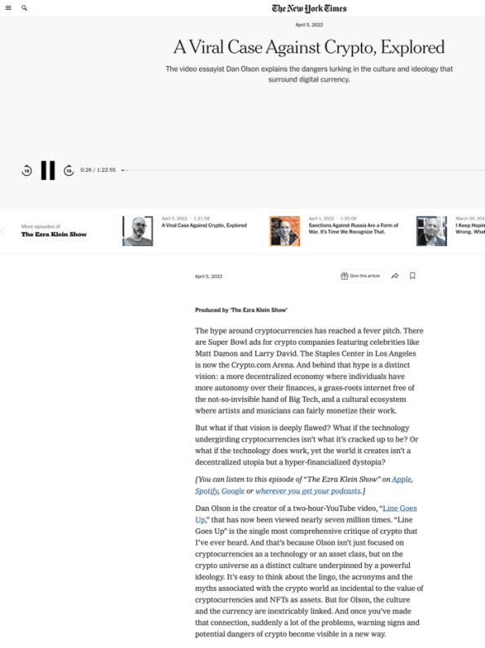

Slide 70
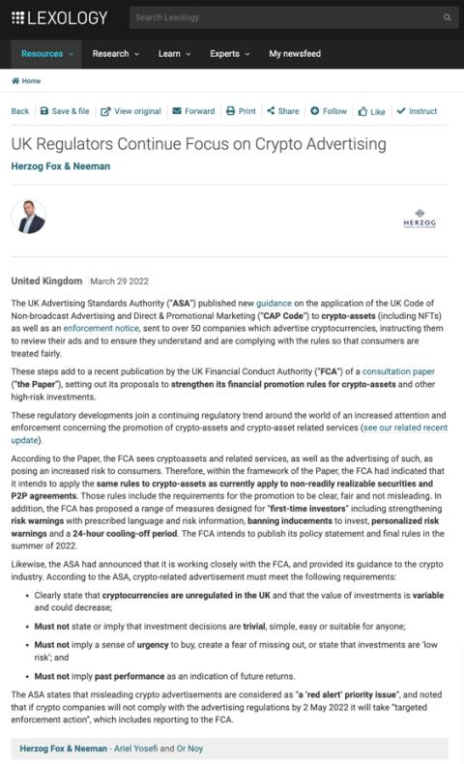

Slide 71
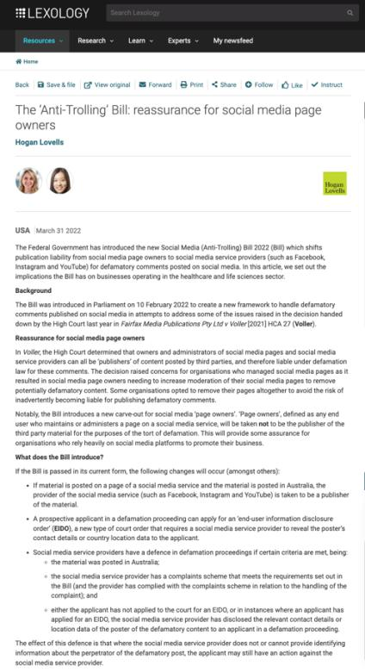

Slide 72
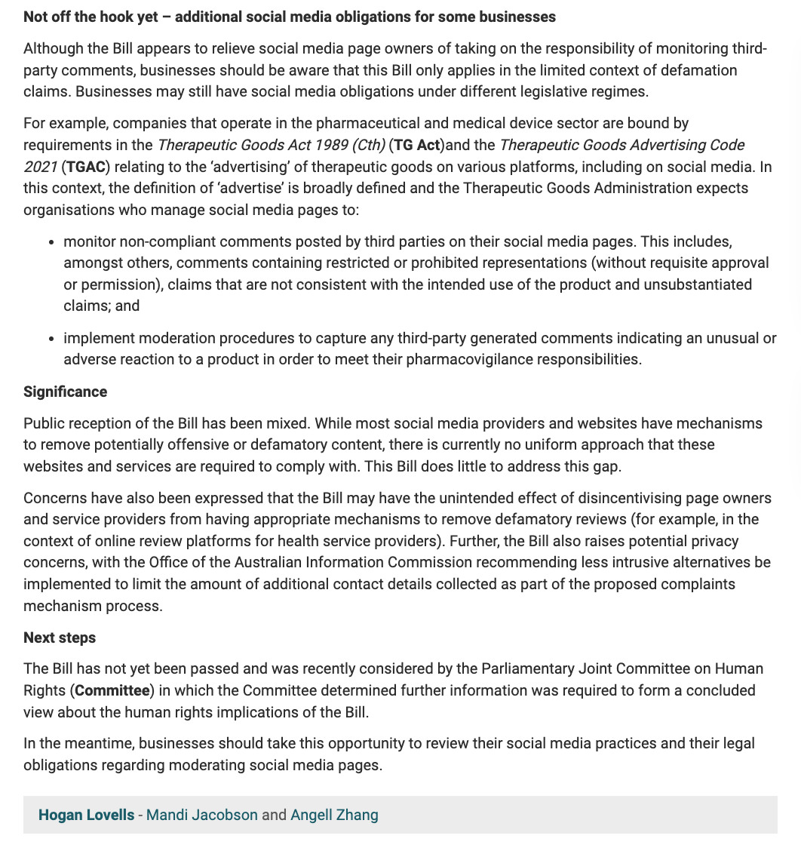

Slide 73
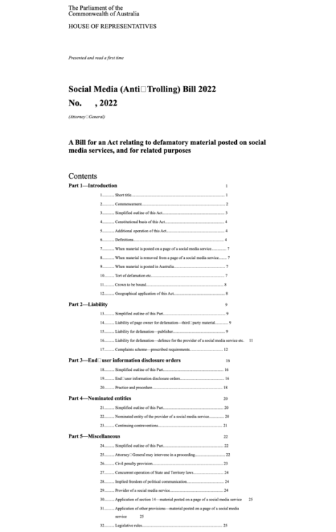

Slide 74
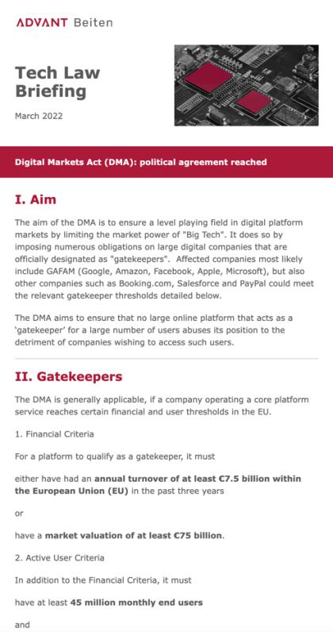

Slide 75
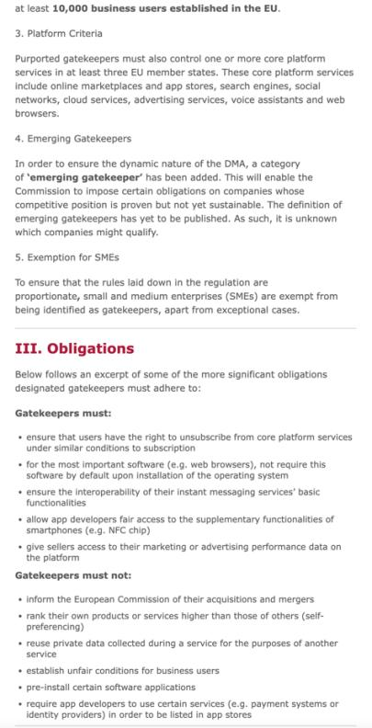

Slide 76


Slide 77


Slide 78


Slide 79


Slide 80


Slide 81


Slide 82


Slide 83


Slide 84


Slide 85


Slide 86


Slide 87


Slide 88


Slide 89


Slide 90


Slide 91


Slide 92


Slide 93


Slide 94


Slide 95


Slide 96


Slide 97


Slide 98


Slide 99


Slide 100


Slide 101


Slide 102


Slide 103


Slide 104




Slide 105


Slide 106


Slide 107


Slide 108


Slide 109


Slide 110


Slide 111


Slide 112


Slide 113


Slide 114


Slide 115


Slide 116


Slide 117


Slide 118

https://youtu.be/zi16ljmKsD4

Slide 119


Slide 120

Not an April Fools Joke (I think)

Slide 121


Slide 122


Slide 123



Slide 124


Slide 125
QUESTIONS?
THOUGHTS?
DISCUSSION?

Slide 126
Yours?

Slide 127
Pause

Slide 128

Re-capping

Slide 129

In Telecom the
issue seems to be
SOVERIGNTY/
(OWNERSHIP)

Slide 130
In Broadcasting the issue seems to be
CULTURE (OWNERSHIP)

Slide 131

Powers v. Policy

Slide 132
9 (1) Subject to this Part, the Commission may, in furtherance of its objects,
  (a) establish classes of licences;
  (b) issue licences for such terms not exceeding seven years and subject to such conditions related to the circumstances of the licensee
    (i) as the Commission deems appropriate for the implementation of the broadcasting policy set out in subsection 3(1), and
    (ii) in the case of licences issued to the Corporation, as the Commission deems consistent with the provision, through the Corporation, of the programming contemplated by paragraphs 3(1)(l) and (m);
  (c) amend any condition of a licence on application of the licensee or, where five years have expired since the issuance or renewal of the licence, on the Commission’s own motion;

Slide 133
  (d) issue renewals of licences for such terms not exceeding seven years and subject to such conditions as comply with paragraph (b);
  (e) suspend or revoke any licence;
  (f) require any licensee to obtain the approval of the Commission before entering into any contract with a telecommunications common carrier for the distribution of programming directly to the public using the facilities of that common carrier;
  (g) require any licensee who is authorized to carry on a distribution undertaking to give priority to the carriage of broadcasting; and
  (h) require any licensee who is authorized to carry on a distribution undertaking to carry, on such terms and conditions as the Commission deems appropriate, programming services specified by the Commission.

Slide 134
Broadcasting &
Telecommunications:
Origins, Policies & Law
Part 2

Slide 135

Telecommunications Policy
PRINCIPLES

Slide 136
Why were/are Telecommunications
Services Regulated?
“Natural monopoly” given economies of scale for network infrastructure ?
Shift from monopoly towards competition (1984 forward)
Myths and memes of the information economy → “The Information Highway”
Security & Sovereignty

Slide 137
Telecom Act
7. Telecom policy objectives
24. Services to be offered under CRTC-approved tariffs
27(1) Rates to be just & reasonable
27(2) No unjust discrimination against or undue preferences toward any person
34. CRTC forbearance power (to be used, e.g. where competition is sufficient to protect consumers)
36. Carriers not to control content or influence meaning of telecoms carried for public
40. Interconnection orders

Slide 138
Forbearance
CRTC may forbear where it finds that this will be consistent with telecom policy objectives and shall forbear where the service in question “is or will be subject to competition sufficient to protect the interests of users”
CRTC may forbear partially
Forbearance covers conditions of service, tariffs, carrier-access agreements etc.
CRTC developed principles governing the introduction of forbearance, including market share and market power analysis

Slide 139
CRTC Telecom Processes
2011 Rules of Procedure
Tariff filing process → now streamlined
Forbearance from most retail tariff regulation
Mostly “paper hearings”
Policy hearings are more common
Move towards ADR & expedited hearings or argument only hearing

Slide 140
Telecom Act: Policy Powers
S. 8, 10: Governor in Council (GiC) Policy Direction Power - proposed order to be discussed with CRTC, Gazetted & referred to Parliamentary Committee
S. 12: GiC Power to vary, rescind or refer back CRTC decisions - within 1 year
S. 14: May order CRTC to report on any matter under Telecom Act or Special Act

Slide 141
Policy parameters of telecom regulation
Canadian Ownership
Universal Service
Cross-subsidies were possible (urban/rural; business/residential; long distance/local)
Competition (since 1984 through both competition & privatization e.g. AGT & MTS)

Slide 142
CRTC has gradually forborne from economic regulation of telecommunications services as markets became more competitive. Price cap regulation remains in place for some local markets where there is less competition.
Requiring interconnection as non-interconnecting telecom networks are inefficient costing their customers more. AKA competitor access to “essential facilities”. E.G. a. CRTC 2015-177 (May 2015) CRTC regulates wholesale wireless roaming rates; b. CRTC 2015-236 (July 2015) CRTC mandates access to FTTP

Slide 143
Non-interference with content by telecom carriers (no responsibility either)
Net neutrality
Privacy (???)

Slide 144


Slide 145

What is Net Neutrality?
https://youtu.be/ltzy5vRmN8Q

Slide 146
Leading to net neutrality (Canadian style)
Telecommunications Act S. 27
Just and reasonable rates
27 (1) Every rate charged by a Canadian carrier for a telecommunications service shall be just and reasonable.
Unjust discrimination
(2) No Canadian carrier shall, in relation to the provision of a telecommunications service or the charging of a rate for it, unjustly discriminate or give an undue or unreasonable preference toward any person, including itself, or subject any person to an undue or unreasonable disadvantage.

Slide 147


Slide 148


Slide 149
2 (1) The definitions broadcasting, broadcasting undertaking, distribution undertaking, network and programming undertaking in subsection 2(1) of the Broadcasting Act are respectively replaced by the following:
broadcasting means any transmission of program regardless of whether the transmission is scheduled or on demand or whether the programs are encrypted or not — by radio waves or other means of telecommunication for reception by the public by means of broadcasting receiving apparatus, but does not include any such transmission of programs that is made solely for performance or display in a public place;

Slide 150
broadcasting undertaking includes a distribution undertaking, an online undertaking, a programming undertaking and a network;
distribution undertaking means an undertaking for the reception of broadcasting and its retransmission by radio waves or other means of telecommunication to more than one permanent or temporary residence or dwelling unit or to another such undertaking, but does not include such an undertaking that is an online undertaking;

Slide 151
Interpretation
(3) This Act shall be construed and applied in a manner that is consistent with
  (a) the freedom of expression and journalistic, creative and programming independence enjoyed by broadcasting undertakings; and
  (b) the commitment of the Government of Canada to enhance the vitality of English and French linguistic minority communities in Canada and to support and assist their development, as well as to foster the full recognition and use of both English and French in Canadian society.

Slide 152
(1) Paragraph 3(1)‍(a) of the Act is replaced by the following:
(a) the Canadian broadcasting system shall, with the exception of foreign broadcasting undertakings providing programming to Canadians, be effectively owned and controlled by Canadians;

Slide 153
(4) Paragraphs 3(1)‍(f) to (h) of the Act are replaced by the following:
  (f) each Canadian broadcasting undertaking shall employ and make maximum use, and in no case less than predominant use, of Canadian creative and other human resources in the creation, production and presentation of programming, unless the nature of the service provided by the undertaking, such as specialized content or format or the use of languages other than French and English, renders that use impracticable, in which case the undertaking shall make the greatest practicable use of those resources;
  (f.‍1) each foreign online undertaking shall make the greatest practicable use of Canadian creative and other human resources, and shall contribute in an equitable manner to strongly support the creation, production and presentation of Canadian programming, taking into account the linguistic duality of the market they serve;
  (g) the programming over which a person who carries on a broadcasting undertaking has programming control should be of high standard;
  (h) all persons who carry on broadcasting undertakings have a responsibility for the programs that they broadcast and over which they have programming control;

Slide 154

Currently

Slide 155
9 (1) Paragraphs 9(1)‍(a) to (h) of the Act are replaced by the following:
  (a) establish classes of licences other than for online undertakings;
  (b) issue a licence, the term of which may be indefinite or fixed by the Commission;
  (c) amend a licence as to its term, on the application of the licensee;
  (d) amend a licence other than as to its term, on the application of the licensee or on the Commission’s own motion;
  (e) renew a licence, the term of which may be indefinite or fixed by the Commission; and
  (f) suspend or revoke a licence.

Slide 156

Proposed: CTV v. CRTC [1982] 1 S.C.R. 530 insurance?

Slide 157
Appeal provisions untouched meaning standard of correctness in administrative law review per Vavilov.

Slide 158


A MATTER OF PERSPECTIVE

Slide 159

Prof. Kingsfield on Communications Law ???
“At times you may feel that you have found the correct answer. I assure you that this is a total delusion on your part. You will never find the correct, absolute, and final answer...there is always another question... another question to follow your answer. Yes, you're on a treadmill.”

Slide 160
Finis

Slide 161

Conclusion

Slide 162
Don’t be a stranger

Slide 163
UNTIL NEXT
TIME!

Slide 164

Always include a cat picture

Slide 165
In learning you will teach
And in teaching you will learn
Phil Collins' Son of Man (1999)

