Slide 1
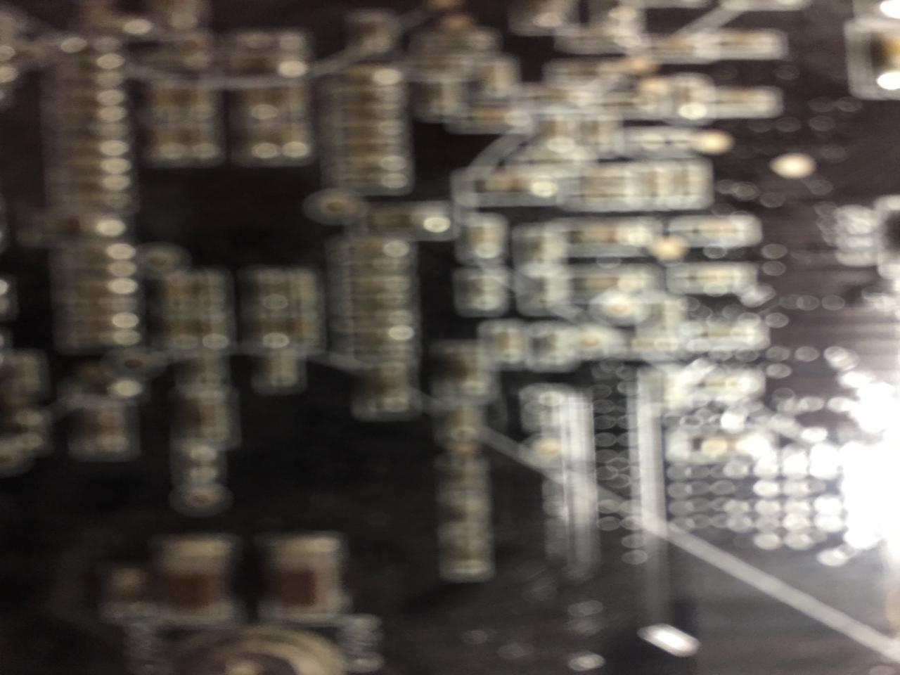

Communications Law: Introducing the Course
Talk 1
LAW 424 001
Communications Law
Allard School of Law, UBC
Spring, 2022
Jon Festinger Q.C.
Centre for Digital Media
QMUL School of Law (CCLS)
Whiteboard Law
http://commlaw.allard.ubc
@jonfestinger
jon_festinger@thecdm.ca

Slide 2
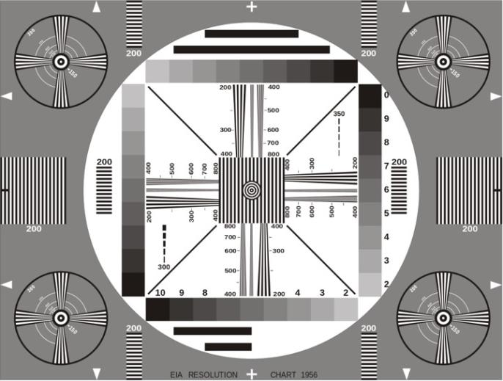
Permission to Record?

Slide 3
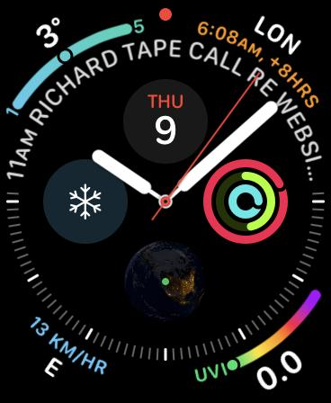
No, we will not spend the whole three hours…
Maybe an hour and thirty minutes...

Slide 4
Logistics

Slide 5
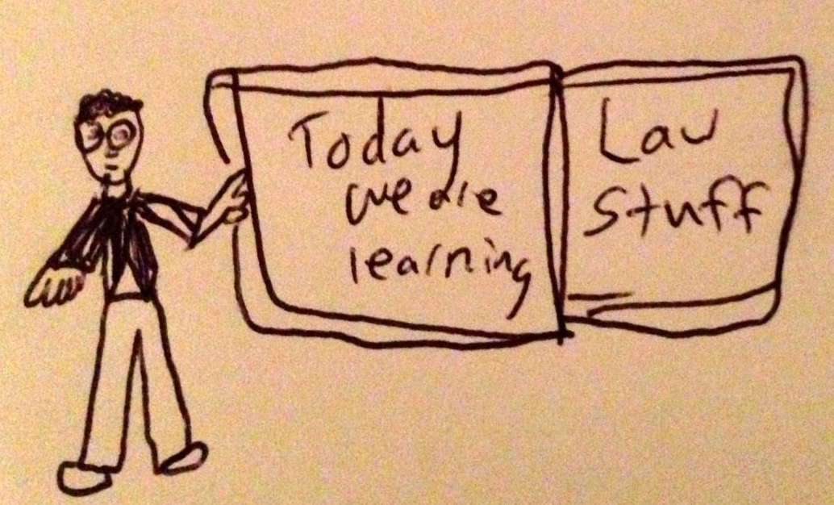

Slide 6
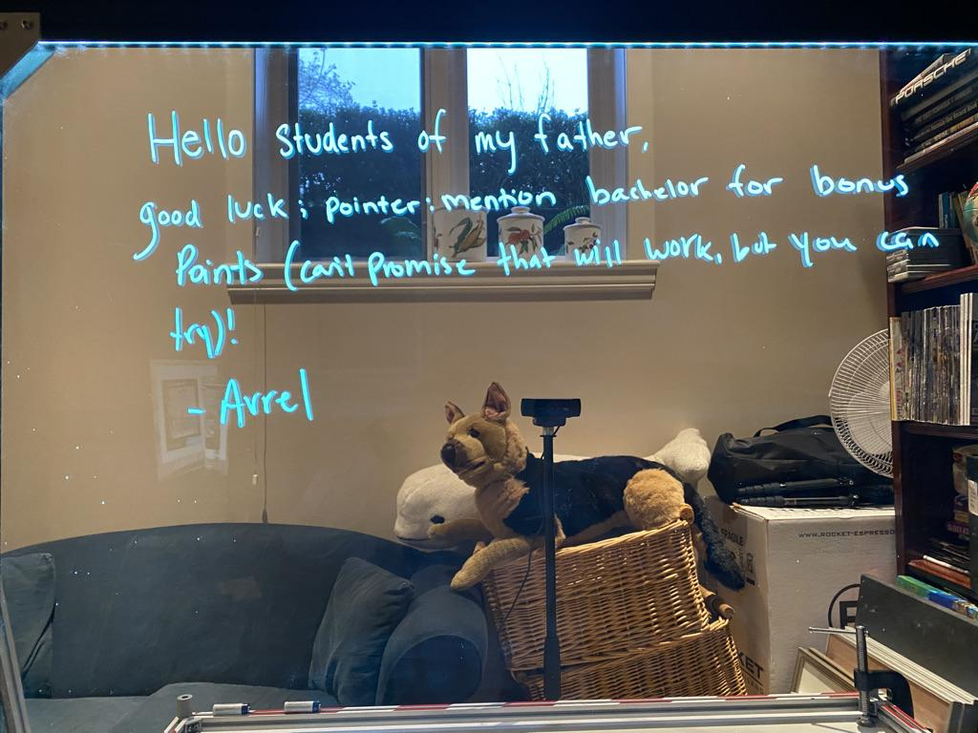

Slide 7
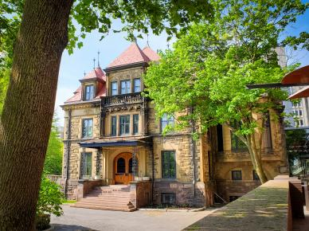



Me (briefly)

Slide 8
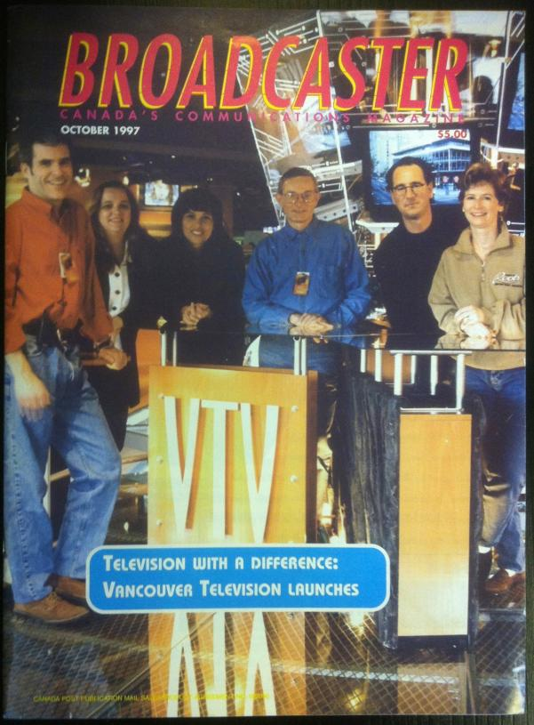

Slide 9


Slide 10


Slide 11

Favorite TV Show? (not exactly)

Slide 12


Slide 13


Slide 14


Slide 15


Slide 16
Now
You

Slide 17
Please, please…
By next week email me a short bio of yourself referencing:
Anything at all you want to say about yourself
Your academic interests
Interests outside of law you wish to mention
What you would like to get out of Communications Law specifically
Comments on evaluation & delivery schemes

Slide 18
+ Don’t Forget
Name
Year of law school
From Allard or Exchange or Visiting or LLMCL (& from where if not Allard)
Favorite Television Program – includes streaming services (current or all-time)

Slide 19

Pause

Slide 20
QUESTIONS?
THOUGHTS?
DISCUSSION?

Slide 21
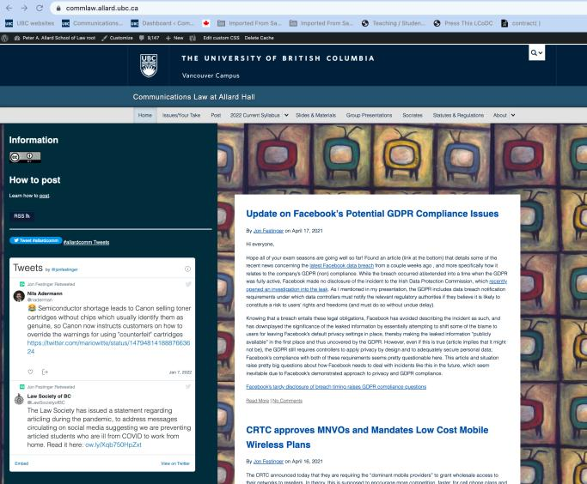
Current V3 Course Website
https://commlaw.allard.ubc.ca

Slide 22
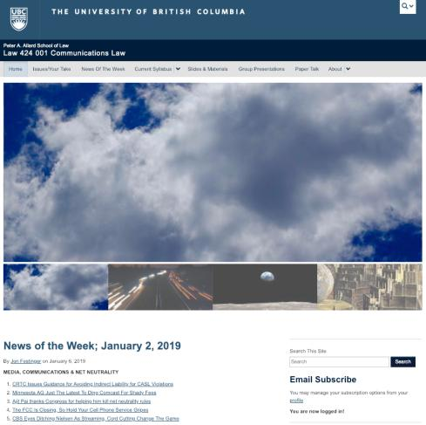
Initial Course Website
http://commlaw.allard.ubc.ca

Slide 23
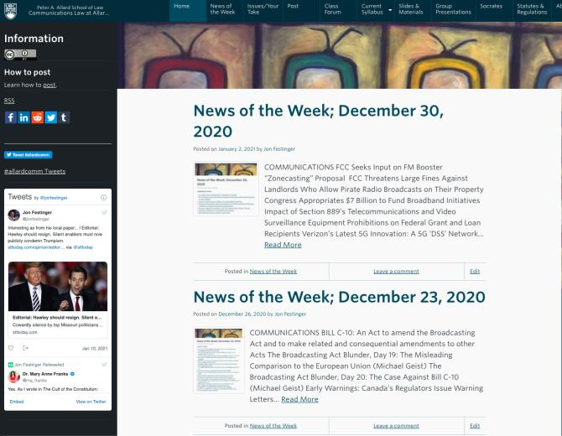
V2 Course Website (Spaces)
https://allard.coursespaces.ubc.ca/LAW-424-001/

Slide 24

“Living” Syllabus

Slide 25
For full privileges on the website
1. Please create an account at http://cms.ubc.ca/ using your CWL.
2. Once you create an account and sign in at http://cms.ubc.ca/ you can click your name in the top right. Half way down the following page will be your WordPress email address.
3. Send me your WordPress email address at jfestinger@telus.net or at jon@fblawstrategy.com
4. Then, I will invite you to participate with authoring privileges via your WordPress email address.

Slide 26

Why post?
Engaging and engaging others is the key.
Because you don’t love speaking up in class.
Because you just saw something and you’ll never remember it unless you post it now.
If you : #allardcomm

Slide 27

Anything & everything can be done via email if you prefer

Slide 29
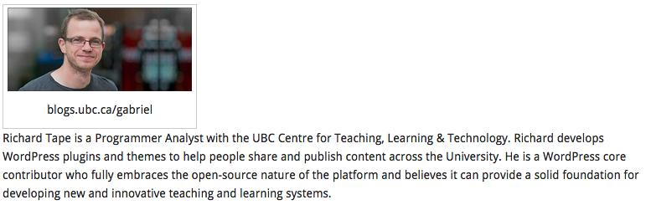
Website issues…

Slide 30
No “hidden” data collected.

Slide 31
Pause

Slide 32
QUESTIONS?
THOUGHTS?
DISCUSSION?

Slide 33
News of the Week
(& topics in the course)

Slide 34
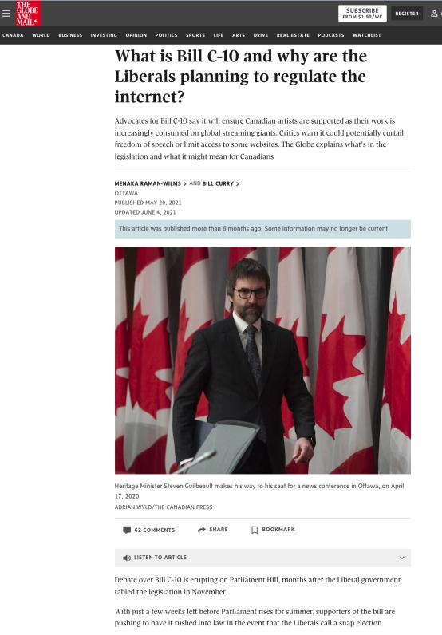

Slide 35
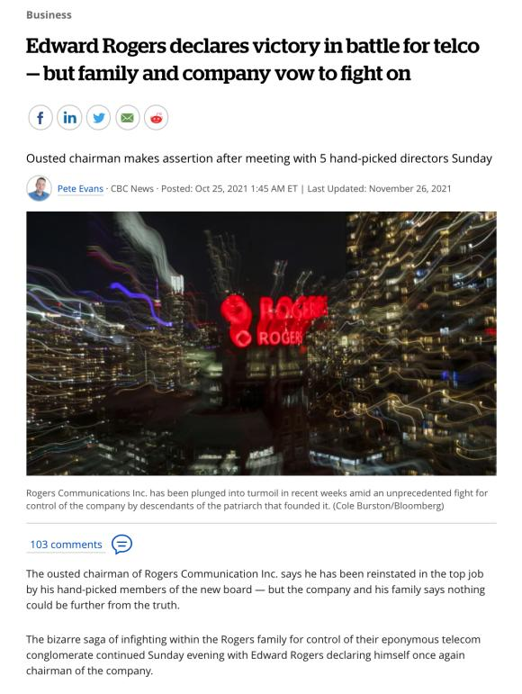

Slide 36
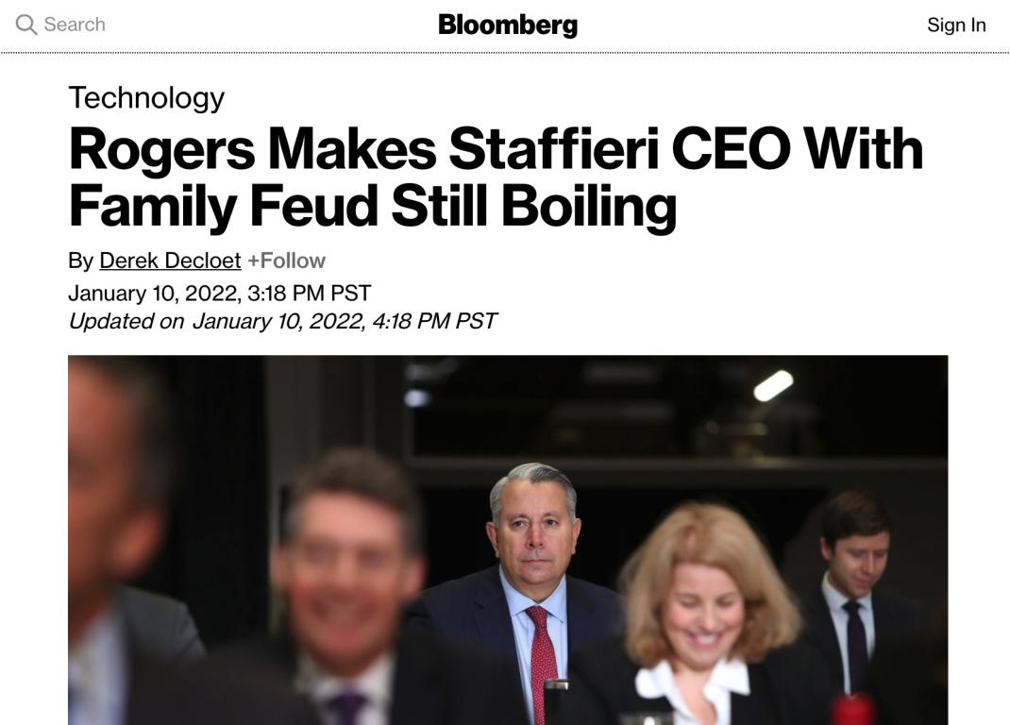

Slide 37
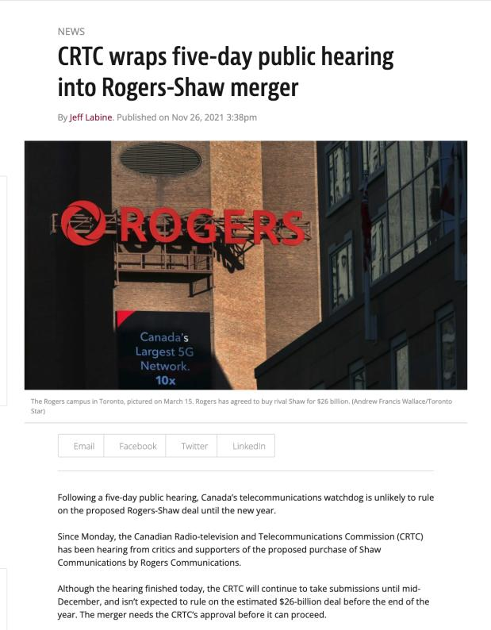

Slide 38
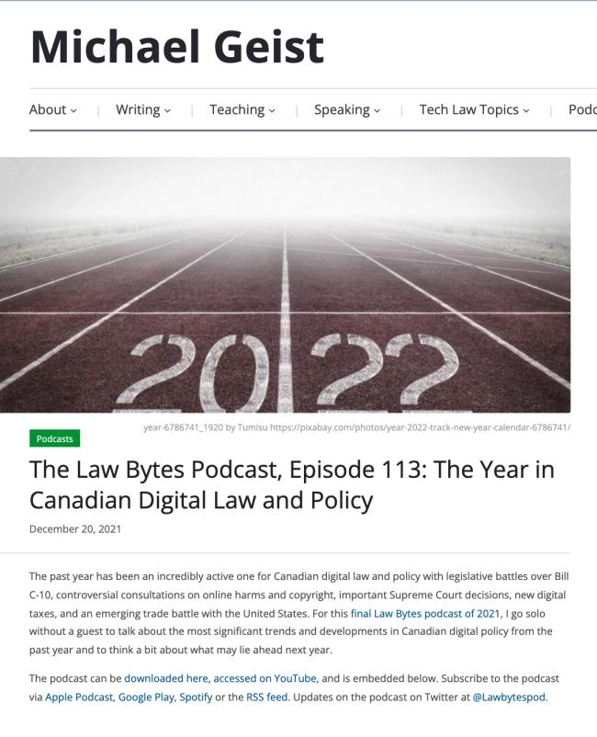

Slide 39
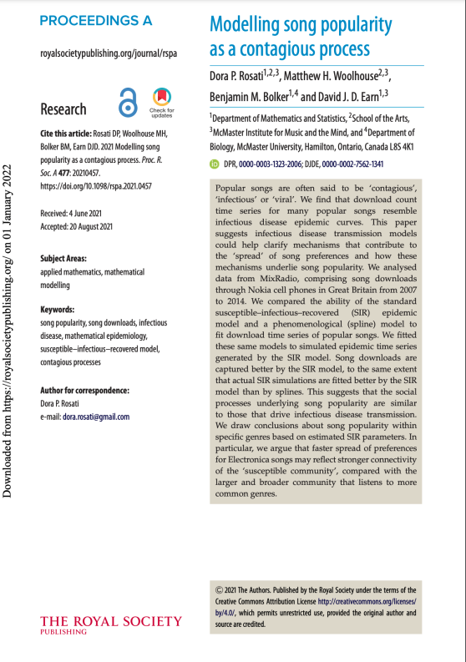

Slide 40
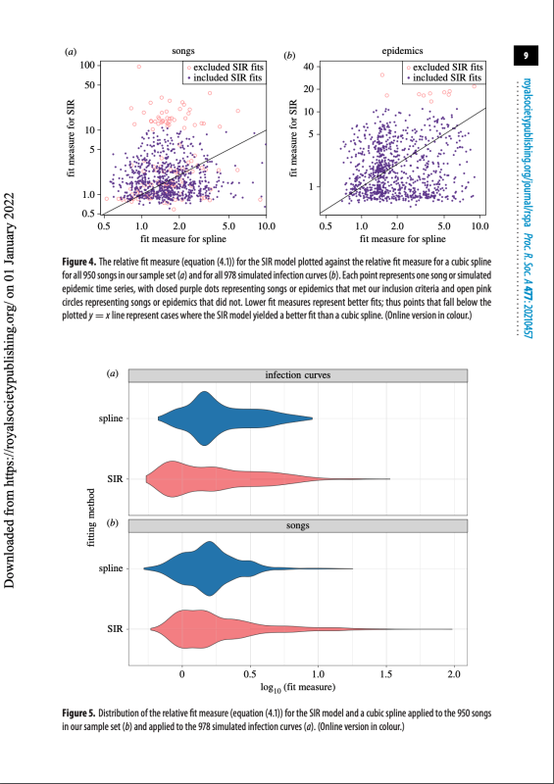

Slide 41
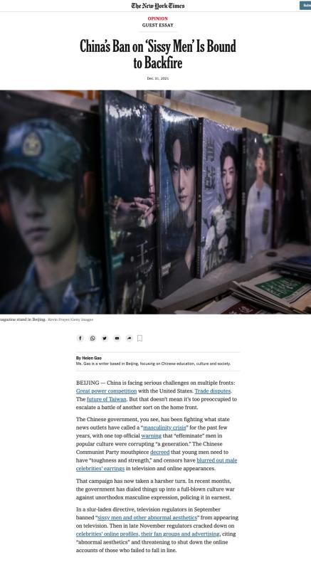

Slide 42
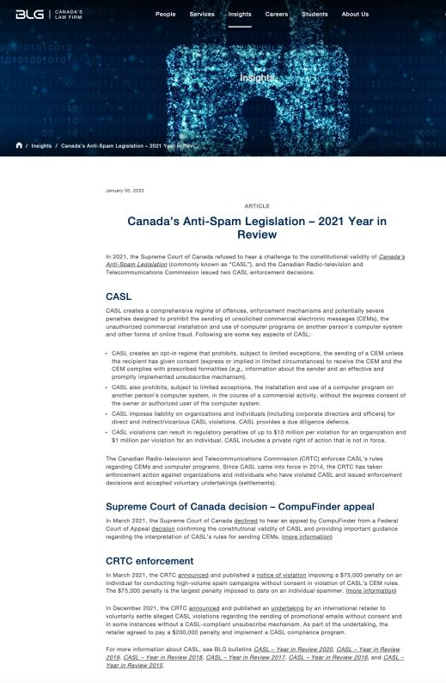

Slide 43
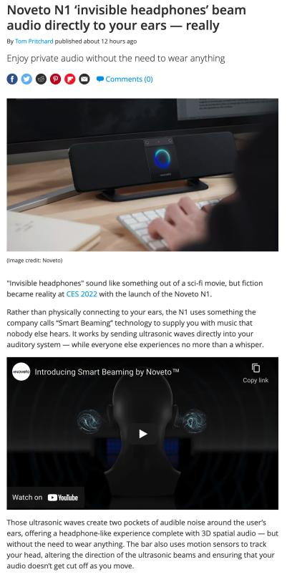

Slide 44
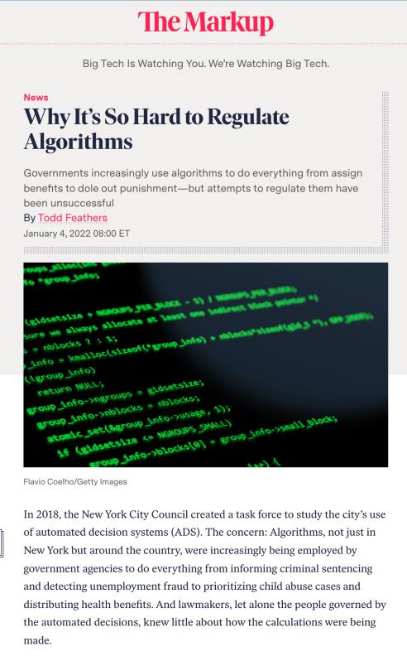

Slide 45
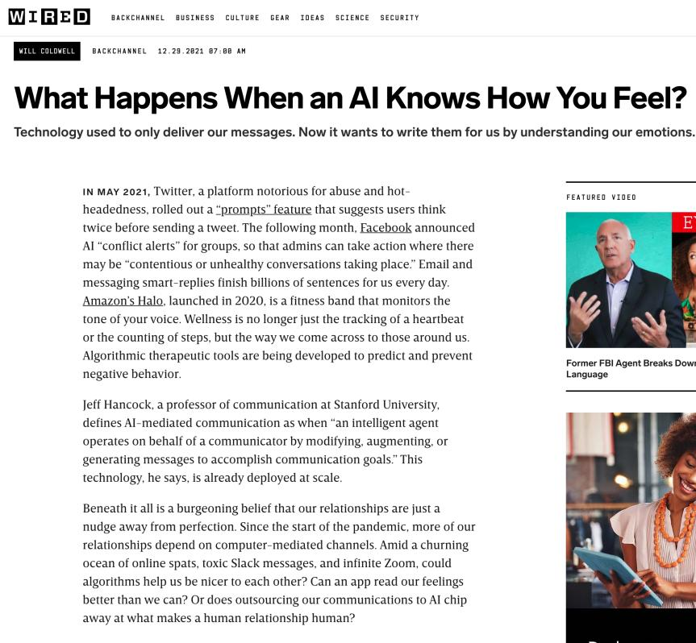

Slide 46
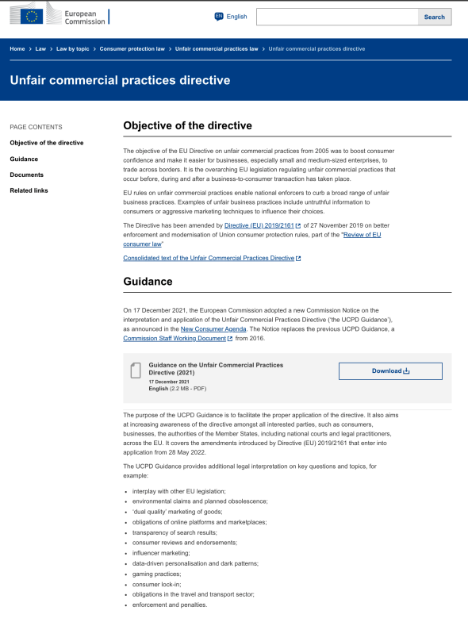

Slide 47
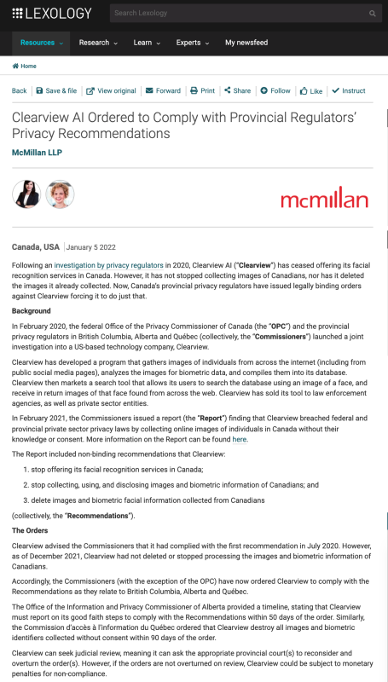

Slide 48
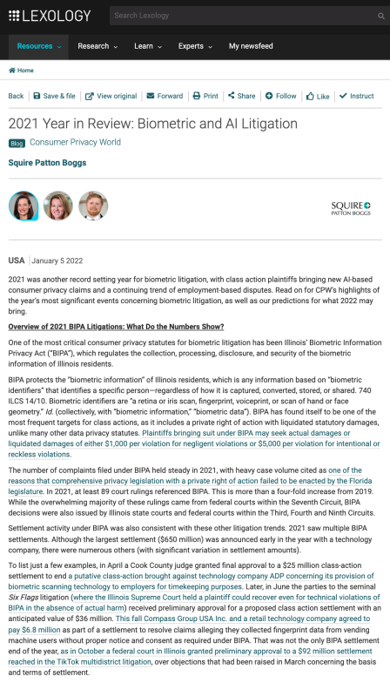

Slide 49
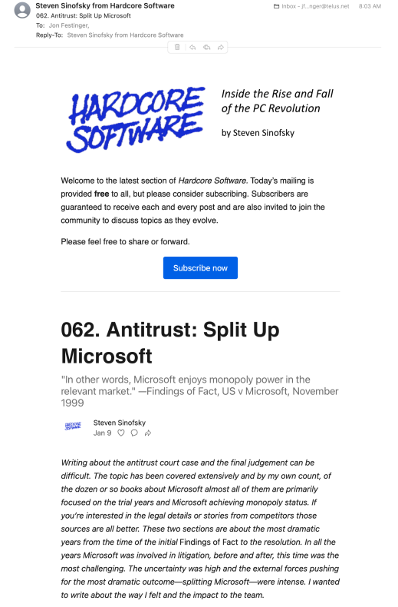

Slide 50
Pause

Slide 51
QUESTIONS?
THOUGHTS?
DISCUSSION?

Slide 52

Office “Hours”: Ideally Tuesdays after class but am flexible…
Email me : jon.festinger@ubc.ca
Office: Allard 449
Phone:
o. 604-568-9192
c. 604-837-6426

Slide 53
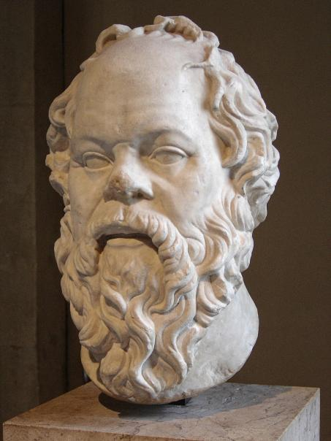
Embedded Self Socratic A.I.

Slide 54
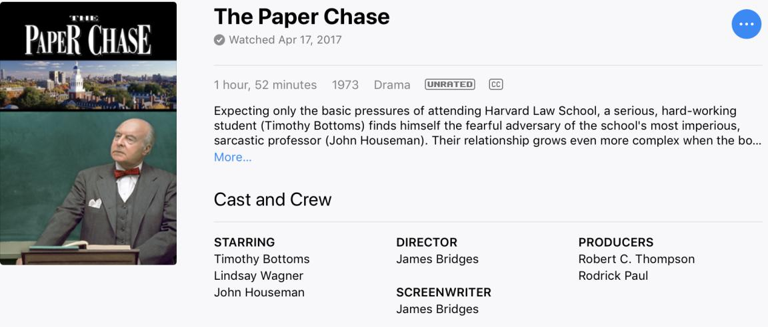

Slide 55
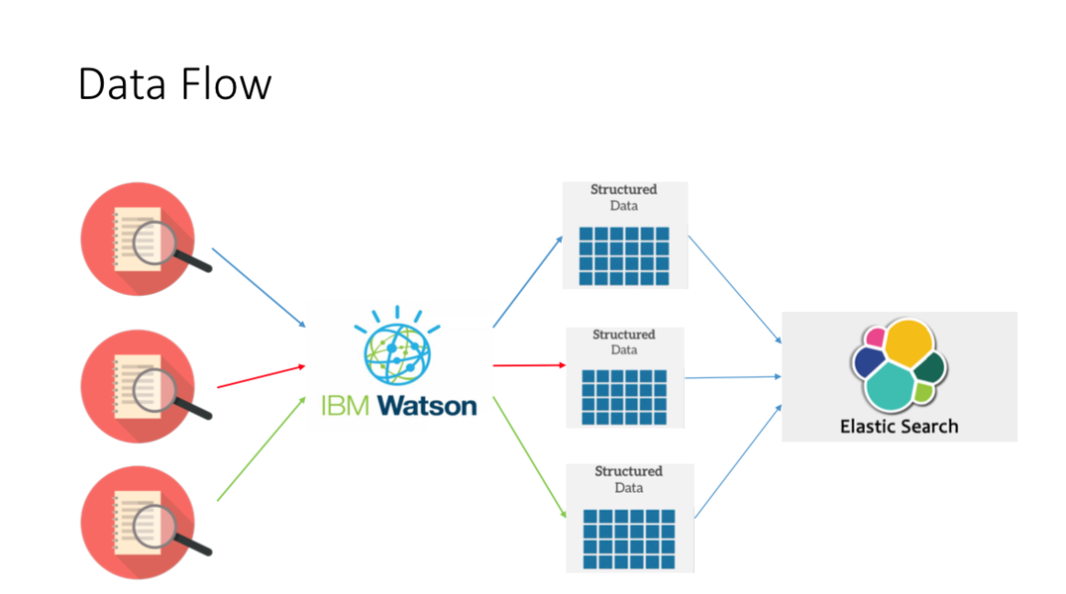

Slide 56
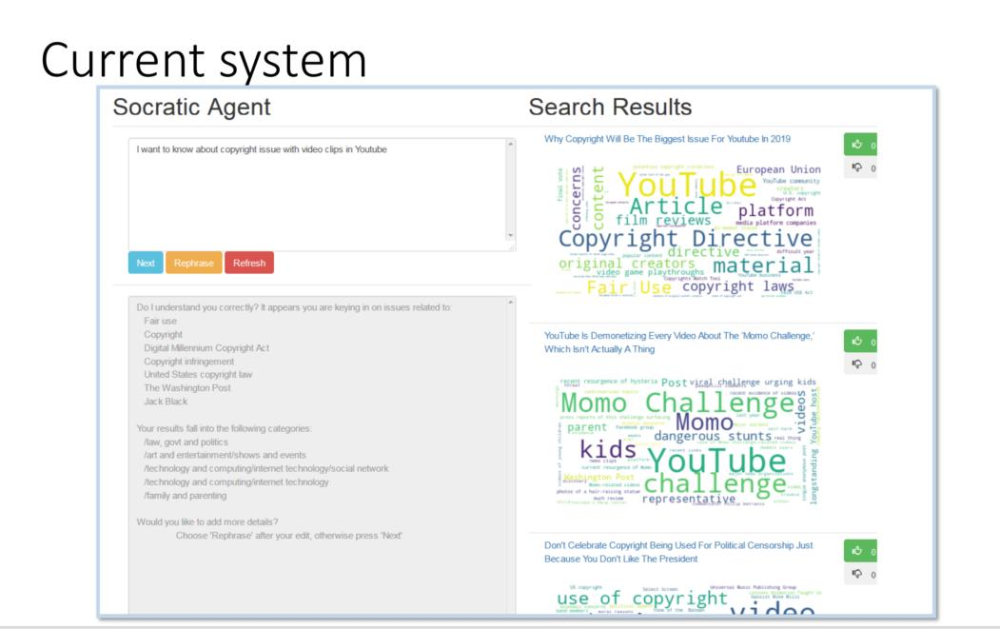

Slide 57
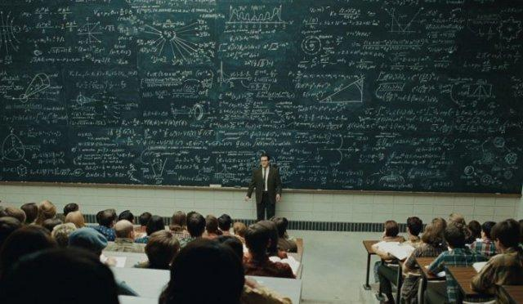
Pedagogic theory please?…

Slide 58
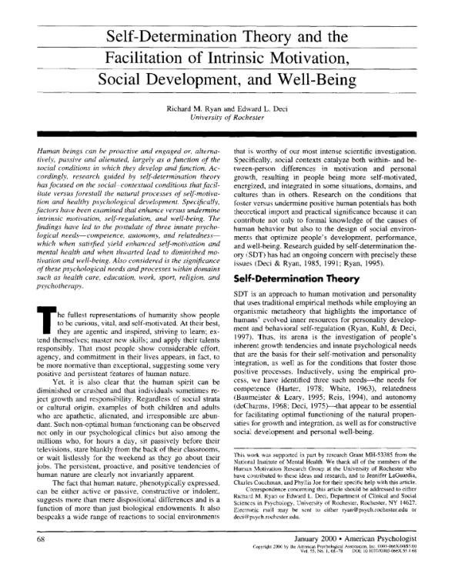

Slide 59
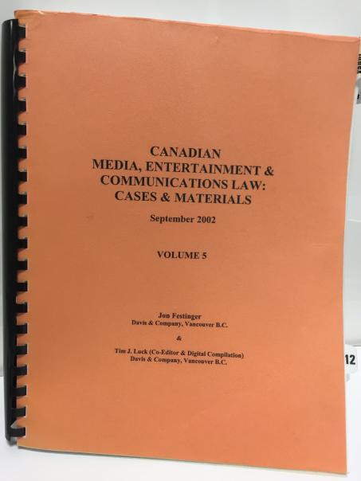
Why this course?

Slide 60
2.0

Slide 61

The Digital Differences

Slide 62
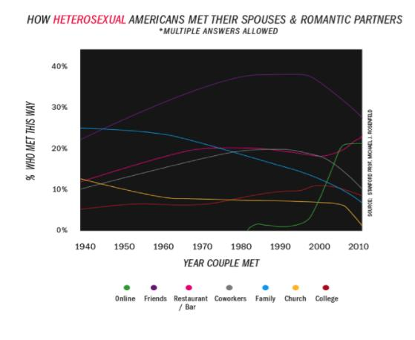

Slide 63
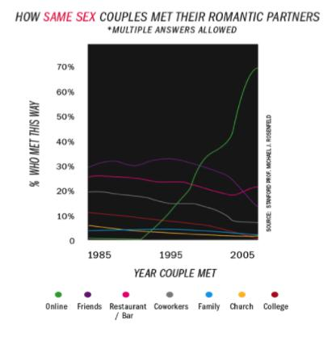

Slide 64
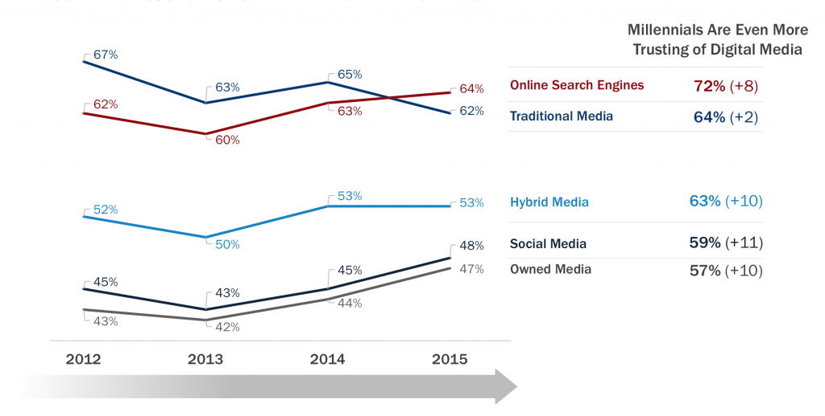

Slide 65
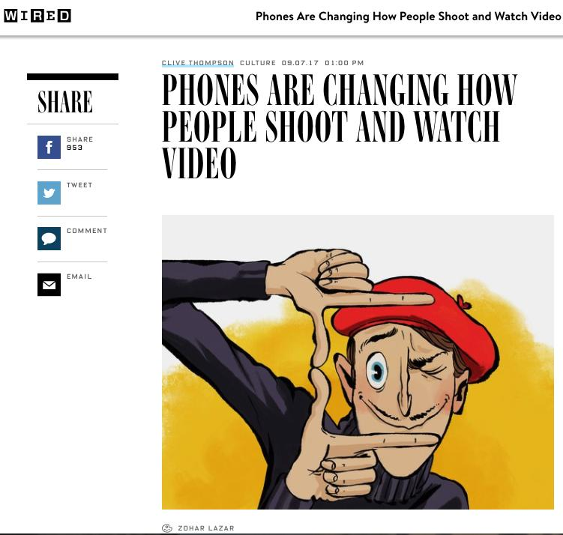

Slide 66
Serious Question: Are we about to be…
3.0

Slide 67
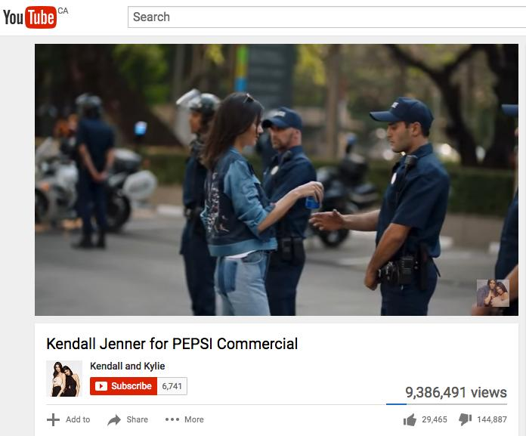
Post-Truth…

Slide 68
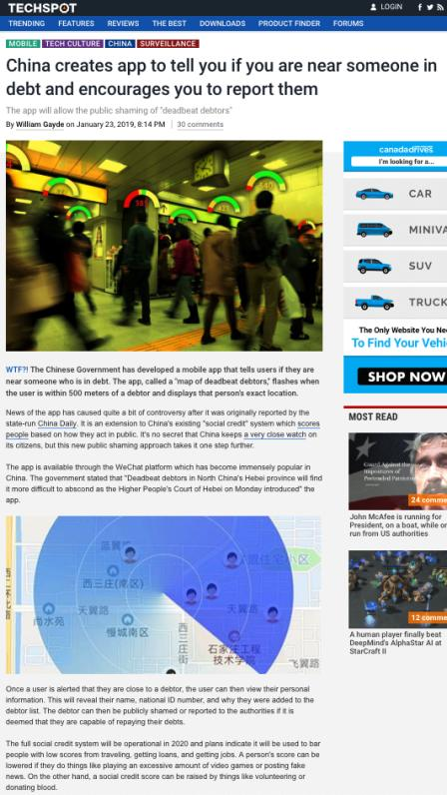

Slide 69
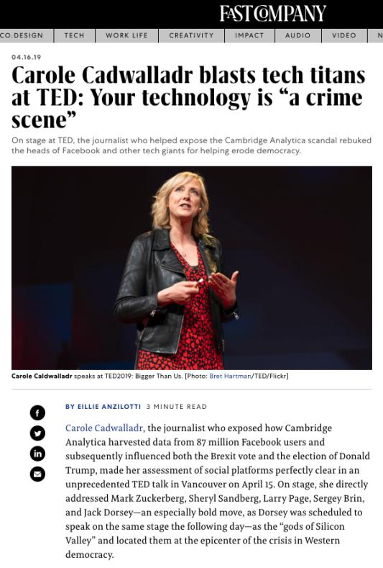

Slide 70
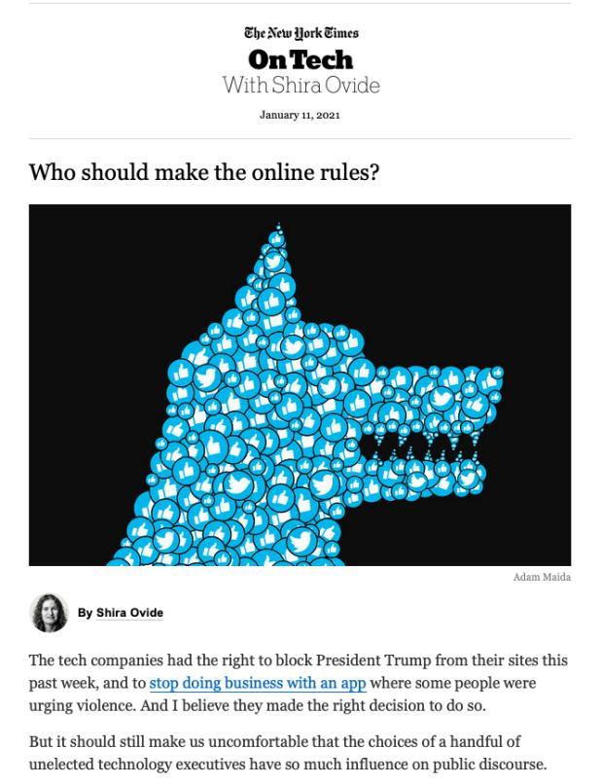

Slide 71
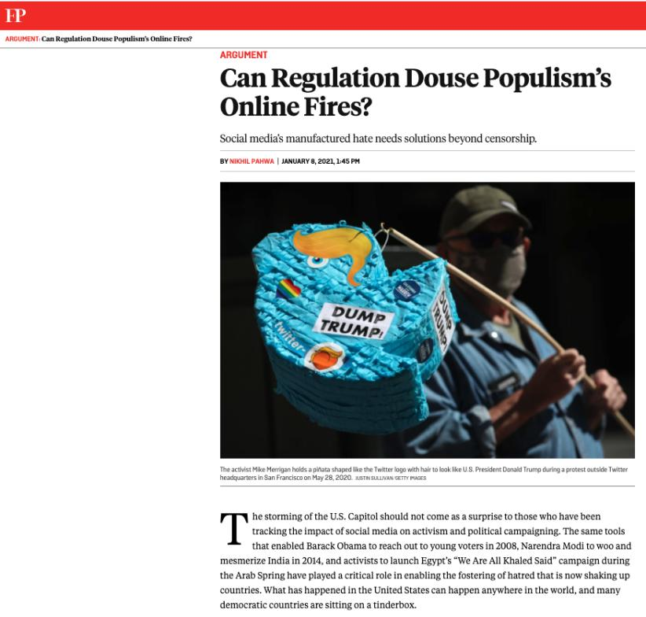

Slide 72
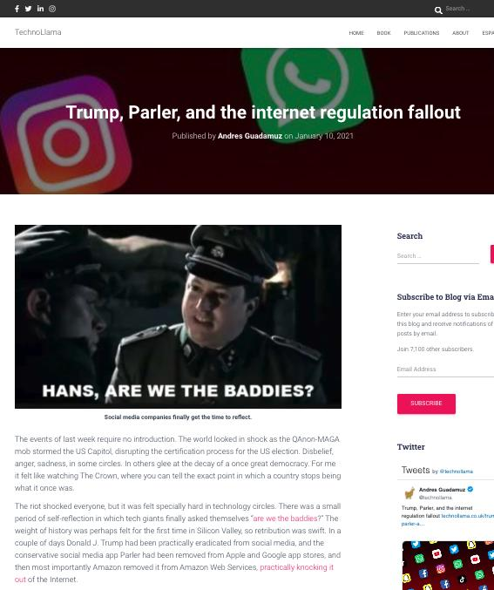

Slide 73
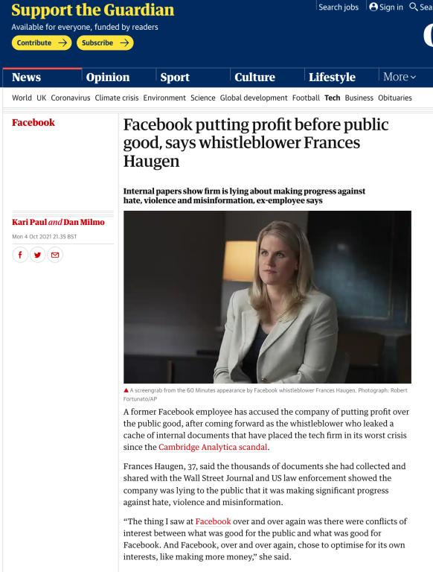

Slide 74
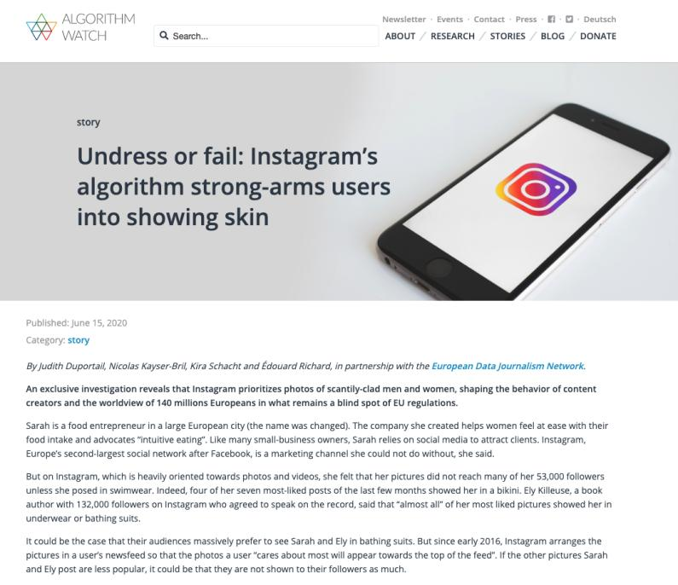
& sometimes there are no words…

Slide 75
2. Everyone has the following fundamental freedoms:
(b) freedom of thought

Slide 76


Slide 77
New or Unique Problems
New Broadcasting Act (Bill C-10) in process?
Digital Content Exemption
Netflix “problem” = tax
S. 2(b) + S.1
Vavilov/Bell = Correctness Standard
Cellular costs
Foreign Telecom Ownership?

Slide 78
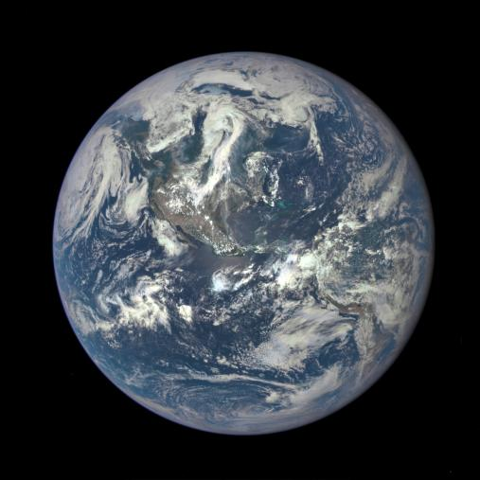
Communications Law is International

Slide 79
Pause

Slide 80
QUESTIONS?
THOUGHTS?
DISCUSSION?

Slide 81
EVALUATION
Term paper = 60% of the final grade.
5000 word paper
The paper is due on the last day of the exam period at 4:00 p.m.
Class Participation = 40% of the final grade
25% of the mark will be based on group preparation of a Class Discussion, with a Discussion Outline provided to the class—preferably by posting on the course website—a week before.
15% for student participation in other course activities including seminar discussions etc.

Slide 82
Paper Confessional
(or what I learned one winter holiday)
Legal/normative reasoning/argument including footnote/bibliography support & Contribution/Move forward → 60%
Presentation including layout, headings, grammar, language/writing skills, “tightness” → 25%
Topic/Originality/Degree of Difficultly → 15%
THIS IS NOT A RUBRIC. IT IS A SELF ASSESSMENT.

Slide 83
Group Presentations
4-6 (ideally) per group if a group
5 minutes per person general rule
Sign-up by email
Any topic – not constrained by what I’m talking about that week
Can consult with me re the topic you want to take on
Post one thing you want us to read or watch

Slide 84
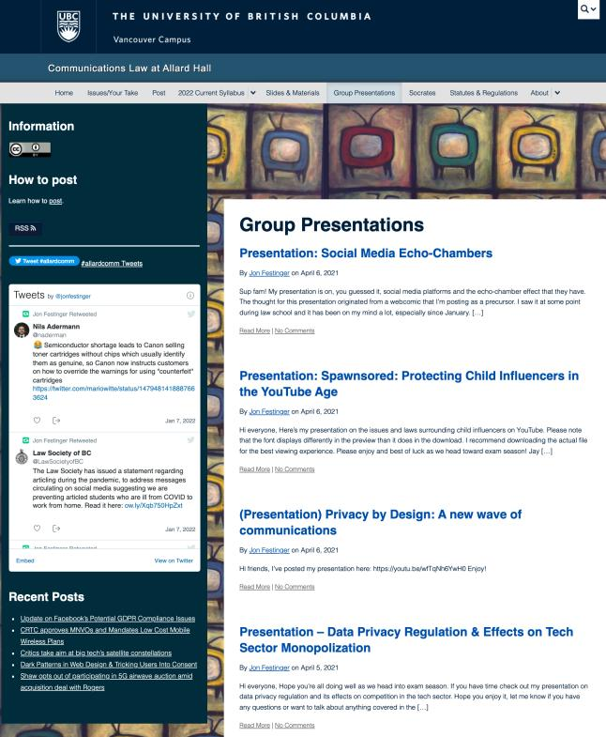

Slide 85
Evaluation Tips
Term paper topics need not be discussed with me, but often helpful to you if you do.
Term paper can be on your presentation topic.
Participation: In-class or other contributions, including attendance.
Group presentation need not be on that week’s topic

Slide 86
Grades (primarily)
Paper → Quality
Participation → Effort

Slide 87
Will read: drafts…outlines…synopsis……abstracts…etc.
As late as I can…
Due last day of exams by 4:00 PM.
Hand in papers to front desk & send by email.
If email only, make sure you get acknowledgment of receipt.

Slide 88
Pause

Slide 89
QUESTIONS?
THOUGHTS?
DISCUSSION?

Slide 90
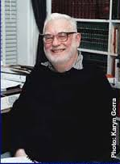
Only rule of of Admin Law
(H. Janisch)?

Slide 91
READ THE STATUTE !!!

Slide 92
What is at the heart of Communications Law?

Slide 93
“To regulate, or not to regulate, that is the question.”

Slide 94
To regulate, or not to regulate, that is the question:
Whether 'tis nobler in the mind to suffer
The slings and arrows of outrageous fortune (like Netflix),
Or to take Arms against a Sea of troubles (like Bell),
And by opposing end them: to die, to sleep
No more; and by a sleep, to say we end
the heart-ache, and the thousand natural shocks
that the Broadcasting Act is heir to? 'Tis a consummation
devoutly to be wished. To die, to sleep,
To sleep, perchance to Dream of Canadian Content; aye, there's the rub,
for in that sleep of death, what dreams may come,
when we have shuffled off these mortal ratings,
must give us pause. There's the respect
that makes Calamity of so long a statutory life:
For who would bear the Whips and Scorns of time,
the Oppressor's wrong, the proud man's Contumely,
the pangs of despised Love of The Littlest Hobo, the Law’s delay,
the insolence of Crull, and the spurns
that patient merit of the unworthy takes of the intervenors,
when he himself might his Quietus make
with a bare Exemption Order? Who would the Chair bear,
to grunt and sweat under a weary life,
but that the dread of something after death,
the undiscovered country, from whose bourn
no applicant returns, puzzles the will,
and makes us rather bear those ills we have,
than fly to other proceedings that we know not of.
Thus conscience does make cowards of us all,
and thus the native hue of a Call for Applications
Is sicklied o'er, with the pale cast of Thought,
And enterprises of great pitch and moment,
with this regard their Tangible Benefits turn awry,
And lose the name of Action. Soft you now,
The fair level playing field? Nymph, in thy Orisons
Be all my sins remember'd (but not in the Decision).
Hamlet: Act 3, Scene 1 (revised)

Slide 95
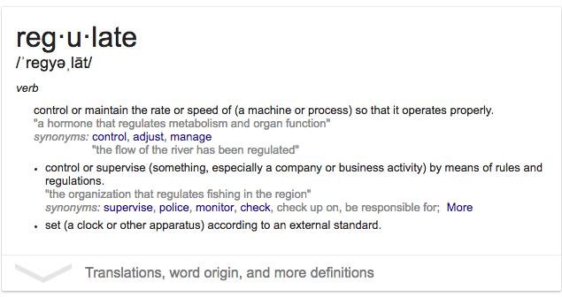
“Regulate” = make regular

Slide 96


Slide 97


Slide 98


Slide 99


Slide 100
QUESTIONS?
THOUGHTS?
DISCUSSION?

Slide 101
Pause

Slide 102

Coming Soon
“Mapping Communications Law 1.0
& 2.0: A Topology”

Slide 103


A MATTER OF PERSPECTIVE

Slide 104

Conclusion

Slide 105
SEE YOU NEXT WEEK!

Slide 106

Always include a cat picture

Slide 107
In learning you will teach
And in teaching you will learn
Phil Collins' Son of Man (1999)

Slide 108
Our Academic Partners

