Slide 1
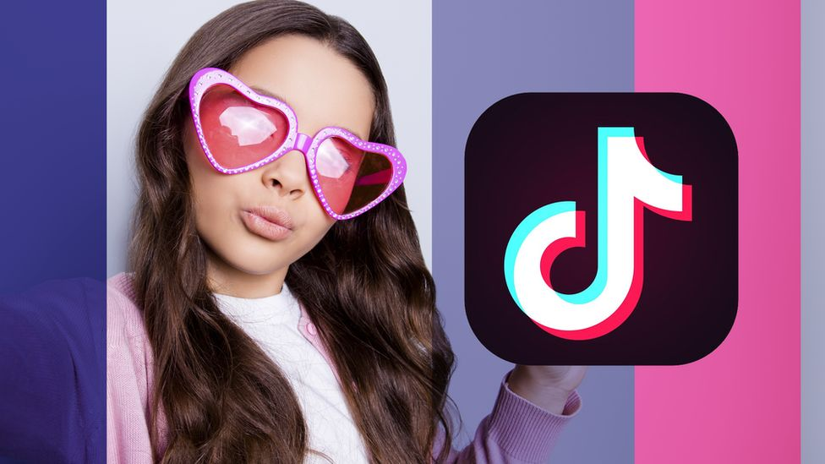

Slide 2
Notes:
It’s 2008 and you regularly use your sick new mp3 ipod touch to listen to FM radio.
One afternoon, you stop at London Drugs to look at some topical cream for an embarrassing personal issue. You leave without buying anything.
On the way home, you pass a protester shouting that the earth is actually flat. This sounds a little far-fetched but you listen to the speech in morbid fascination as you wait for your bus.
That night, you call your cousin to congratulate her on her pregnancy.
For the next two weeks, whenever you listen to the radio, you hear tons of radio ads for anti-itch cream and maternity wear. The radio DJs discuss the merits of flat earth theory and other conspiracies. You think: some of these conspiracies aren’t too far-fetched.
In many ways, TikTok and radio are VASTLY different. Most obviously, TikTok is composed of user-generated content which you can participate in.
However, TikTok & radio aren’t completely unalike: Many people are passive users of TikTok and never share anything, and may not even have a tiktok account. BUT, the company still collects data on these passive users.

Slide 3
What information do you assume is collected by TikTok?

Slide 4
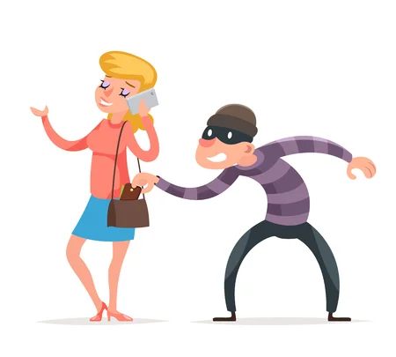
DATA COLLECTED
Info you disclose
Profile info
"User content"
Other info
Technical info about your device(s)
Location
"Behavioural information"
Info from third parties
Notes:
INFO YOU DISCLOSE
Profile info -- username, password, date of birth, email address &/or phone number, info you disclose in your user profile, and your photograph or profile video
“User content”
Preferences (e.g. language)
Comments
Livestreams
Uploads
The umbrella of “user content” includes:
Deleted uploads
Near-uploads (that you don’t post)
Collect specific information about images and video:
Identify objects & scenery within user content, or
Existence & location of face/body features & attributes
A step away from facial recognition?
Saving a transcript of words spoken in user content
What is this info used for?
Usability - Enable special effects, content moderation
Demographic classification
Content & ad recommendations
OTHER INFO
Technical info about your device(s):
IP address, time zone
browser, mobile carrier, device model
screen resolution, battery state, audio settings
app & file names and types
keystroke patterns or rhythms
“We may also associate you with information collected from devices other than those you use to log-in to [TikTok]”
Location
based on SIM card, IP address; GPS location collected with permission only
“Behavioural information”
How you use TikTok
interaction with content
ads you view
videos you watch
content you like
what you save to ‘Favourites’
problems you encounter
users you follow, how you engage with mutual followers
Inferences made: preferences, interests, age, gender
Info from third parties

Slide 5
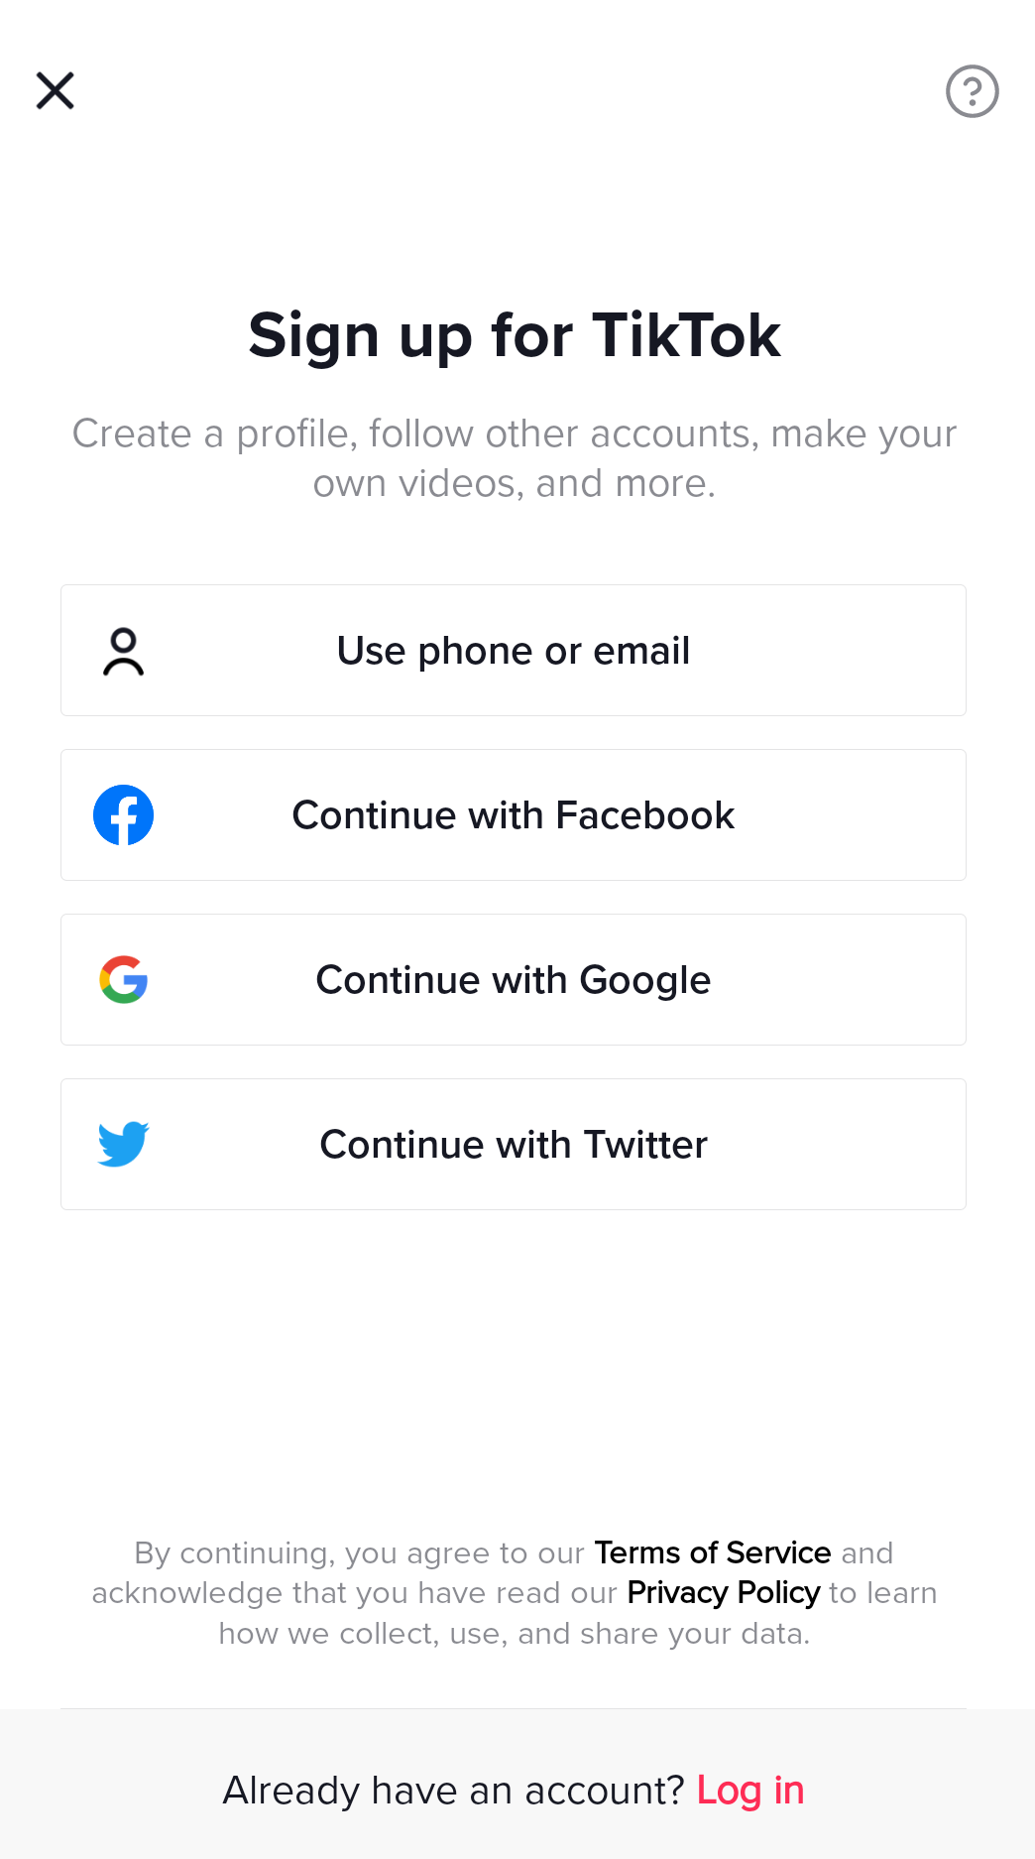
DATA COLLECTION
Info from third parties
Business partners
Advertisers, advertising networks & analytic providers
“We allow our business partners, advertising networks, and other advertising vendors and service providers… to collect information about your online activities through Cookies”
“We are not responsible for the privacy practices of these third parties, and the information practices of these third parties are not covered by this Privacy Policy.”

Slide 6
USE OF DATA
Functionality
Personalise content;
consider how this can impact political leanings, mis/information, etc.
Detection & prevention of abuse, harmful activity, fraud, spam, & illegal activity;
Data analysis
TikTok’s algorithms
Personalised advertising

Slide 7
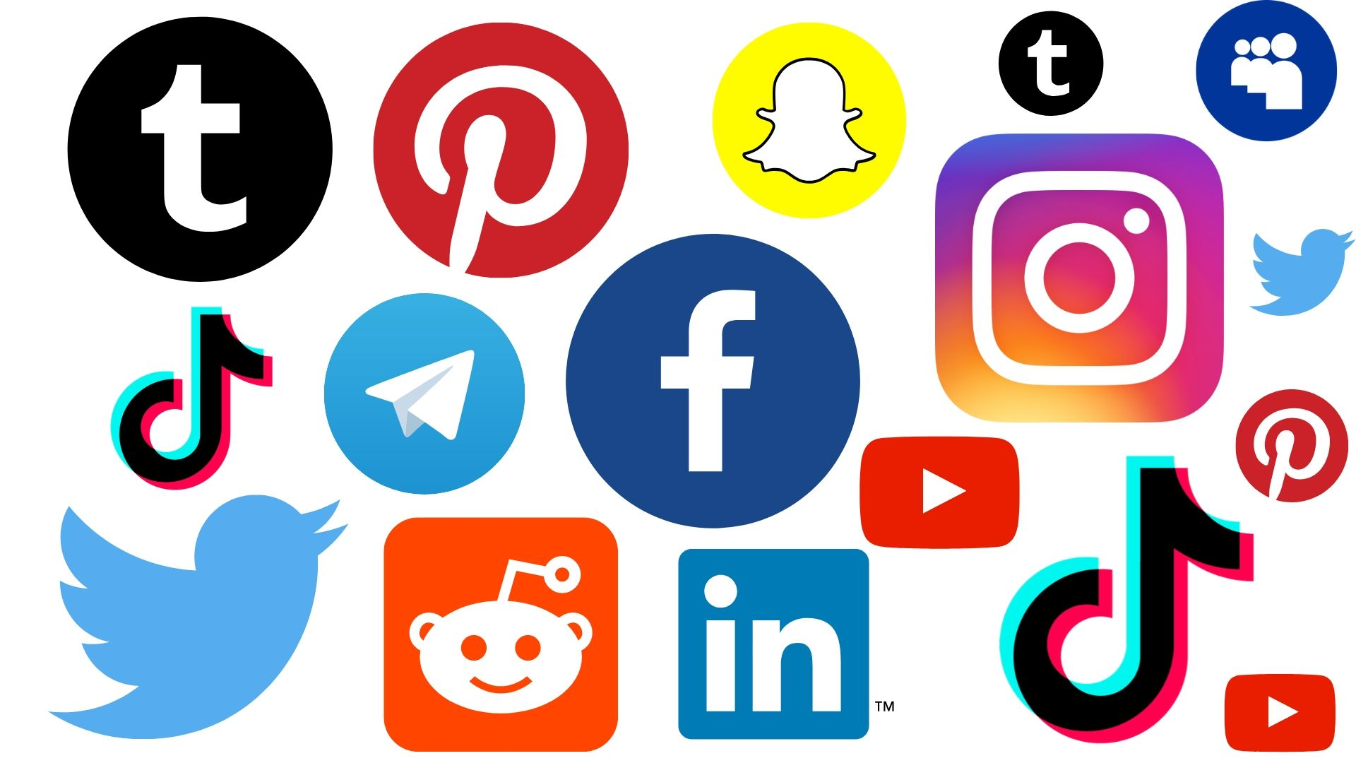
USE OF DATA
Data is shared with:
Business partners
Payment providers
Service providers
Analytics providers
Advertisers & advertising networks
Our corporate group (members, subsidiaries, affiliates)
Law enforcement (where legally required or reasonably necessary)
The public (via your public profile)

Slide 8
SECURITY OF DATA
“Although we will protect your personal data, for example, by encryption, we cannot guarantee the security of your information transmitted via the Platform; any transmission is at your own risk.”
“We have appropriate technical and organizational measures to ensure a level of security appropriate to the risk of varying likelihood and severity for the rights and freedoms of you and other users.”
???
“You can delete the User Content you uploaded.”
But they still store it.

Slide 9
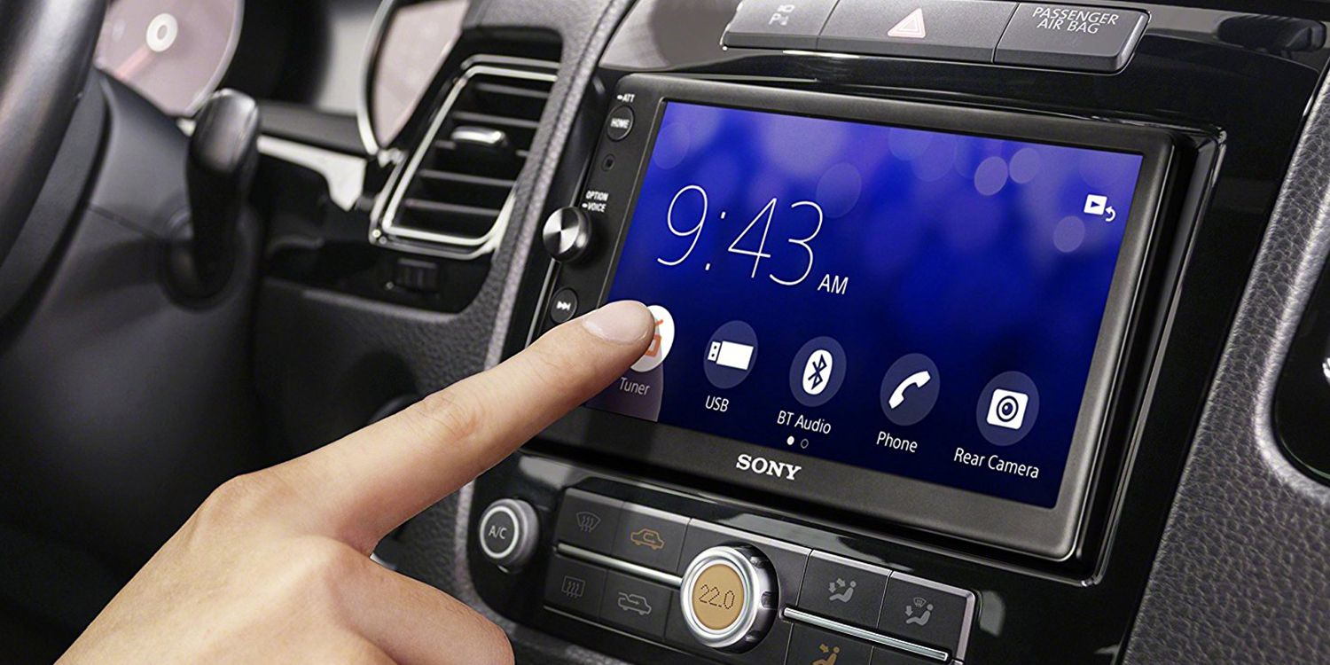
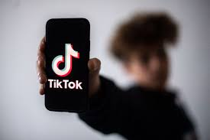

Slide 10
DATA STORAGE
(Just kidding….)
Notes:
In early 2019, President Trump attempted to ban the app from the United States out of concern that the sheer amount of Americans’ data being harvested and stored on servers in China could be a “national security threat”.
TikTok is owned by a Chinese parent company called ByteDance. Because of the peculiarities of Chinese state law, the company is legally obliged to share any and all data requested by the Chinese government, including data collected from foreign nationals. While the company moved all of its data servers out of China before Trump’s pronouncement, the company’s privacy policy explicitly states that they “reserved the right” to share any data with the authorities–and the CEO of the company had even issued a MOU the year prior affirming this commitment to cooperating with the CCP.
The US government opened a formal investigation into the company’s data sharing policy, which all users had implicitly agreed to upon downloading the app and creating an account. All branches of the US government and military banned the app on work devices immediately due to its “spying nature”, with Trump signing an executive order banning the app in September 2020. Interestingly, at the time of this debacle, TikTok was not even active in China––you could not download the app from Chinese app stores, and the data itself was being stored in Virginia, with backup servers being routed through Singapore. As a US-based company, any request by the Chinese government for data would have to be routed through the US government according to the company’s chief security officer. Yet due to the fact that the parent company was based in Beijing, Trump’s order came into effect on November 12, 2020 (thanks to a fed court injunction), but Apple and Google did not remove the app from phones that had it currently downloaded––so American users were only unable to download any new updates to the software until Biden revoked the TikTok order six months later.

Slide 11
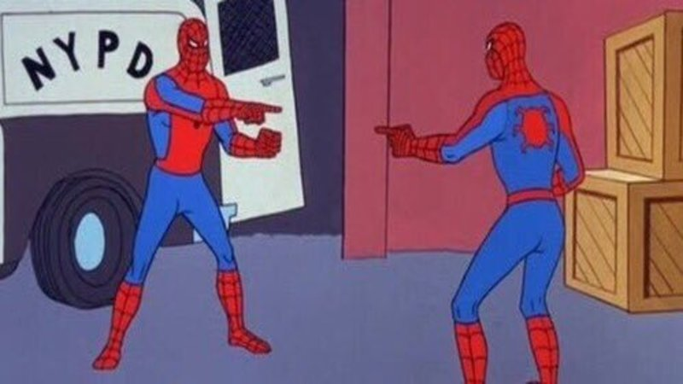
WHOSE JURISDICTION IS IT ANYWAY?
What happens when a private but international communication platform is nationalized––or capable of being nationalized––by a foreign state that other countries view as a security threat?
Notes:
The US-China TikTok saga is fascinating because of the sheer volume of legal hurdles that TikTok, its parent company, the US government and multiple multinational technology firms had to jump through in order to figure out the answer to a seemingly simple question. When President Trump first raised the concern to the Committee on Foreign Investment in the US, TikTok execs were quick to point out the fact that ByteDance’s operations as Beijing-based had little to no interaction with its the app or the user data collected on its servers. They sought an injunction and won one, and in the end the effect of Trump’s EO was negligible on TIkTok users in the US while the “ban” was in place.
But the debacle raised interesting and complicated questions that we’re seeing crop up more and more in an interconnected and globalized online world. After Trump threatened the EO, he warned TikTok that unless ByteDance divested some of its ownership to a US-based company, he would enforce the ban. Months of negotiations between massive corporations such as Microsoft and Oracle and Walmart ensued, with the latter two making a bid for a 20% stake in the company in an attempt to curtail the ban, which Trump vetoed and the deal was dead in the water.
What’s interesting about the ban is that technically the President does not have the authority to unilaterally shut down the operations of a US-based company, but merely restrict its ability to do business if there are FDI concerns related to national security. But many commentators speculated that the decision was (a) retaliatory against the company due to the use of the app to “troll” the President’s rallies through crowdsourcing venue bookouts; and (b) financially-driven as Trump stated that the US Treasury would be owed a “substantial amount” for any deal of the sale to a US-company because of the app’s enormous success in the country; and (c) politically motivated as the app had banned many Trump-related hashtags following the Capitol Riots to prevent misinformation spread. Much of this will be referenced in the following freedom of expression section, but the ultimate result of the TikTok v Trump case was (i) a preliminary injunction to delay the ban followed by a (ii) complete denial by the DC District Court judge of the ban as it constituted an arbitrary usage of the presidential emergency powers. Currently, the only country in the world that has successfully split up regional lines of an international social media app is India, which banned the app last year, even though it had over 323 million unique downloads.

Slide 12
BUT WHAT ABOUT CANADA!
Could the Prime Minister attempt to ban social media apps like President Trump’s TikTok ban?
Short answer: Probably not.
Long answer:
Emergencies Act
Investment Canada Act
Personal Information Protection and Electronic Documents Act
Bill C-11?
Who knows.
Notes:
BUT this is all happening elsewhere. Most importantly for us here in Canada, Public Safety Minister Bill Blair said that the country will absolutely not be banning TikTok without further evidence of data misuse. That does still leave the question of what happens if that threshold is ever crossed––what if China does ask ByteDance, who still owns an 80% stake in the app, to allow it access to its data stores? Can the US, or Canada for that matter, intervene to stop it? The question has yet to be answered conclusively because no common law country has had to grapple with it yet – although New Zealand and Australia both have considered it as well–but there are some tools that could be leveraged by the Canadian government if they wanted to.
The Emergencies Act allows the Prime Minister to declare a "public order emergency," which is an "emergency that arises from threats to the security of Canada that is so serious as to be a national emergency." The Act continues and then defines "threats to the security of Canada" as a laundry list of items that includes espionage or sabotage against Canada or its interests, foreign influenced activities detrimental to the country’s interests, amongst other vague security concerns. They are substantially similar to the emergency powers invoked by President Trump in his TikTok ban that was ultimately overruled by the DC Circuit Court, and while Canadian courts may fall on a different decision in the end, it seems unlikely that this Act would be a surefire win.
The Investment Canada Act allows the government to stop FDI that are “injurious to national security”. It was used a few years ago to block a Chinese company from building a factory in Quebec near the Canadian Space Agency HQ, but seeing as TikTok is not really “investing” in Canada, it doesn’t seem likely that this Act would be a winner either.
The PIPEDA governs the data privacy of Canadians. When a business mishandles personal information, the business could be subject to fines. PIPEDA appoints a Privacy Commissioner to protect the privacy rights of Canadians. However, the Commissioner is not an officer. The Commissioner is merely an investigator who then asks the federal courts-the officer-to dish out fines. Practically speaking, if TikTok was mishandling personal information and refused to comply with the Commissioner, the Commissioner could not "ban" TikTok. The Commissioner would have to seek the courts help.
Some could argue that the Commissioner needs more power-perhaps the power to establish minimum privacy standards for software that, if violated, would prevent the software from entering the market similar to how the Canadian Food Inspection Agency prevents certain unsafe foods from entering the market. But this is not the current legal regime in Canada. However, with the advent of Bill C-11, the Commissioner may be getting some more power soon.
And regarding Bill C-11, I pass it off to Alex who will walk us through the highs and lows of this contentious proposition!

Slide 13
Online Streaming Act (Bill C-11)
Notes:
What is Bill C-11? Who is Michael Geist?

Slide 14
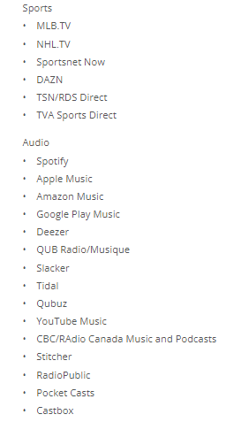
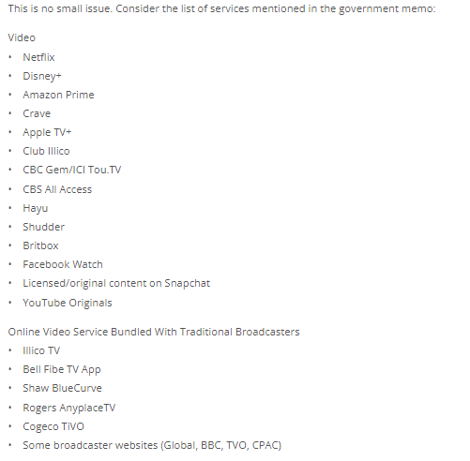
Online Streaming Act (Bill C-11)
Notes:
Geist argues that the definitions of “programming” and “broadcasting” are very overbroad
“program” means sounds or visual images, or a combination of sounds and visual images, that are intended to inform, enlighten or entertain, but does not include visual images, whether or not combined with sounds, that consist predominantly of alphanumeric text
broadcasting means any transmission of programs – regardless of whether the transmission is scheduled or on demand or whether the programs are encrypted or not – by radio waves or other means of telecommunication for reception by the public by means of broadcasting receiving apparatus, but does not include any such transmission of programs that is made solely for performance or display in a public place;
Geist’s principal arguments are:
Laziness: no distinction between traditional media platforms and video-sharing, etc. as found in Europe, for example.
Adverse impacts on consumer choice: may drive out different service providers through over-regulation
Adverse impacts on digital first: We should be putting out new platforms and new information without significant limitation

Slide 15
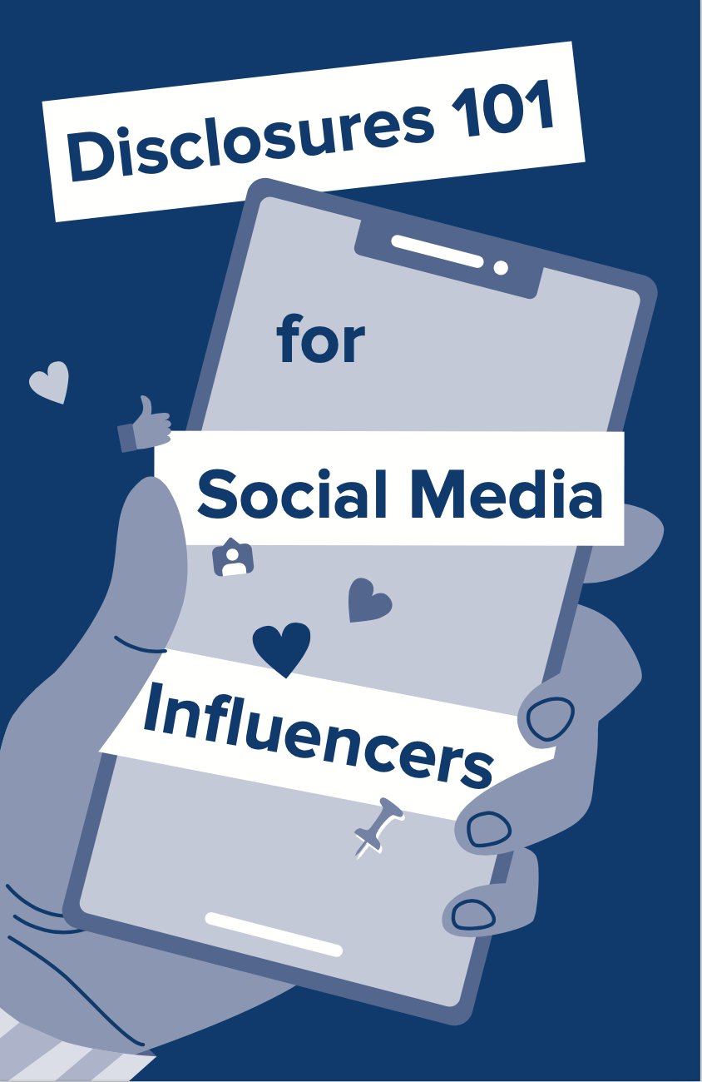
Regulating Advertising in the Age of Influencers

Slide 16
Online Streaming Act (Bill C-11): User-generated content? A “legislative pretzel”?
Notes:
Geist argues that the federal government has created a “legislative pretzel” with this legislation. Why?
The bill creates a general exception for user-generated content on social media BUT creates an exception to an exception
What is the exception? 3 criteria established under s. 4.2 that allow the CRTC to regulate user generated content after considering 3 factors:
whether the program that is uploaded to a social media service directly or indirectly generates revenue
if the program has been broadcast by a broadcast undertaking that is either licensed or registered with the CRTC
if the program has been assigned a unique identifier under an international standards system
Problems for Geist:
Overpowering the CRTC to regulate internet content
Freedom of expression - not just for user-generated content but for the bill as a whole

Slide 17
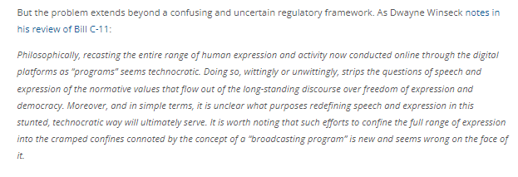
Online Streaming Act (Bill C-11): Freedom of Expression?
Notes:
Admits that 10.1 directs CRTC NOT to make orders inconsistent with FOE or use certain algorithm for discoverability
Argues that “recasting the entire range of human expression and activity now conducted online through the digital platforms as “programs” seems technocratic.
Inherently problematic and damaging to the normative value of free expression
One thing which comes to mind is how the regulation of user generated conduct might create new forms of policing commercial speech (think financial, fitness advice given on Tik Tok, Instagram, etc.)
Although, I am more skeptical of how this is damaging to freedom of expression, based on how the Charter operates.
Bestowing power on an administrative body does not necessarily result in an infringement.
I need to see a factual matrix alleging an infringement before I can weigh in on whether and to what extent the “normative value” of freedom of expression has been stripped away from digital platforms, and whether that infringement is justified under s. 1.
Any comments or questions before moving onto Mike?

Slide 18
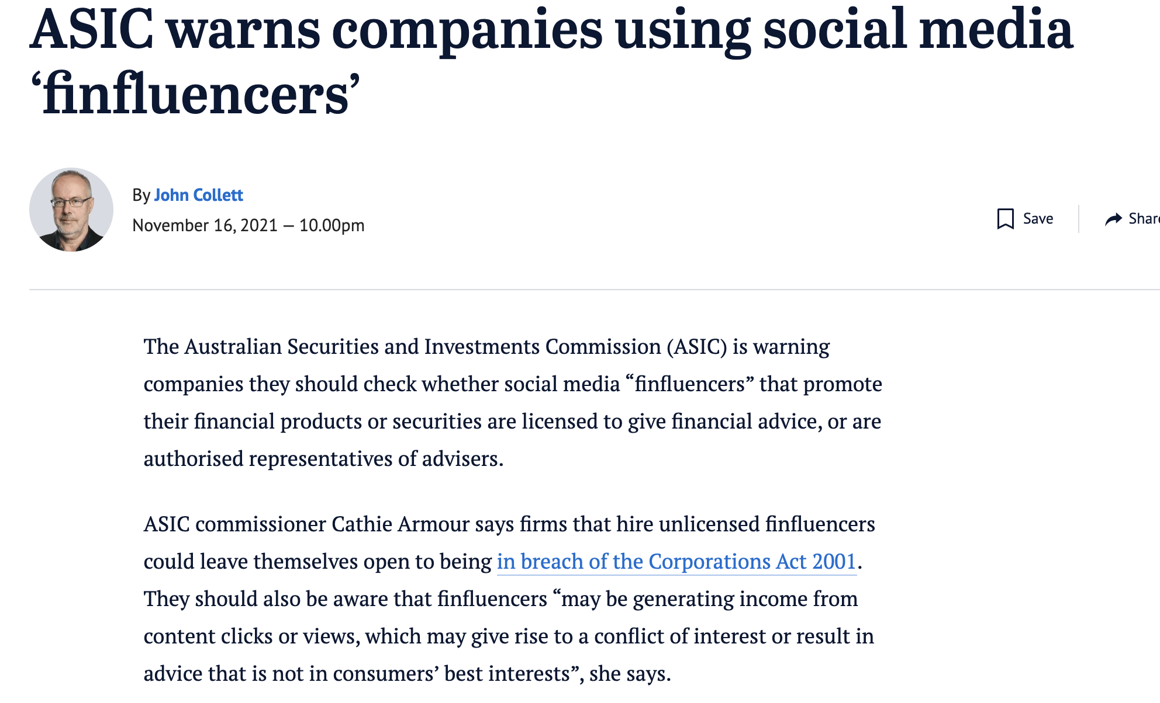
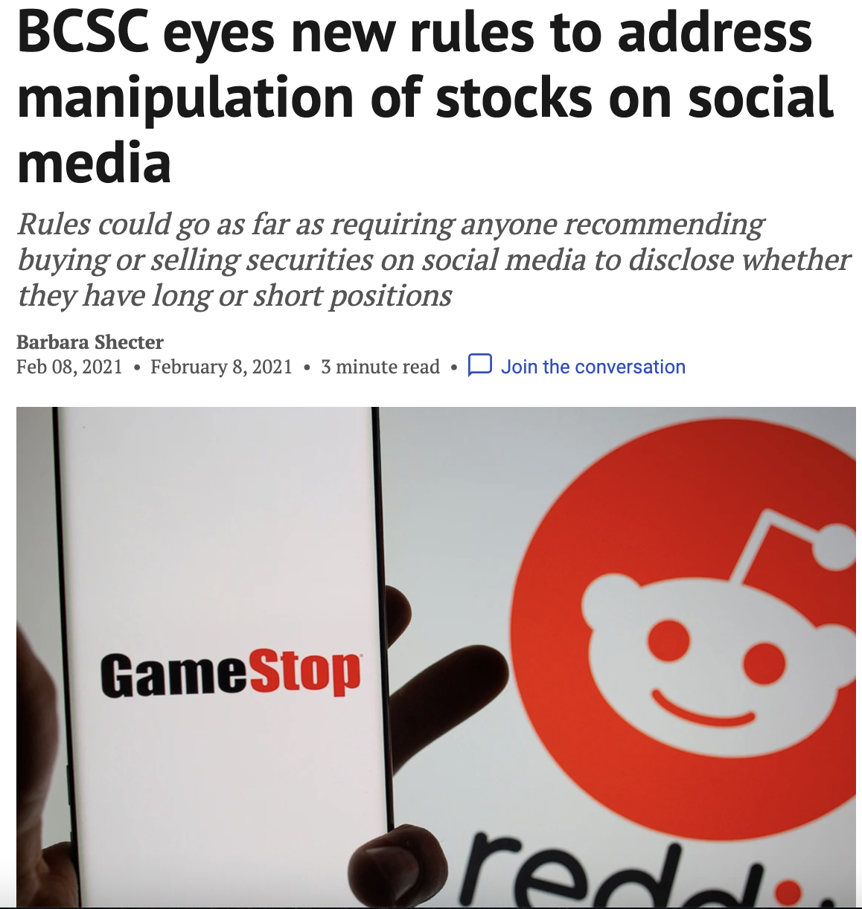
Finfluencers and Stonks

Slide 19
PRIVATIZATION OF MODERATORS IN SOCIAL MEDIA

Slide 20
TODAY’S CONUNDRUM

Slide 21
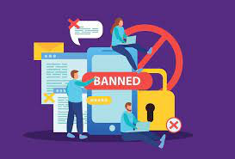
THE ROLE OF SOCIAL MEDIA MODERATORS
Social media moderation refers to the review and management of activities performed on a social media platform. User-generated content (UGC) on a brand's social media accounts often require action, whether by responding, reporting, or removing.

Slide 22
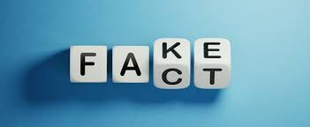
WHO SHOULD BE RESPONSIBLE FOR MODERATION?
Companies – Privatization of Regulators
Companies are free to regulate their platform as they see fit
Government – Regulation through the State
Governments regulate platforms, content and users
Third Party – Fact Checkers and Debunkers have the final say
External companies are hired to regulate content and users

Slide 23
COMPANIES FACING THESE ISSUES
Facebook – Recently allowing hateful content against Russians and Putin
TikTok – Financial advice from unregulated advisors
Twitter – Censoring of certain accounts, fact checking certain tweets
Google – Reorganization of information and search rankings
YouTube – Removing the Nelk Boys interview with Donald Trump
Instagram – Fact checking posts relating to the Covid vaccinations
DuckDuckGO – Down ranking sites with Russian “misinformation”

Slide 24
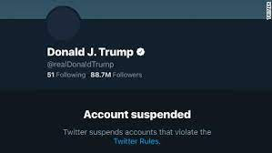
INTERNAL PRIVATIZATION
Companies
Companies and their employees are free to regulate their platform as they see fit
Issues?
Large companies can disproportionately affect the landscape of media consumes and push certain narratives
i.e. Twitter/ YouTube
Employees experience traumatization when viewing graphic/ offensive material
Liability due to mental health issues
Company objectives may not align with government, societal or democratic goals
Studies show people interact more with opposing views and inflammatory posts
Interaction equals time spent on the apps and time spent equals money for these companies
Potential for exclusion of information that does not fit the companies narrative
Twitter removing Donald Trump

Slide 25
EXTERNAL PRIVATIZATION
Third Party
External parties are hired to regulate, fact check and debunk the content and users
Facebook has attempted, at least in part, to use third party fact checkers (Snopes, Politifact, ABC News, FactCheck.org)
Issues?
Lobbying these companies for positive coverage
Who bears the economic cost of the Moderators? The companies or the consumers
Traditional increases in costs/ taxes are born by the consumers
Will this lead to pay-to-play social media services?
What happens to the data/ content these Moderators are privy to?
Will the external company have access to all user account information
What can they do with that information?
Who decides what is to be reviewed by them?

Slide 26
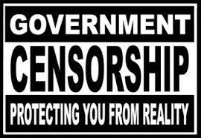
ALTERNATIVE TO PRIVATIZATION
Government
Governments regulate platforms, users and content of private companies
Issues?
State can effectively control the narrative to whatever it sees fits
Kim Jong II’s -38 round of golf
Excludes alternative voices that do not align with government goals
Positive or Negative?
Singular State view may suppress expression of journalism and exploration into the affairs of the State – creates a chilling affect
Russia making it criminal to report negatively on the war
State can more easily operate in a nefarious manner
“He who controls the media controls the mind of the public” – Noam Chomsky
Perception of bias of State funded media
Should the Provincial or Federal government retain jurisdiction

Slide 27
ALTERNATIVE TO PRIVATIZATION
Zero Regulation
No regulation of the platform, users or content, complete freedom of expression i.e. Rumble
Issues?
Material can be wildly inappropriate, misleading or detrimental to society
Terrorist groups, child trafficking, child pornography
Voices of extremists may be amplified
Anger sparks interaction and can create a snowball effect
Virtual meeting rooms for extremist groups
Potential for malevolent actors to take advantage of users through fake advertisements and scams
Fake advertisements
Scamming individuals through phishing links and malware

Slide 28
OUR SUGGESTION
Privatization by objective third party providers
Companies should have a say over the content purported on their platforms
Private businesses should remain free of totalitarian government regimes
Clearly stated terms of use in a simpler to read presentable manner
Legal jargon and extremely long T&C documents discourage comprehension. Provide the T&Cs in a simplified, accessible manner
Companies flag certain material – flagged material is then sent to a third party moderator who provides unbiased fact checking and debunking
Third party does not retain right to any data it acquires and must destroy content after providing their service

