Slide 1
Spreading of Disinformation and Misinformation in the Media
By Madison Sutherland and Priya Gill

Slide 2
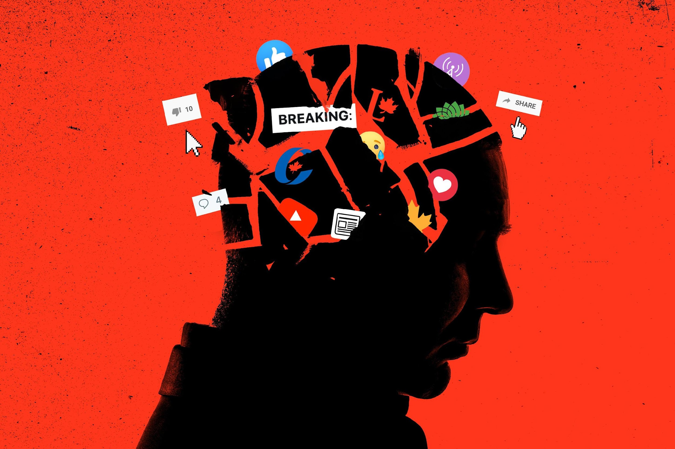
Disinformation v Misinformation
https://muse.jhu.edu/article/579342/pdf?casa_token=sApgolP8eCEAAAAA:lSOr5urySzdRNJEJ3roEpBE2dxy21K456XkQCGy2gGuYQYc4V9kesbZe0eeDqrq7g251QbcGfaw
https://opinion.inquirer.net/149955/the-perils-of-disinformation
https://techpolicy.press/why-people-believe-misinformation-and-resist-correction/

Slide 3
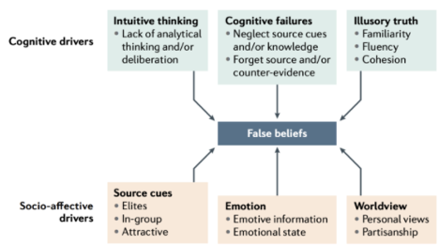
Drivers of Misinformation
https://techpolicy.press/why-people-believe-misinformation-and-resist-correction/

Slide 4

How Prominent Is Disinformation In Our Daily Lives Due to Media Consumption?
Where these actors operate:
Blogs and Websites
Forums and Message Boards
Mainstream Social Media Sites
https://datasociety.net/library/media-manipulation-and-disinfo-online/

Slide 5

Discussion Question: Who uses social networking sites to get news?

Slide 6
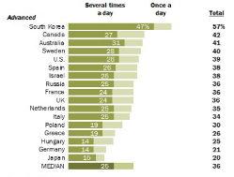
How often Canadian use social networking sites to get news
​​https://www.pewresearch.org/global/2018/01/11/people-in-poorer-countries-just-as-likely-to-use-social-media-for-news-as-those-in-wealthier-countries/?utm_content=bufferce337&utm_medium=social&utm_source=twitter.com&utm_campaign=buffer

Slide 7
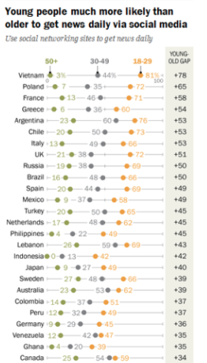
Young people much more likely than older to get news daily via social media

Slide 8
Discussion Question: Why do you think people want to spread disinformation?

Slide 9

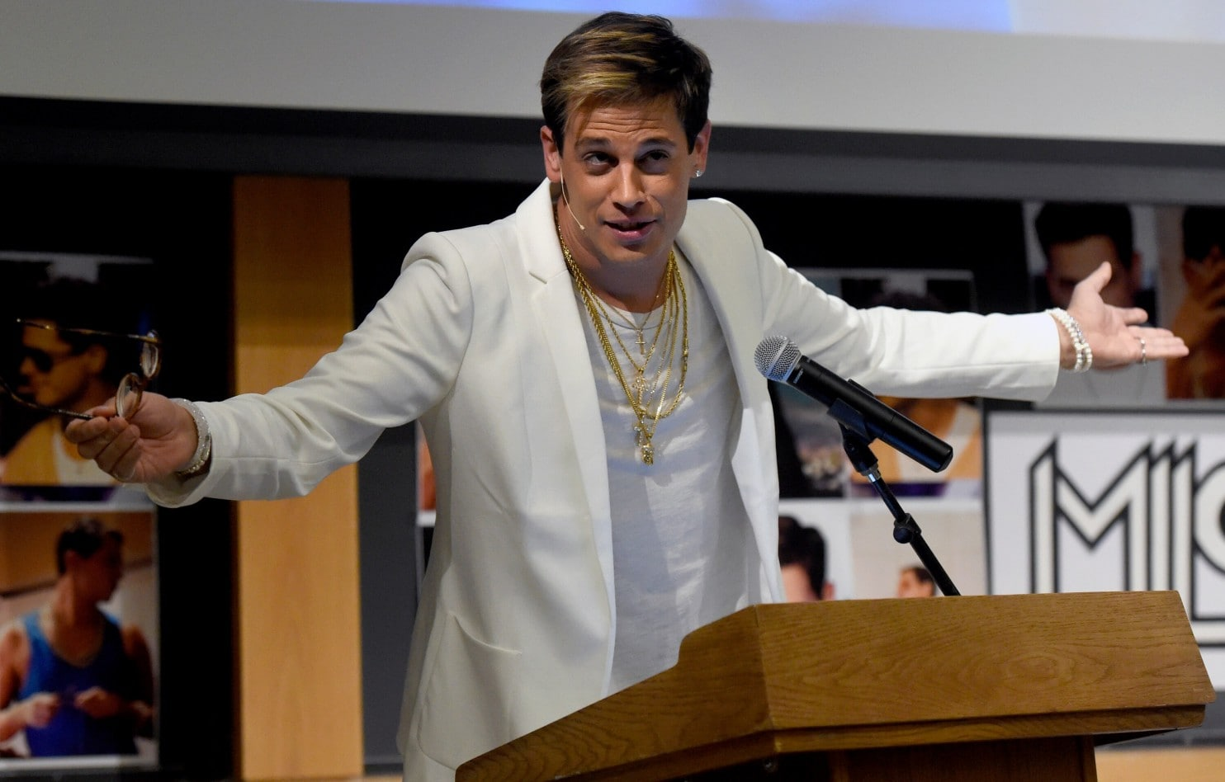

Motivations
Ideology
Radicalization
Money
Status and Attention
https://datasociety.net/library/media-manipulation-and-disinfo-online/

Slide 10
Discussion Question: Can you think of any recent disinformation trends?

Slide 11
Recent Examples of Disinformation Trends
Climate change
Public health
Politics

Slide 12
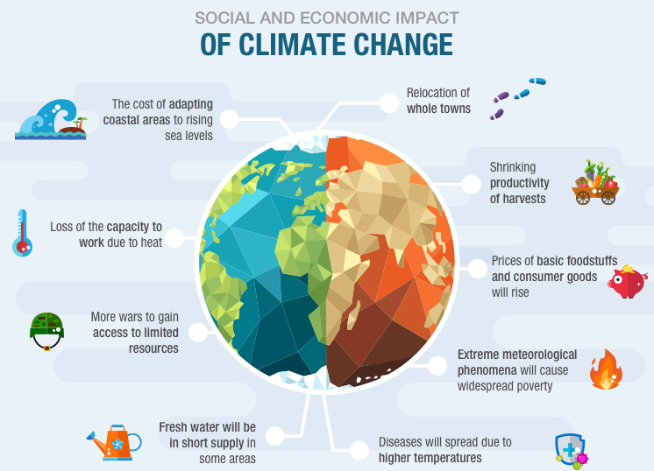
Climate Change
https://wmich.edu/news/2022/01/66880

Slide 13
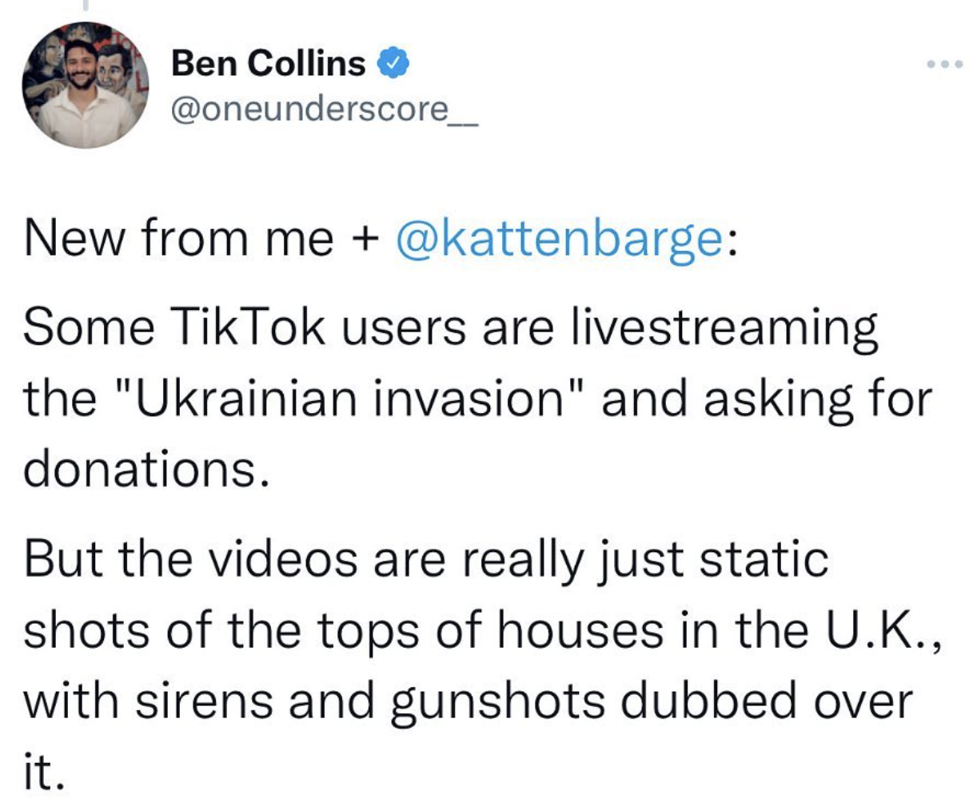
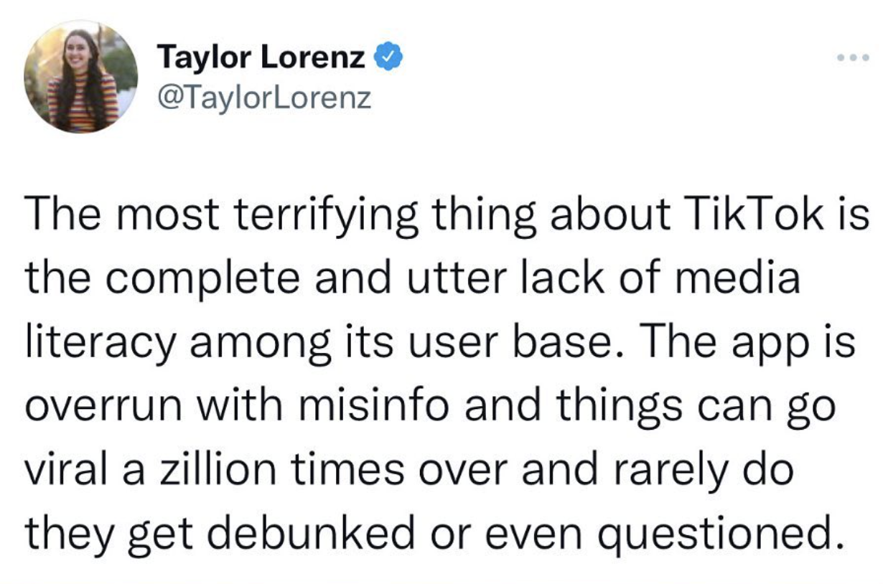
Russia/Ukraine
https://beta.ctvnews.ca/national/world/2022/2/25/1_5797222.html

Slide 14
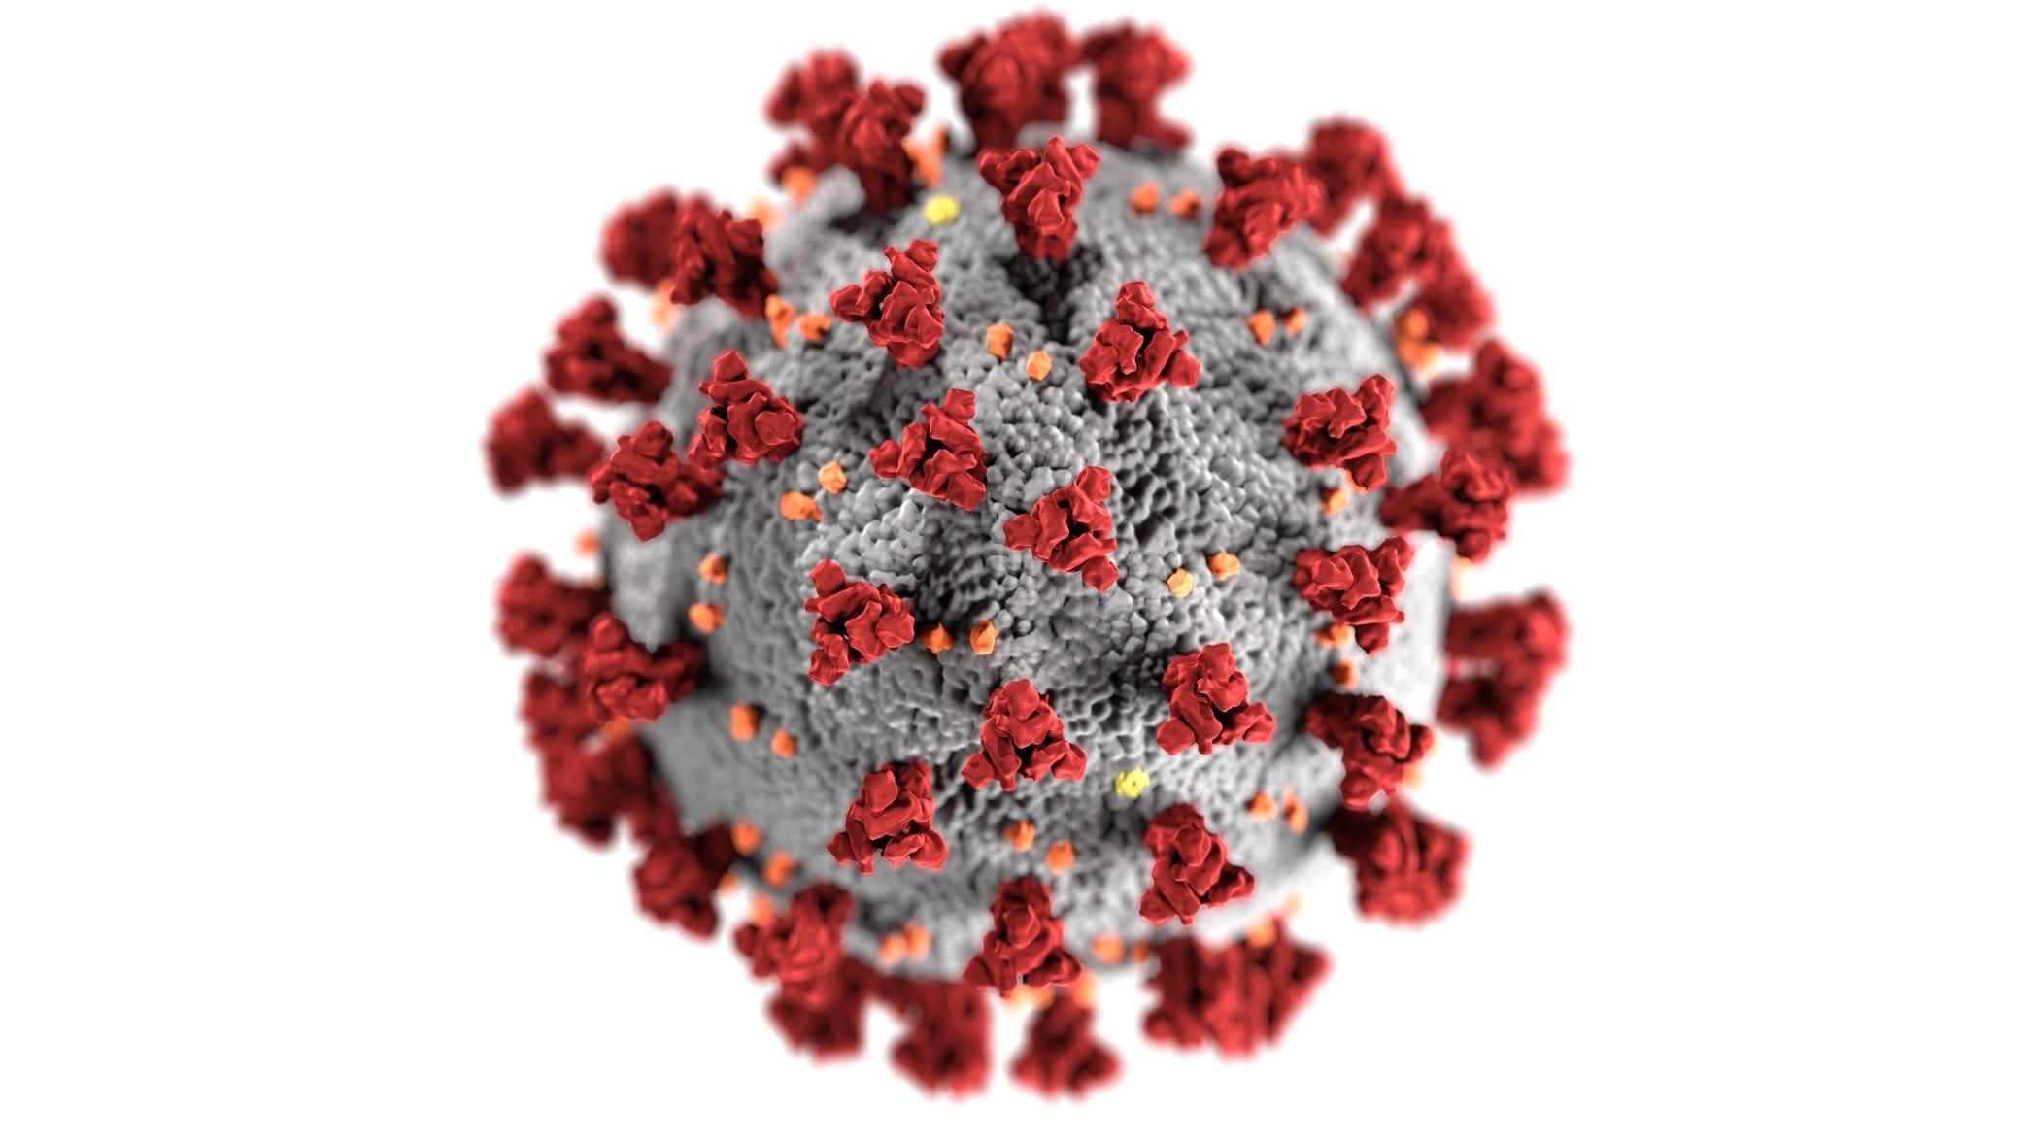
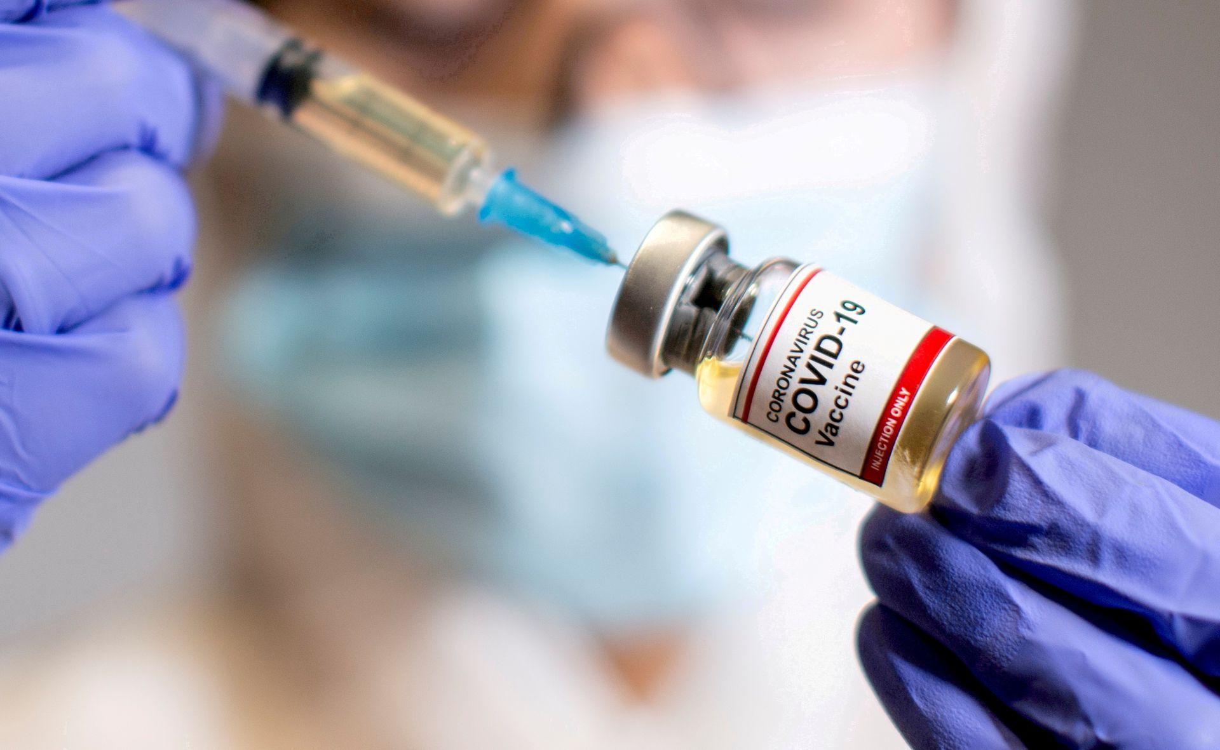
Public Health
Covid-19 as a “hoax”
Vaccines
https://rsc-src.ca/en/voices/conspiracy-theorists-are-falsely-claiming-that-coronavirus-pandemic-is-elaborate-hoax
https://globalnews.ca/news/8450263/infodemic-covid-19-disinformation-canada-pandemic/

Slide 15
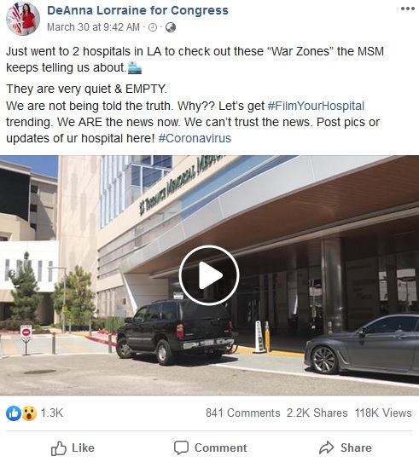
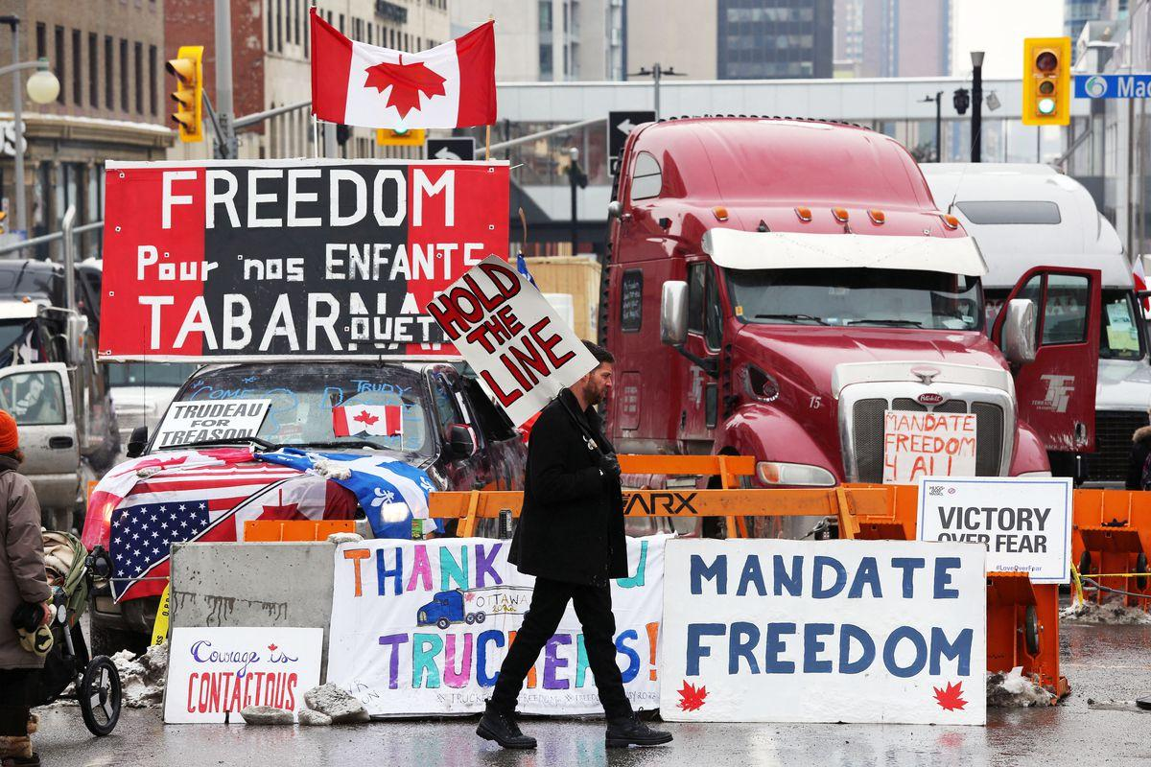
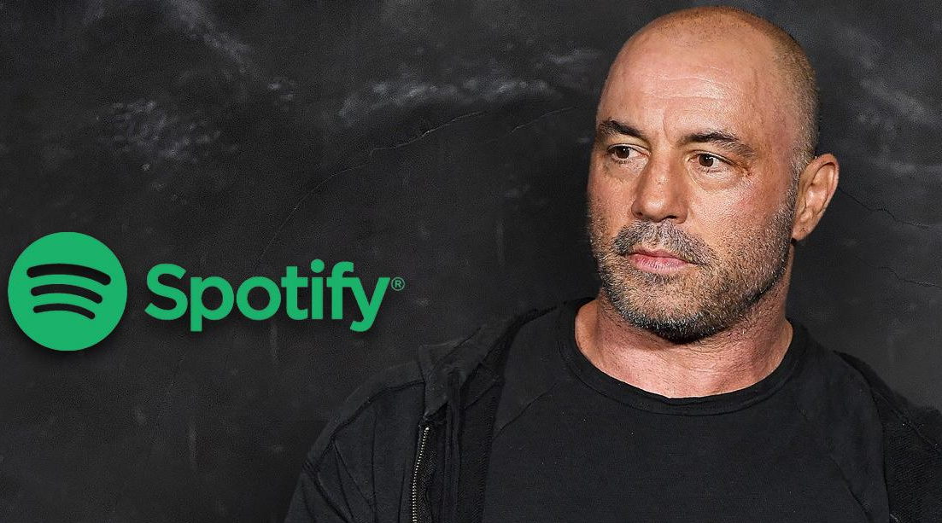
Examples
#FilmYourHospital
Joe Rogan
Freedom Convoy
https://www.rollingstone.com/culture/culture-news/covid-misinformation-joe-rogan-spotify-petition-1282240/
https://www.theglobeandmail.com/opinion/article-the-trucker-convoy-shows-how-canadians-are-being-sucked-into-larger/
https://www.theverge.com/2022/2/19/22941291/facebook-canada-trucker-convoy-gofundme-groups-viral-sharing

Slide 16
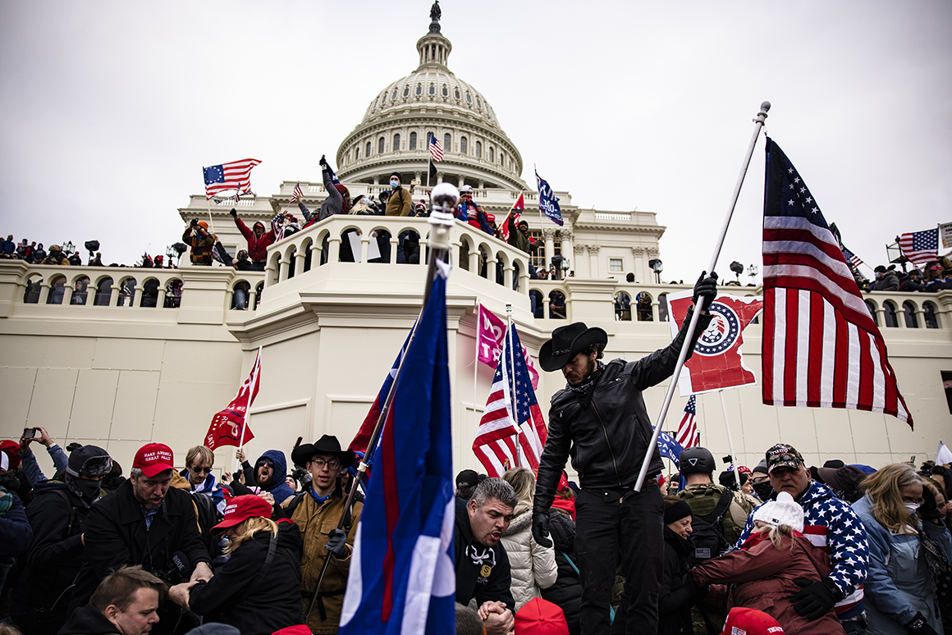
Politics
2020 US Presidential Election
January 6th insurrection
https://www.washingtonpost.com/politics/2022/01/06/january-6-attack-capitol-guide-what-we-now-know/
https://www.vox.com/recode/22221285/trump-online-capitol-riot-far-right-parler-twitter-facebook

Slide 17
Discussion Question: Can you think of any consequences of such misinformation consumption?

Slide 18
Consequences of Disinformation Consumption
Distrust in Media
Attention Economy
Further Radicalisation
People living in an echo chamber and refusing to be corrected
https://datasociety.net/library/media-manipulation-and-disinfo-online/
https://techpolicy.press/why-people-believe-misinformation-and-resist-correction/

Slide 19

Reforms
Harmful Content Online Bill
https://globalnews.ca/news/8353819/google-canada-online-hate-plan/
https://techpolicy.press/why-people-believe-misinformation-and-resist-correction/

