Slide 1
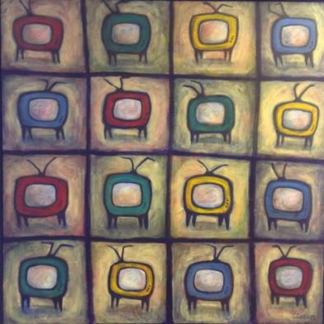
A Theory
Talk 7
Communications Law
Allard School of Law, UBC
Fall 2023
Jon Festinger K.C.
Allard Law of Law, UBC
QMUL School of Law (CCLS)
Of Counsel, chandler, fogden, lyman
https://commlaw.allard.ubc.ca/

Slide 2
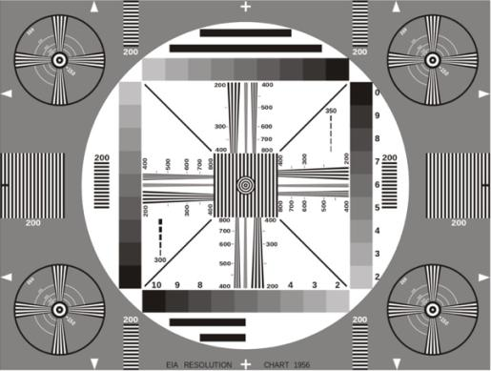
Permission to Record?

Slide 3
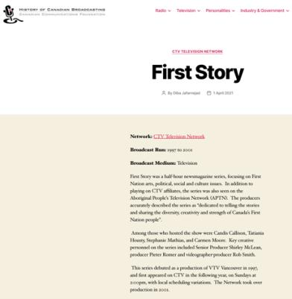
I would like to acknowledge that we are situated on the
traditional, ancestral, unceded territory of the Musqueam people.

Slide 4
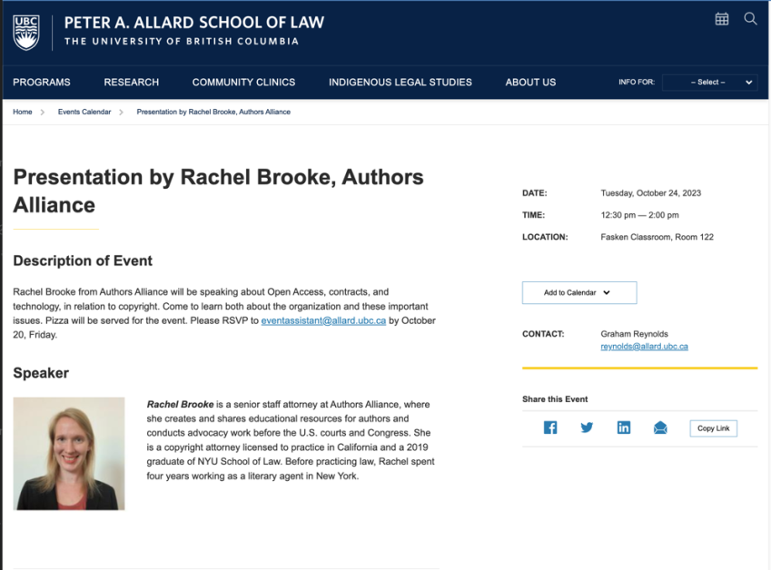

Slide 5
Group Presentation

Slide 6
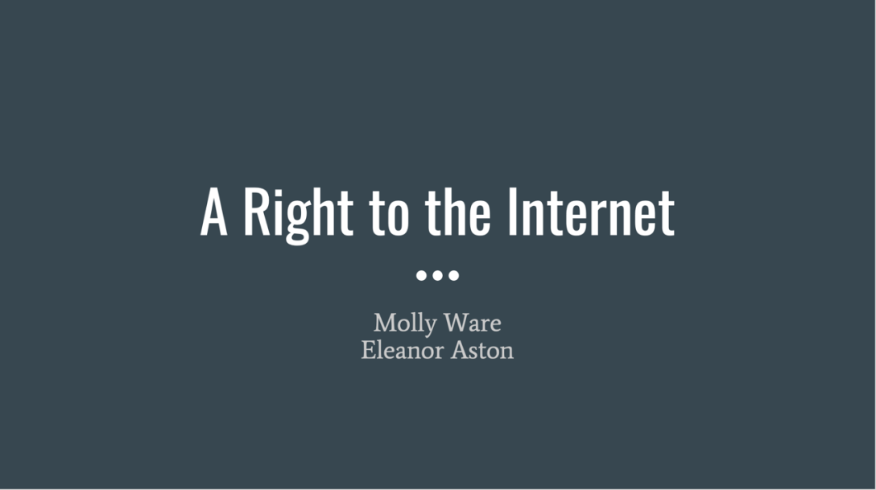

Slide 7
Logistics

Slide 8
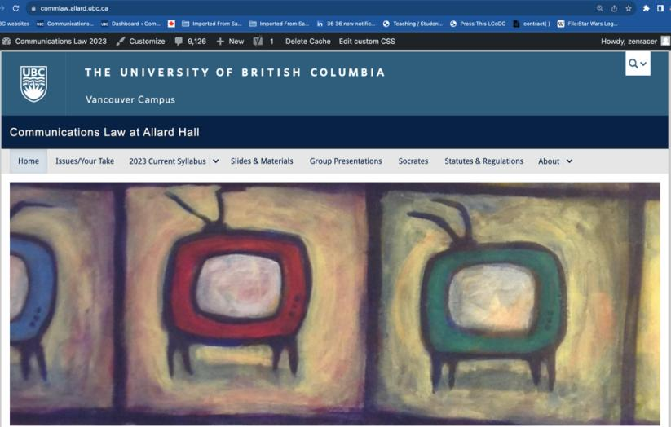
https://commlaw.allard.ubc.ca/

Slide 9
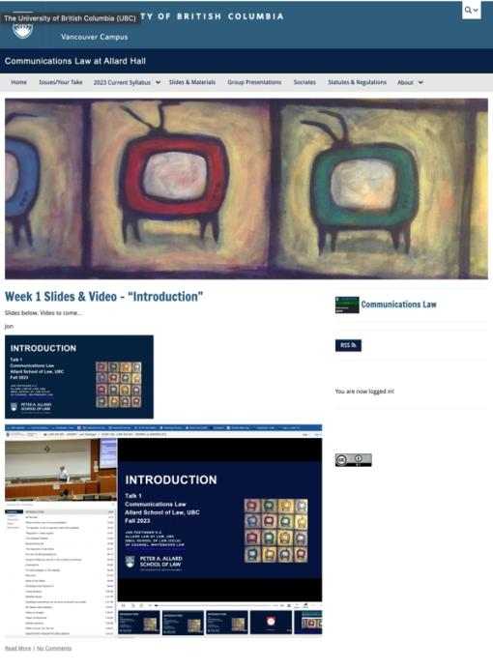

Slide 10
For full privileges on the website
1. Please create an account at http://cms.ubc.ca/ using your CWL.
2. Once you create an account and sign in at http://cms.ubc.ca/ you can click your name in the top right. Half-way down the following page will be your WordPress email address.
3. Send me your WordPress email address at jfestinger@telus.net or at jon.Festinger@ubc.ca
4. Then, I will invite you to participate with authoring privileges via your WordPress email address.

Slide 11
Why post?
Engaging and engaging others is the key.
Because you don’t love speaking up in class.
Because you just saw something, and you’ll never remember it unless you post it now.
Please sign your name to your post

Slide 12
“Living” Syllabus

Slide 13
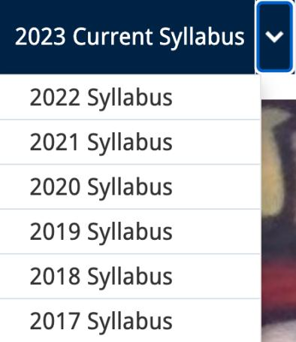
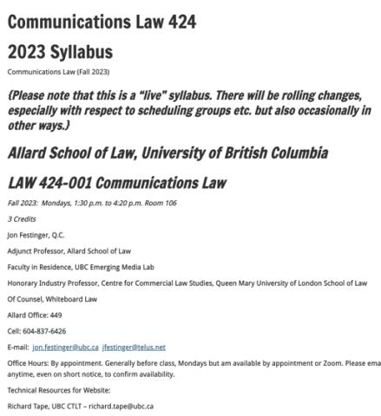

Slide 14
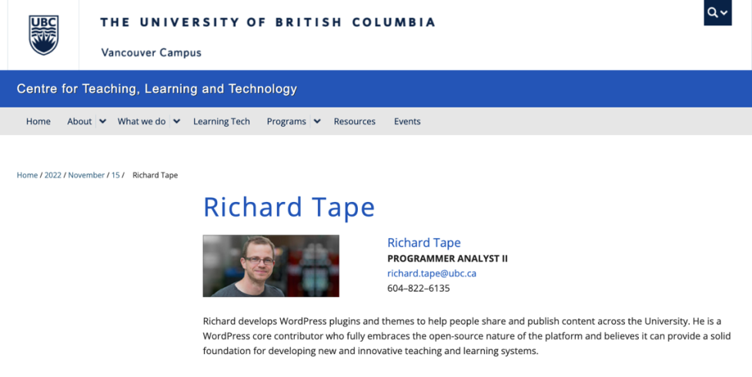
Website issues…

Slide 15
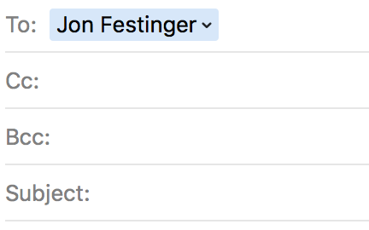
Anything & everything can be
done via email if you prefer

Slide 16
Notes on Grades
Scale-down tendency (ok, after 30 years it’s more than a tendency…)
Paper is 60%. Participation is 40%. In-class, website, email, presentations, anything you want to do (within reason)…
Presentations: Group or Individual. Engaging your classmates is the key.
Presentation and paper can be related

Slide 17
Paper Confessional (or what I learned one winter holiday)
Legal/normative reasoning/argument including footnote/bibliography support & Contribution/Move forward → 60%
Presentation including layout, headings, grammar, language/writing skills, “tightness” → 25%
Topic/Originality/Degree of Difficultly → 15%
THIS IS NOT A RUBRIC. IT IS A SELF ASSESSMENT.

Slide 18
Will read: drafts…outlines…synopsis……abstracts…etc.
As late as I can…
Due last day of exams by 4:00 PM.
Send in papers by email. Make sure you get acknowledgment of receipt.

Slide 19
Grades (primarily)
Paper → Quality
Participation → Effort

Slide 20
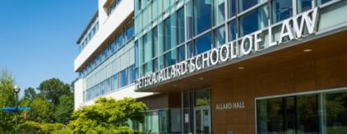
Office “Hours”: You Tell me
Room 449
Email me jon.Festinger@ubc.ca jfestinger@telus.net
Text:
c. 604-837-6426

Slide 21
QUESTIONS
THOUGHTS
DISCUSSION

Slide 22
Humour of the Week

Slide 23
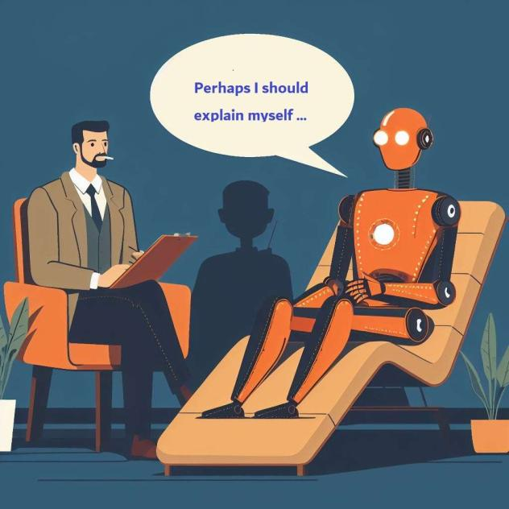

Slide 24
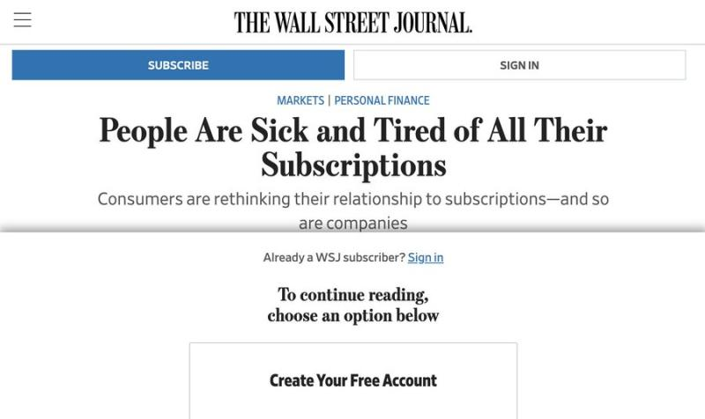

Slide 25
QUESTIONS
THOUGHTS
DISCUSSION

Slide 26
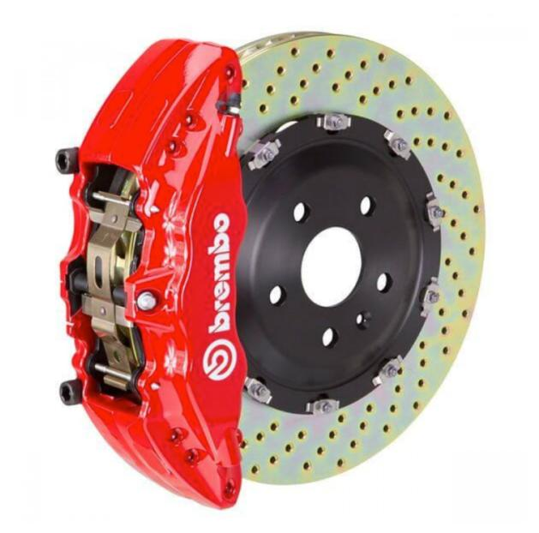

Slide 27
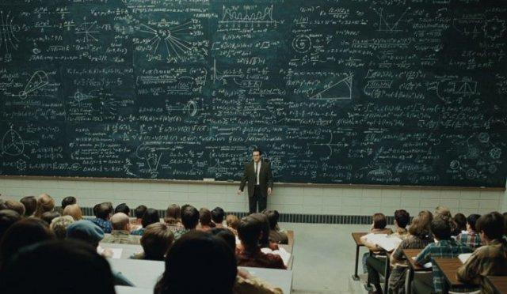
A Theory of Future Media?…

Slide 28
Sub Nom:
THE END OF
ENTERTAINMENT
(as we know it)

Slide 29
Perspective

Slide 30
Aligning Vectors

Slide 31
Vectors 1:
A. Everyone is a creator.
B. Everyone is a story.

Slide 32
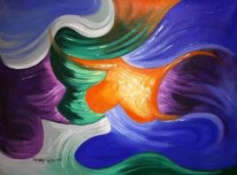
Deeply rooted…
Genesis 1:
So, God created humankind
in the image of God…

Slide 33
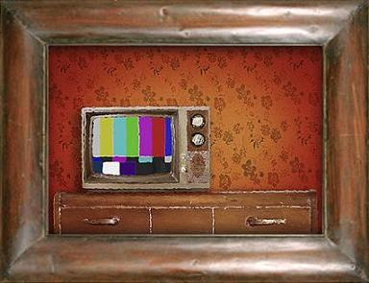

Slide 34
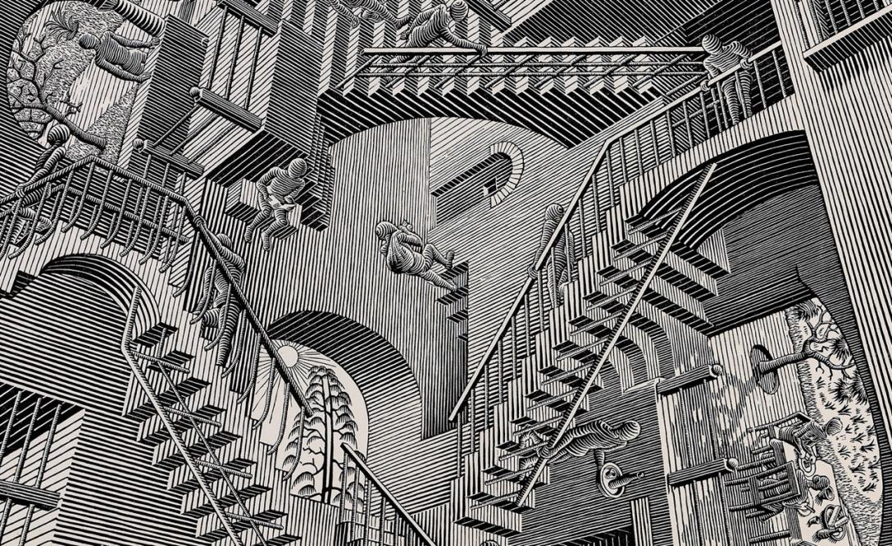

Slide 35
*Footnote to Vectors 1
Can A.I. ever create?
Do we really create?

Slide 36
Vectors 2:
A. We are not the same.
B. We are diverse.
C. We interpret the same things differently.

Slide 37
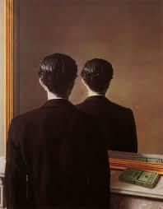
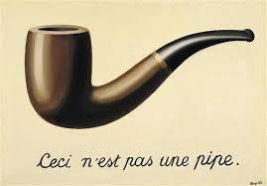
Post-Structuralism
René Magritte

Slide 38
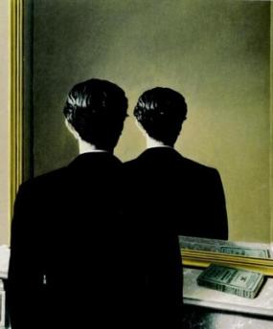
Post-Structuralism encourages/reinforces/represents the value of human agency, choice, & creativity.
Rene Magritte
“Not to be
Reproduced”
1937

Slide 39
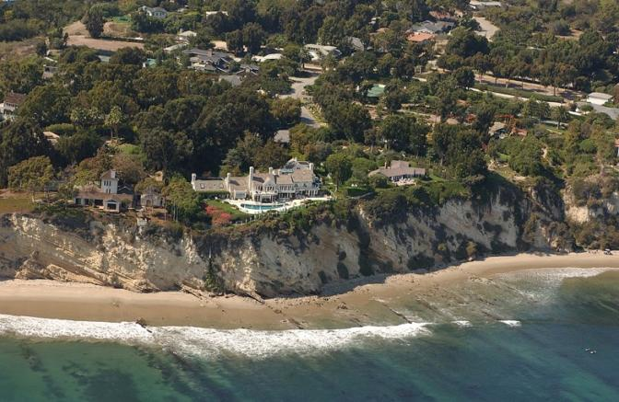
Post Structuralist consequence – The Streisand Effect Losing control of intended meanings

Slide 40
Vector 3:
Why We Engage With Media

Slide 41
Sub-Theory:
Self narrative enabled by
media & entertainment
(raw materials already workshopped)
Perhaps an antidote to the “realist”
view of life which can be bleak.

Slide 42
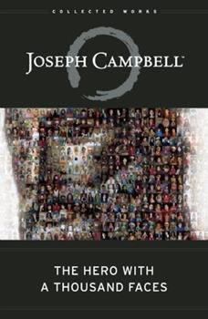

Slide 43
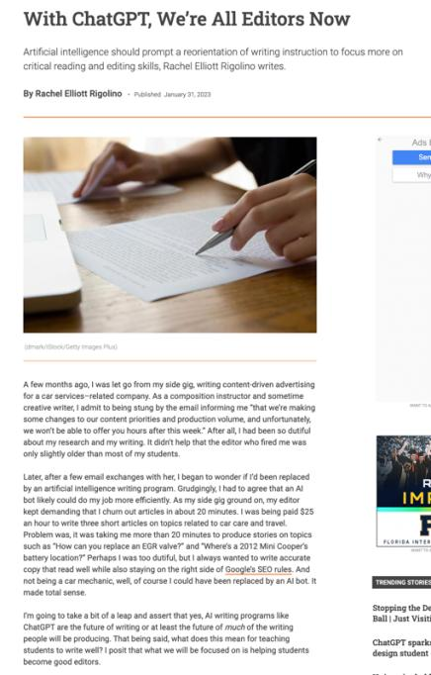

Slide 44
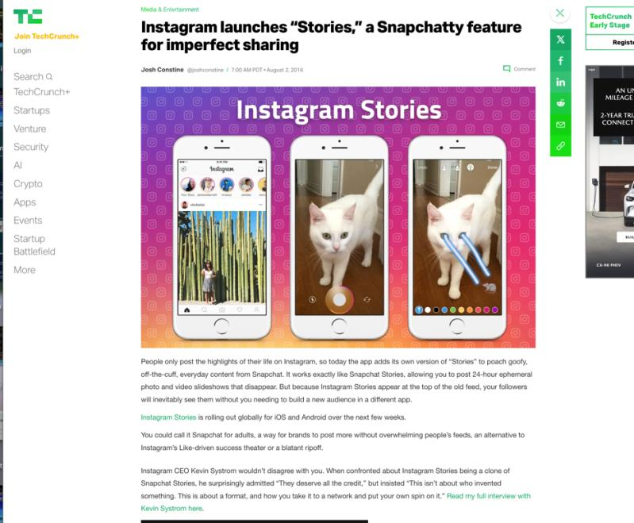

Slide 45
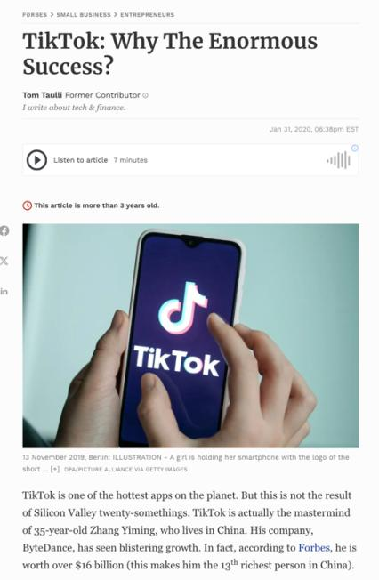

Slide 46
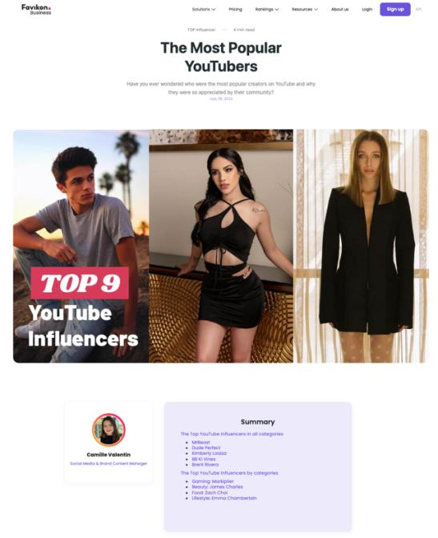

Slide 47
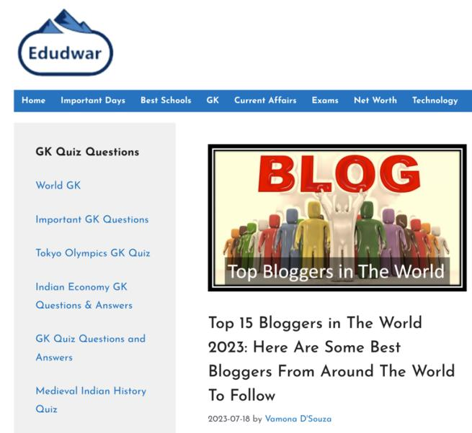

Slide 48
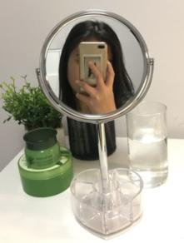
Vectors 4:
A. Technology Controls Images.
B. Technology Images Control.

Slide 49
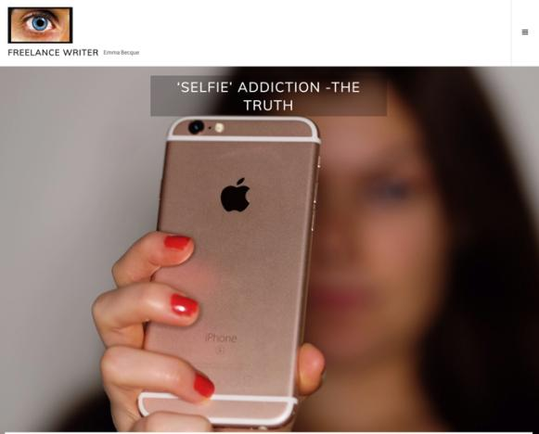
Form Over Substance?
Or an Additional Form of Substance?

Slide 50
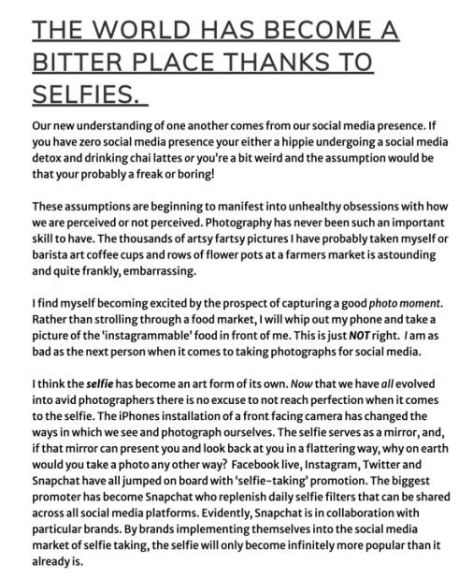

Slide 51
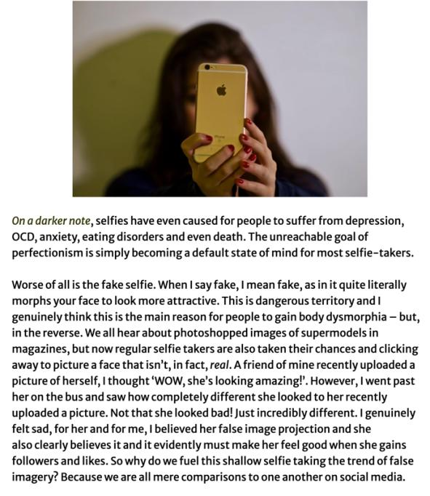

Slide 52
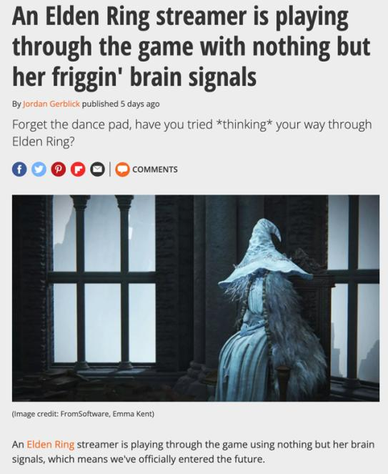
*if it bleeds it leads

Slide 53
McLuhan – sort of…
“We become what we behold. We shape our tools and then our tools shape us.”
From an article by Father John Culkin about McLuhan: Culkin, J.M. (1967, March 18). “A schoolman’s guide to Marshall McLuhan”. Saturday Review, pp. 51-53, 71-72

Slide 54
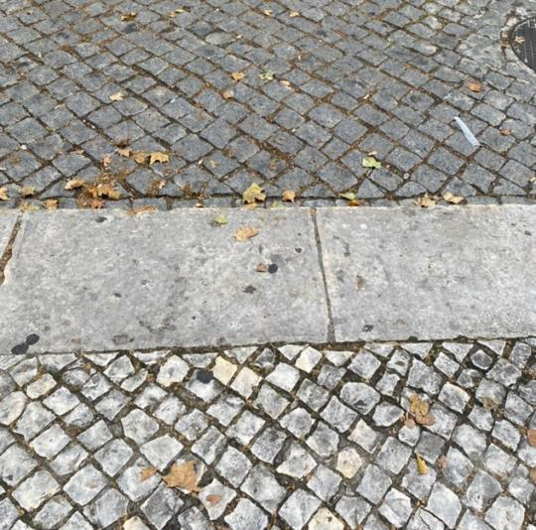
Portugal

Slide 55
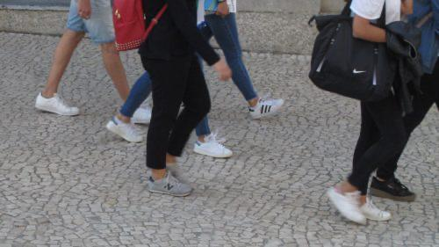

Slide 56
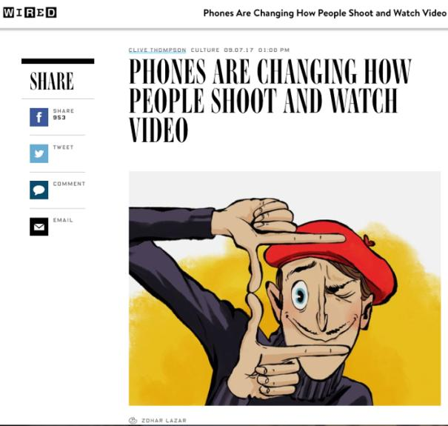

Slide 57
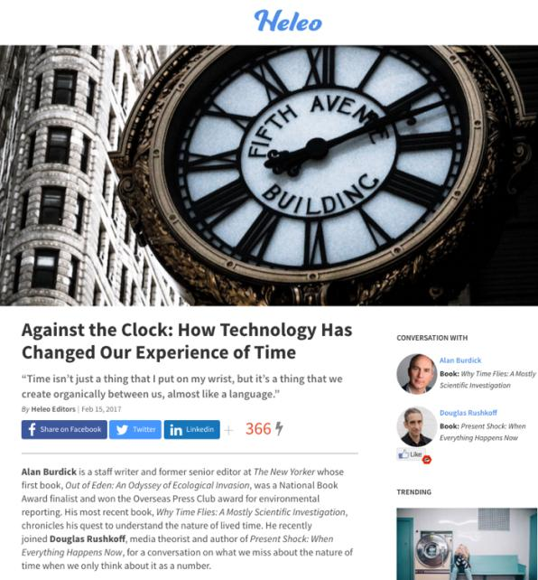

Slide 58
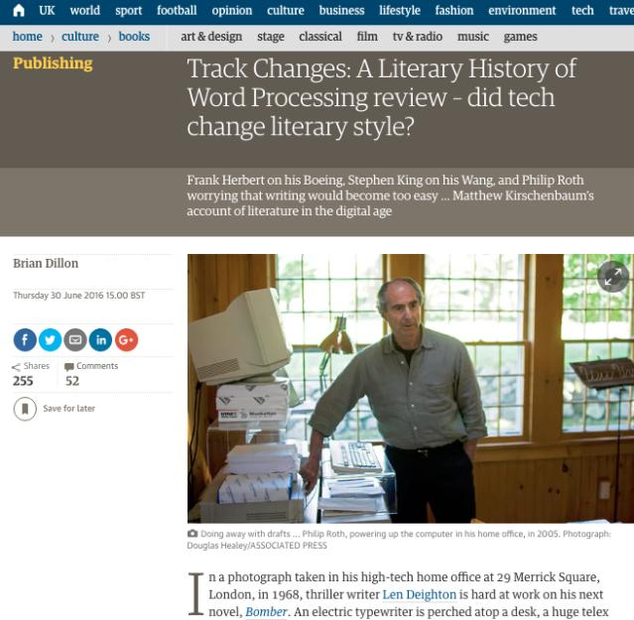

Slide 59
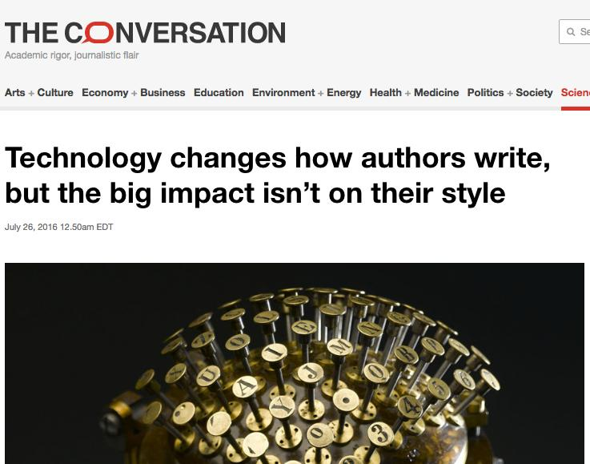

Slide 60
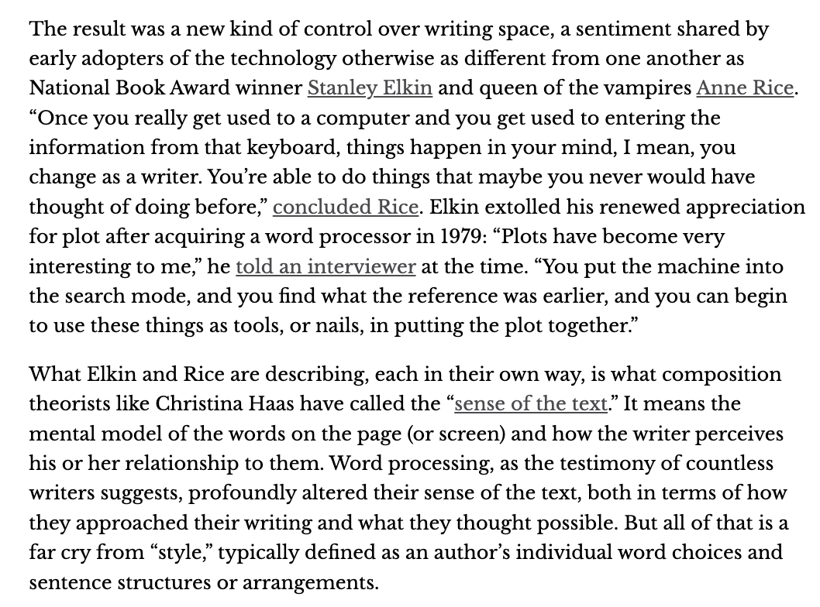

Slide 61
“Technology is a useful servant but a dangerous master.”
Christian Lous Lange, Noble Peace Prize (1921)

Slide 62
“…there is a delicate balance between appropriating new technologies and being appropriated by them.”

Slide 63
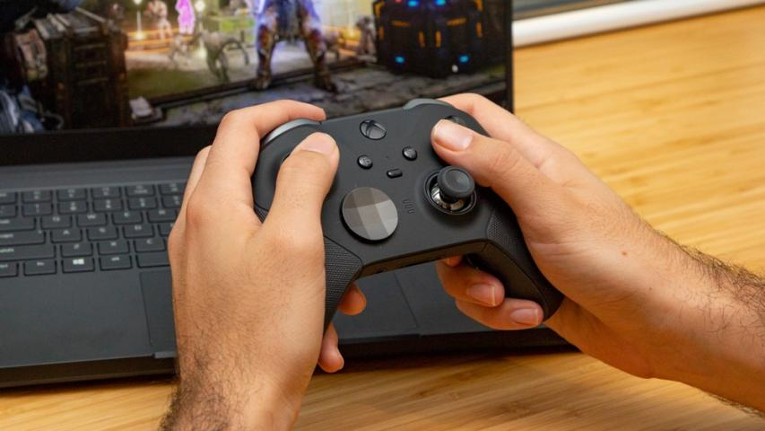
Controller as both Metaphor & Reality

Slide 64
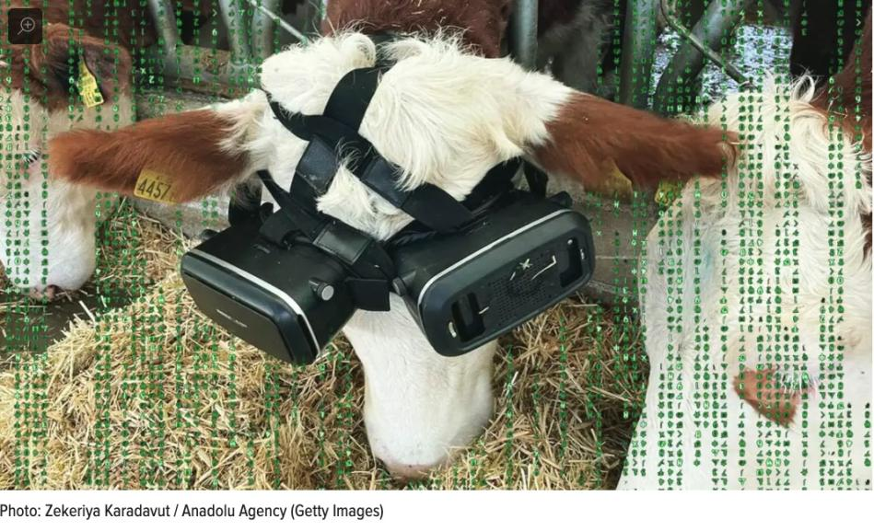

Slide 65
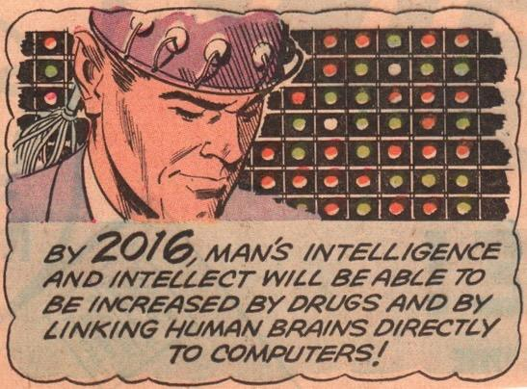

Slide 67
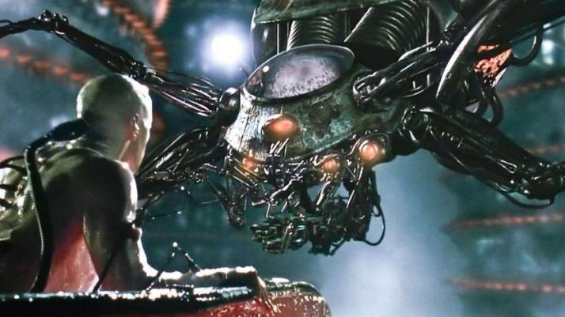
Who/What is
Controlling Who?
Neo – The Matrix

Slide 68
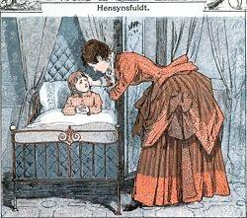
The illusion of choice…

Slide 69
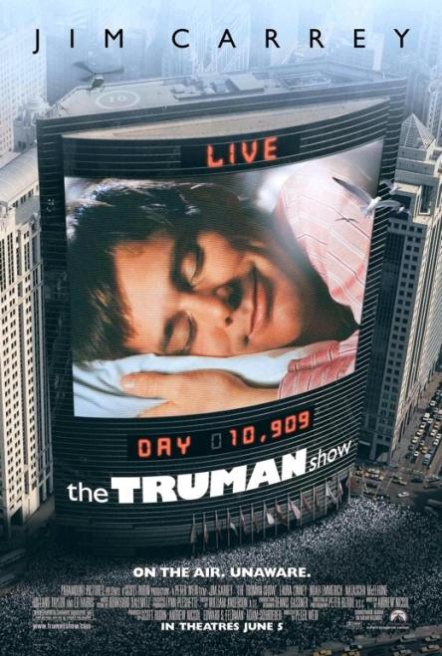
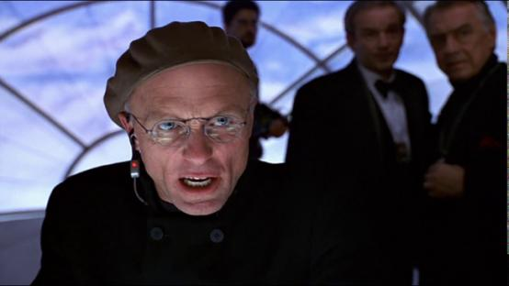

Slide 70
What we can’t see, can hurt us.

Slide 71
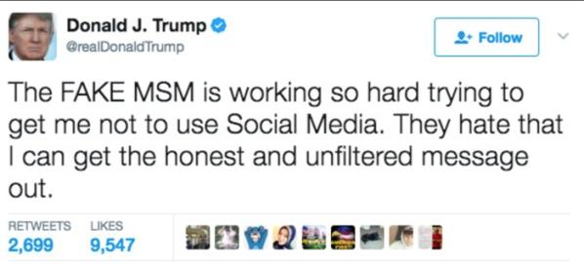
The irony of calling
traditional news “fake”
from a digital media platform.

Slide 72
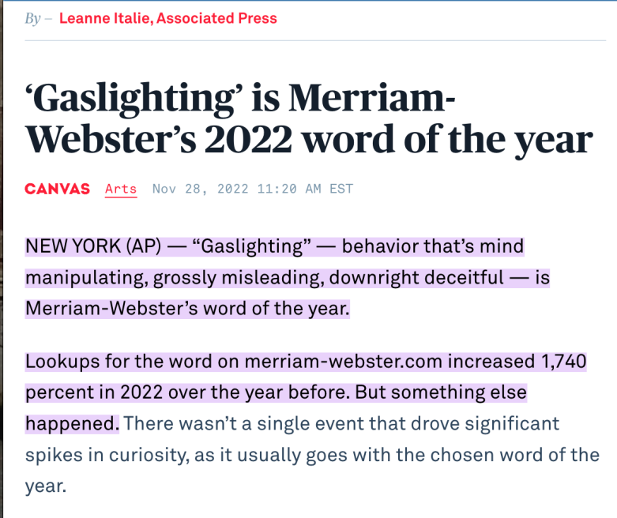

Slide 73
Is the theory of cognitive dissonance
applicable to digital media systems ?

Slide 74
Seems like YES

Slide 76
Meaning…
If the internet is indeed a social (media) system,
those most harmed are likely to be the most fervent
supporters of the (oppressive) system…

Slide 79
Vector 1:
Everyone is a creator
Everyone is a story

Slide 80
Vector 2:
We are not the same
We are diverse
We interpret the same things differently

Slide 81
Vector 3:
Why We Engage With Media

Slide 82
Vector 4:
Technology Controls Images
Technology Images Control

Slide 84
Vector 5:
Digital

Slide 85
Is there an inherent limitation to the completely binary language of only 1’s & 0’s?

Slide 86
Broadcast paradigm overturned by games and social media where user controls & the “world” seems to form around them.
TV Transmitters
Minecraft

Slide 87
Enables: Everyone is a creator

Slide 88
Enter Devices that measure you.

Slide 89
The Metaverse = Life Through Digital Lenses

Slide 90
We became data outputs…

Slide 94
Dark Patterns

Slide 96
Loot-boxes
as Manipulation

Slide 101
& sometimes there are no words other than “sick & evil”…

Slide 104
Digital Reality is very structured

Slide 105
Creative freedoms/human agency may have an inverse relationship to the degree of technology (?).
8000 BC
3500 BC
1440 AD
1876 AD
1894 AD
1927 AD
1943 AD

Slide 106
Technology is (very) Structuralist

Slide 107
Vector 6:
A.I.

Slide 108
A.I. Metaphor For A.I.
A.I. as Constructed Reality/Distorted Mirror

Slide 109
+
Edward Lewis/Vivian Ward

Slide 111
=
Rachel Zane/
Michael Ross

Slide 117
“Hallucinations”
=
Anthropomorphizing

Slide 119
Sony Aibo

Slide 120
WE TRUST
FORM OVER SUBSTANCE?

Slide 121
What A.I. is missing
Compassion
Critical thinking
Ability to generate new
(circuitous analysis of refracted
and reflected data)

Slide 122
Bad Bots…

Slide 123
When A.I. Can Do This…
http://youtu.be/z8iEogscUl8

Slide 124
And This…

Slide 125
And This…

Slide 126
It probably already can!

Slide 127
But the Wizard will probably
still be human for now…

Slide 128
Vectors 7:
A. Everything is Entertainment.
B. We Are Each Others Entertainment.

Slide 134
Vector 8:
MEdia

Slide 135
What if an algorithm knew…
My favorite type of movie (romantic comedy)
My favorite stars (Anna Kendrick + “young” John Cusack)
My favorite screen writer (Adam Sorkin)
My favorite plot trope (time travel that teaches life lessons)
Plot points & dialogue that I laugh at
Plot points & dialogue that I cry at
Favorite music (Springsteen + The Clash)
My personality profile (in detail)
My personal history & biographical details (Dad passed of cancer; mom of Alzheimer’s; Parents both Holocaust survivors from Poland)
And everything else ascertainable about me including from publicly posted lectures on Allard Law course websites .

Slide 136
Fictional Storytelling uniquely tailored to me: At the extreme an algorithmically directed “The Truman Show”

Slide 137
Been done?

Slide 139
We are simultaneously both AUDIENCE & CO-CREATOR

Slide 143
ABOUT TO ARRIVE ?

Slide 147
THE END OF
ENTERTAINMENT
(as we know it)

Slide 148
Conclusion 1
Extreme Social Media:
We will be each be
& have the tools to be
the source of our own
and each others
entertainment “content”.

Slide 149
Conclusion 2
Extreme Social Media:
Future “content” will be
individual IMAGE-ings created by us
consciously or subconsciously
through A.I. tools that defy boundaries,
targeted consciously or subconsciously
at audiences of ourselves or each other .

Slide 153
QUESTIONS?
THOUGHTS?
DISCUSSION?

Slide 155
Canadian Content & The Law

Slide 156
A MATTER OF PERSPECTIVE

Slide 157
Perspective

Slide 159
Always include a cat picture

Slide 160
In learning you will teach
And in teaching you will learn
Phil Collins' Son of Man (1999)

