Slide 1
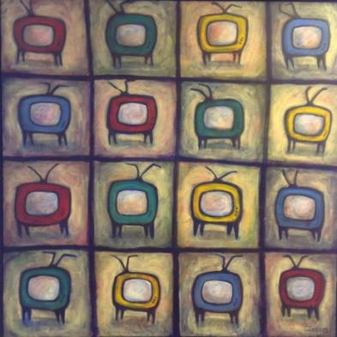
Theory POSTSCRIPTS
Talk 8
Communications Law
Allard School of Law, UBC
Fall 2023
Jon Festinger K.C.
Allard Law of Law, UBC
QMUL School of Law (CCLS)
Of Counsel, Chandler, Fogden, Lyman
https://commlaw.allard.ubc.ca/

Slide 2
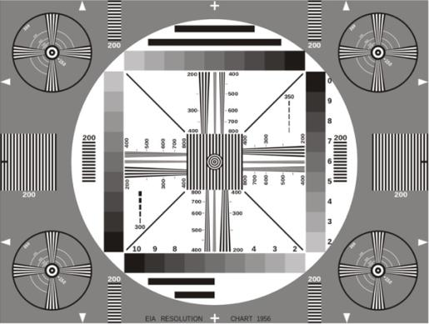
Permission to Record?

Slide 3
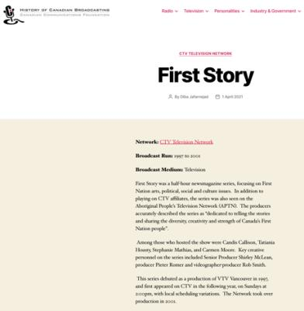
I would like to acknowledge that we are situated on the
traditional, ancestral, unceded territory of the Musqueam people.

Slide 4
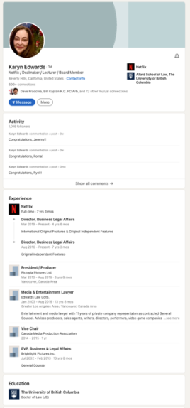
Special Guest

Slide 5
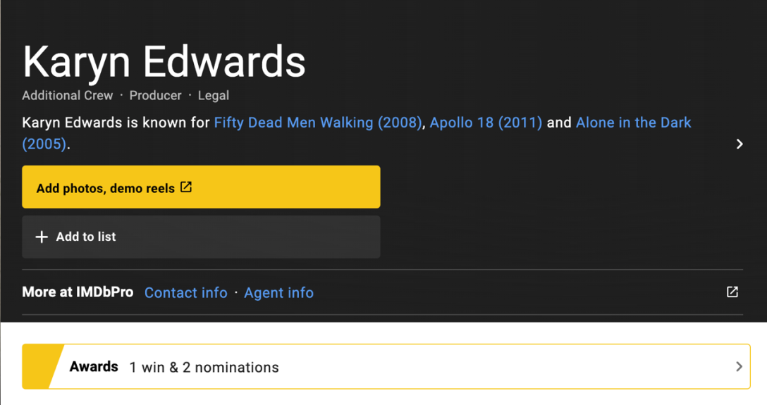
IMDB

Slide 6
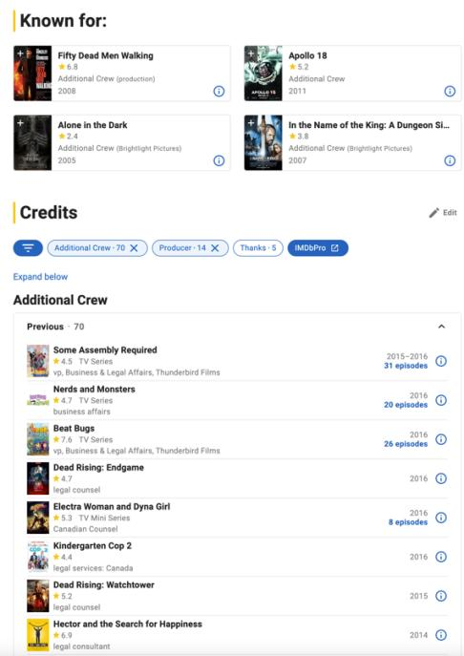

Slide 7
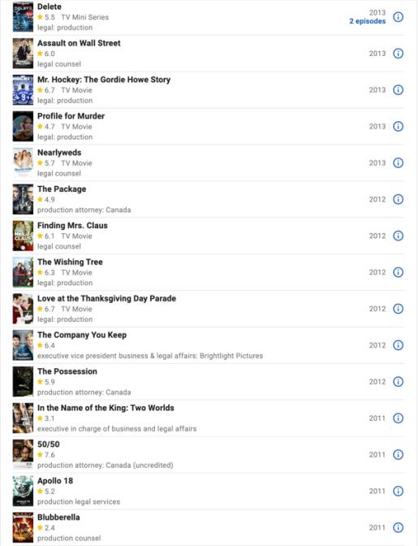

Slide 8
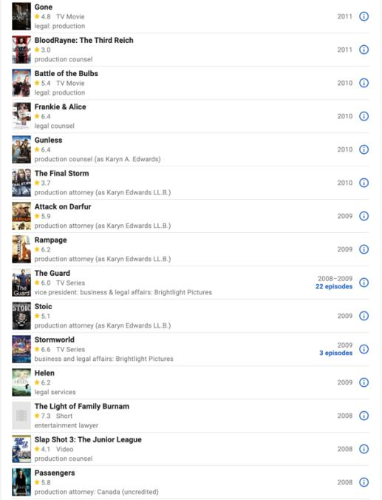

Slide 9
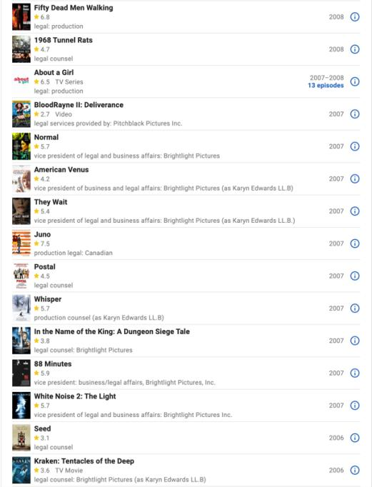

Slide 10
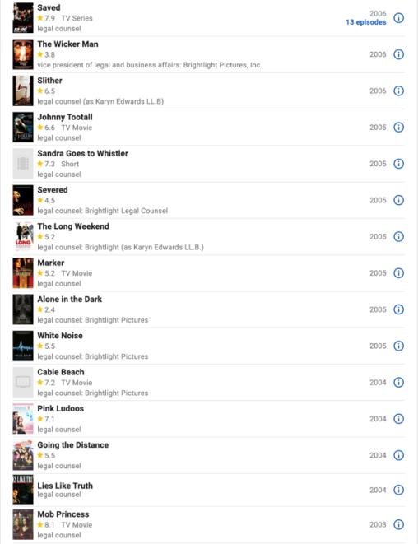

Slide 11
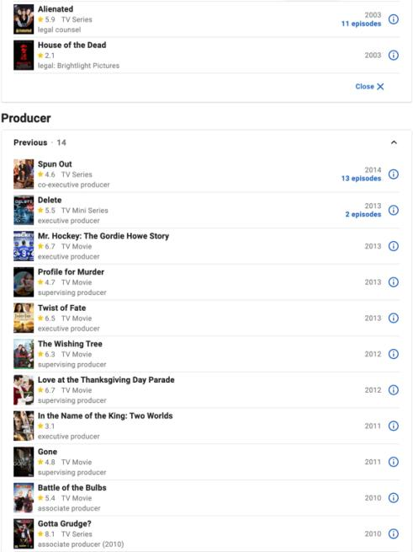

Slide 12
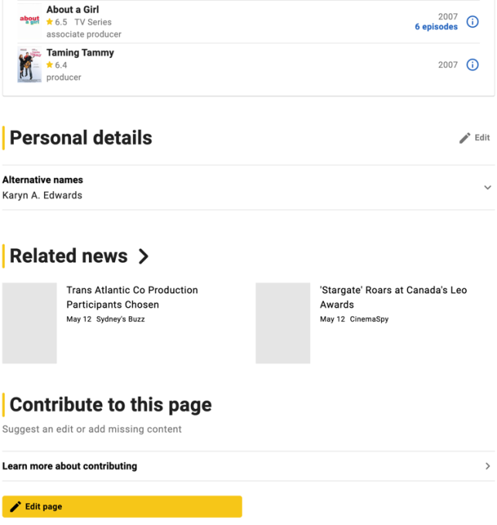

Slide 13
Logistics

Slide 14
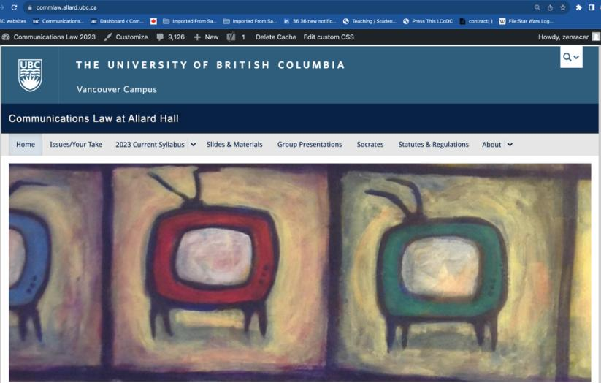
https://commlaw.allard.ubc.ca/

Slide 15
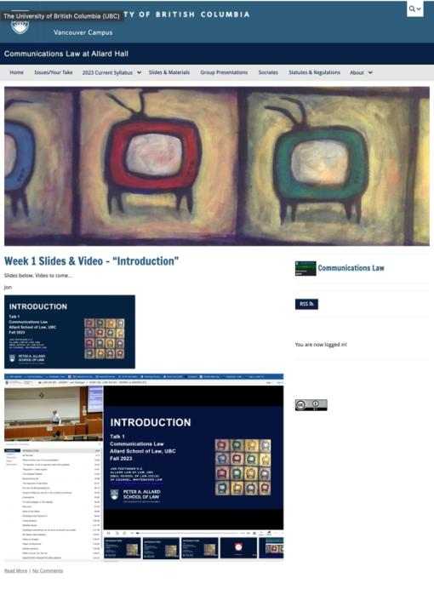

Slide 16
For full privileges on the website
1. Please create an account at http://cms.ubc.ca/ using your CWL.
2. Once you create an account and sign in at http://cms.ubc.ca/ you can click your name in the top right. Half-way down the following page will be your WordPress email address.
3. Send me your WordPress email address at jfestinger@telus.net or at jon.Festinger@ubc.ca
4. Then, I will invite you to participate with authoring privileges via your WordPress email address.

Slide 17
Why post?
Engaging and engaging others is the key.
Because you don’t love speaking up in class.
Because you just saw something, and you’ll never remember it unless you post it now.
Please sign your name to your post

Slide 18
“Living” Syllabus

Slide 19
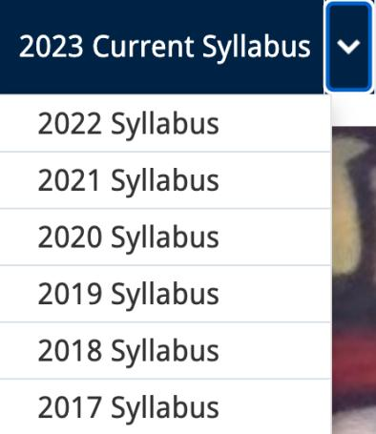
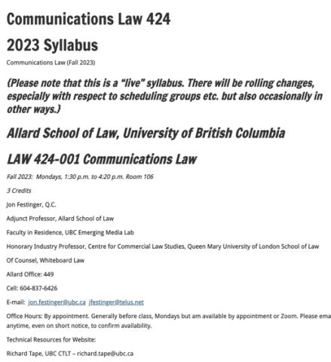

Slide 20
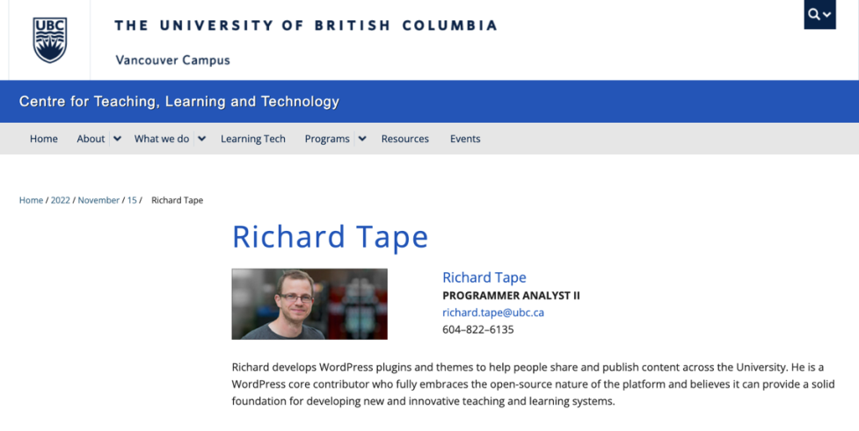
Website issues…

Slide 21
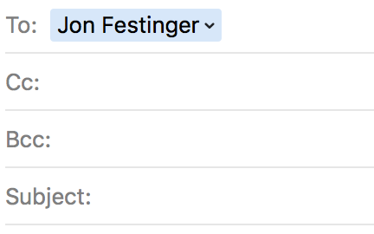
Anything & everything can be
done via email if you prefer

Slide 22
Notes on Grades
Scale-down tendency (ok, after 30 years it’s more than a tendency…)
Paper is 60%. Participation is 40%. In-class, website, email, presentations, anything you want to do (within reason)…
Presentations: Group or Individual. Engaging your classmates is the key.
Presentation and paper can be related

Slide 23
Paper Confessional (or what I learned one winter holiday)
Legal/normative reasoning/argument including footnote/bibliography support & Contribution/Move forward → 60%
Presentation including layout, headings, grammar, language/writing skills, “tightness” → 25%
Topic/Originality/Degree of Difficultly → 15%
THIS IS NOT A RUBRIC. IT IS A SELF ASSESSMENT.

Slide 24
Will read: drafts…outlines…synopsis……abstracts…etc.
As late as I can…
Due last day of exams by 4:00 PM.
Send in papers by email. Make sure you get acknowledgment of receipt.

Slide 25
Grades (primarily)
Paper → Quality
Participation → Effort

Slide 26
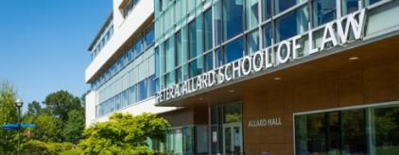
Office “Hours”: You Tell me
Room 449
Email me jon.Festinger@ubc.ca jfestinger@telus.net
Text:
c. 604-837-6426

Slide 27
QUESTIONS
THOUGHTS
DISCUSSION

Slide 28
Humour of the Week

Slide 29
Reality “Show”

Slide 30
QUESTIONS
THOUGHTS
DISCUSSION

Slide 31
News of the Weeks

Slide 32
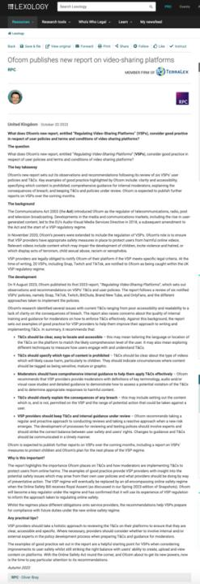

Slide 33
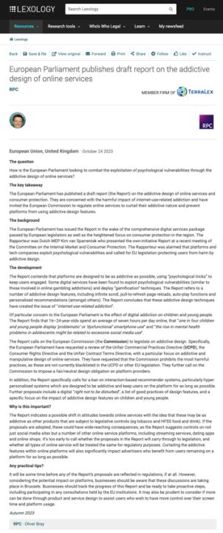

Slide 34
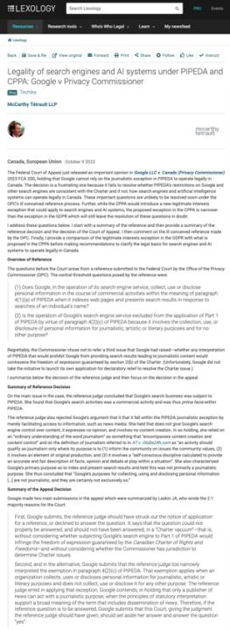

Slide 35
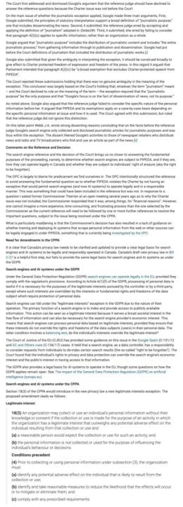

Slide 36
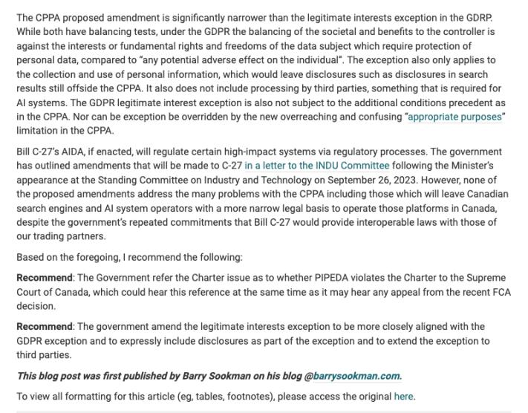

Slide 37
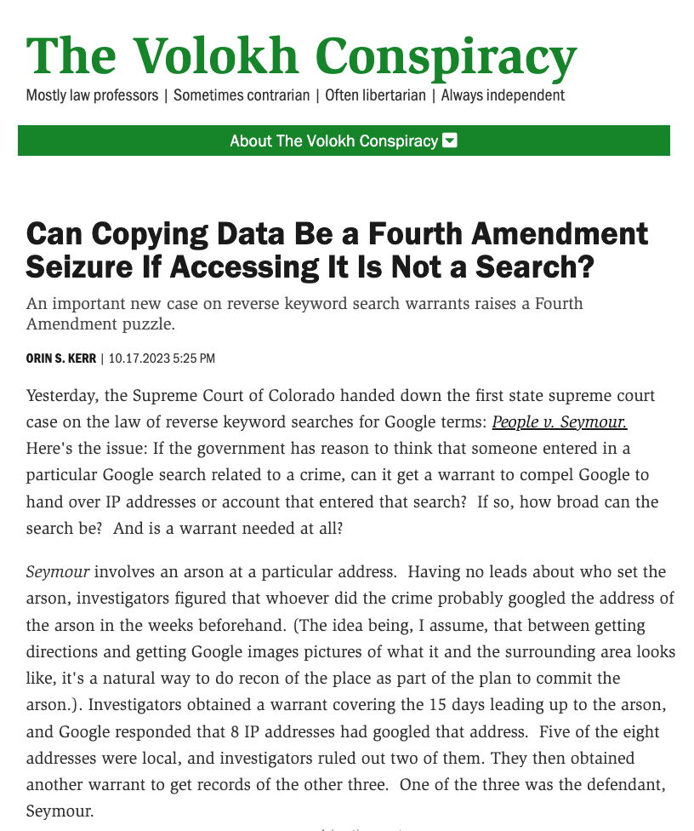

Slide 38
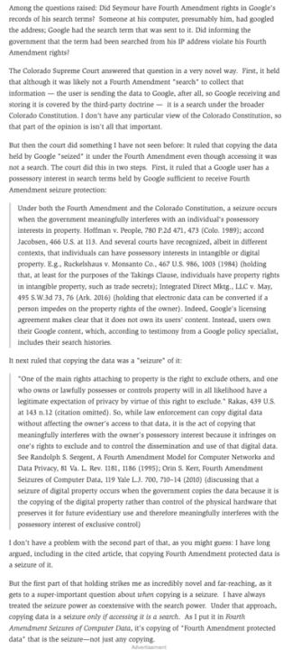

Slide 39
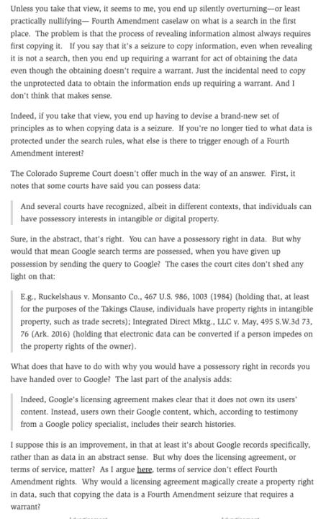

Slide 40
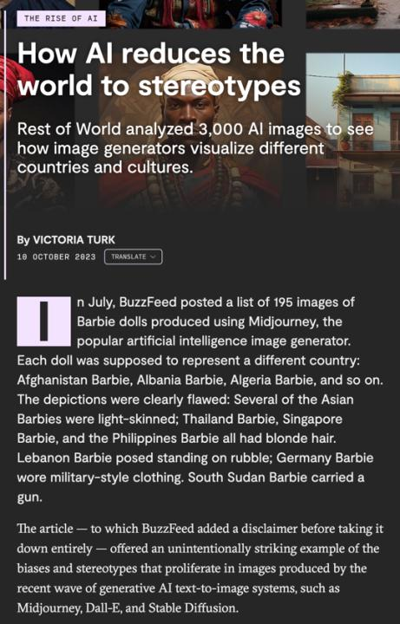

Slide 41
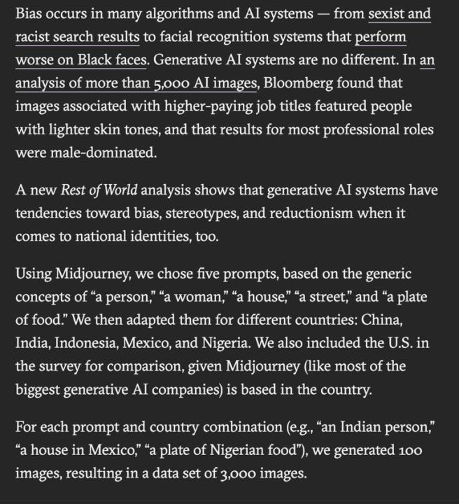

Slide 42
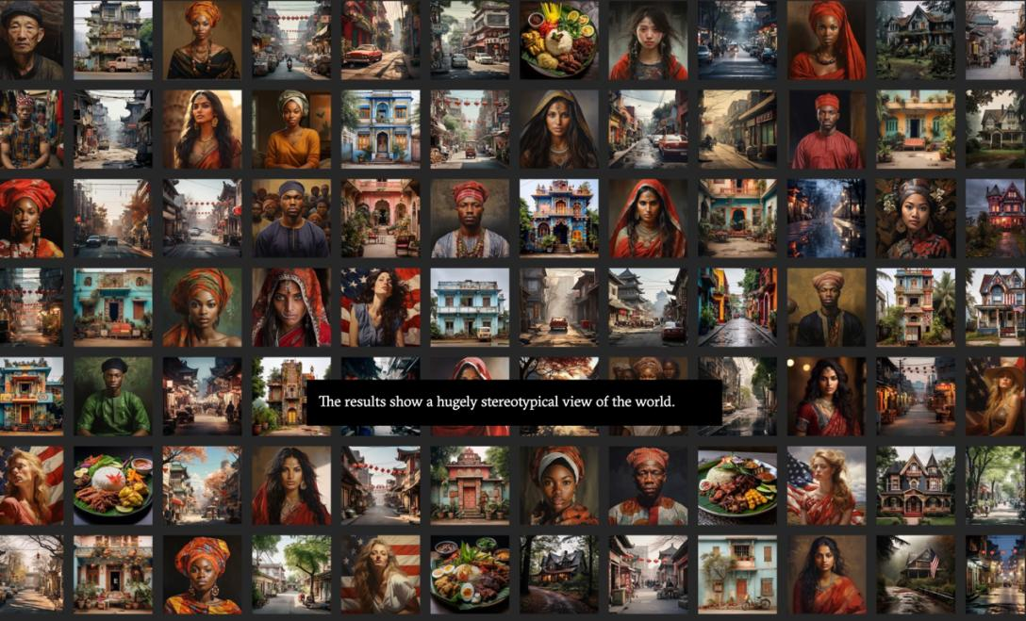

Slide 43
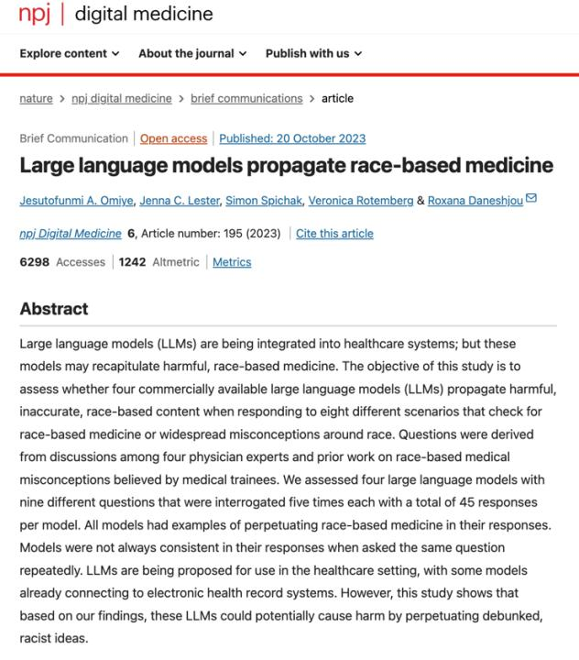

Slide 44
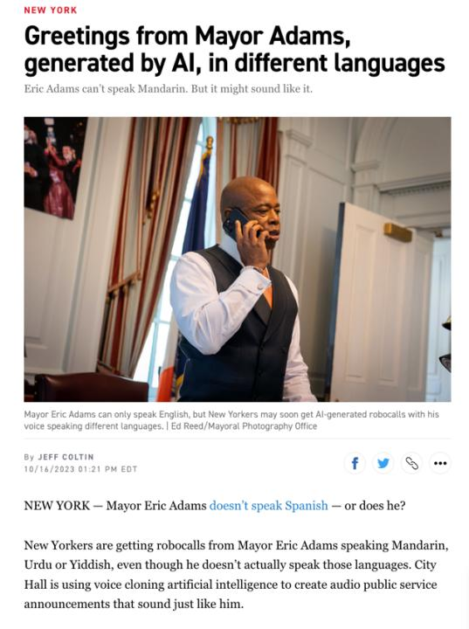

Slide 45
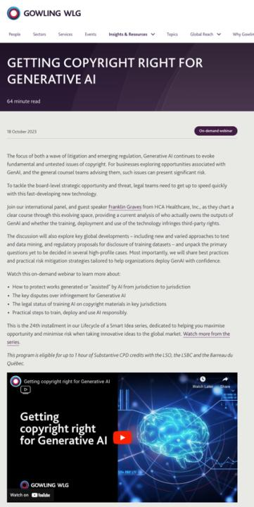

Slide 46
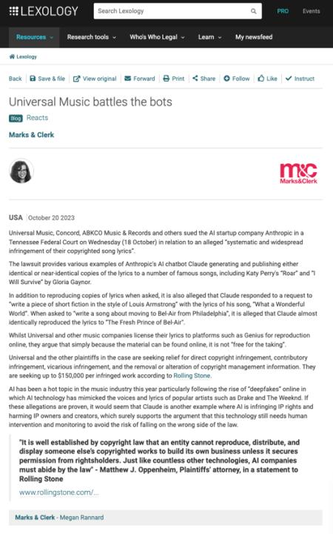

Slide 47
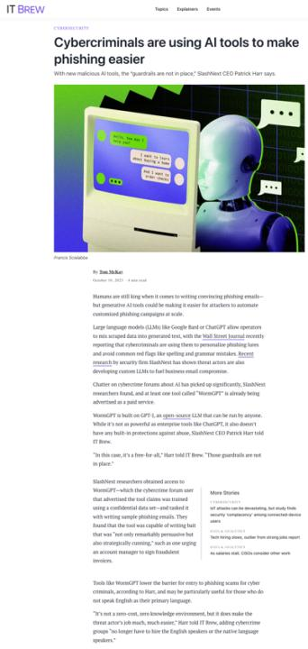

Slide 48
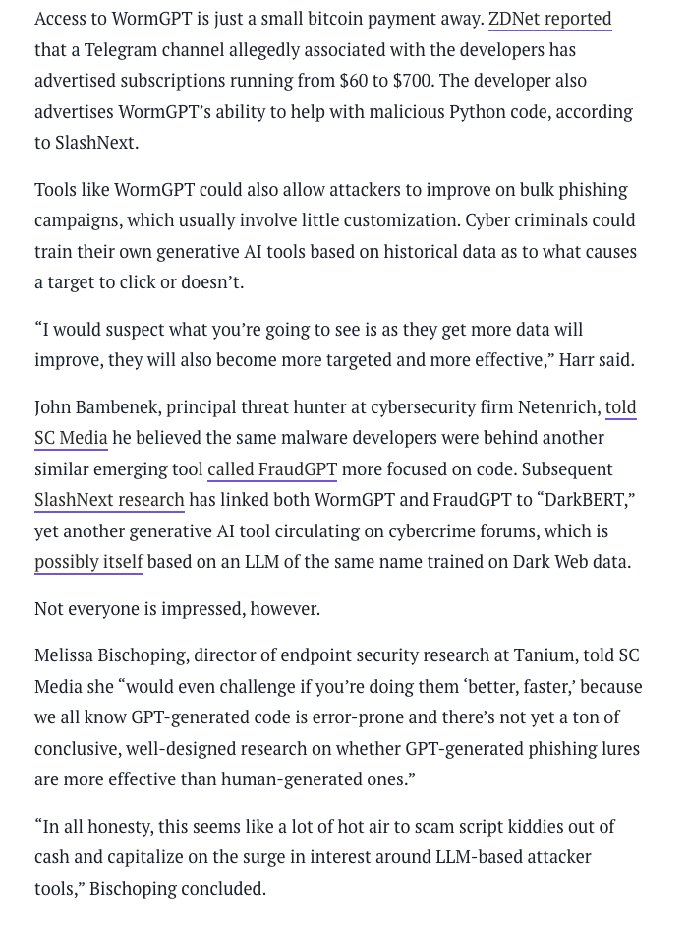

Slide 49
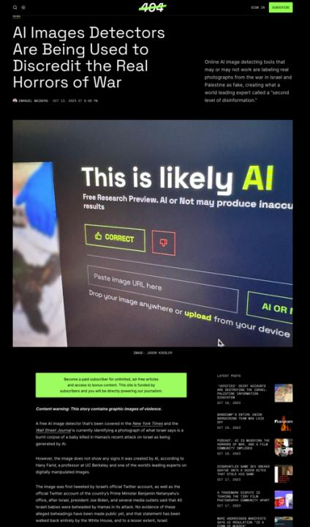

Slide 50
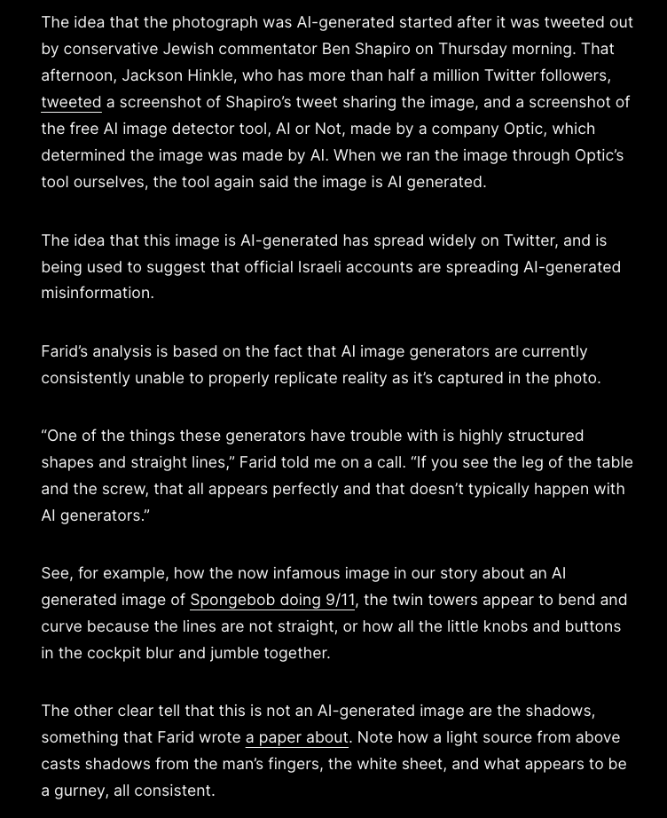

Slide 51
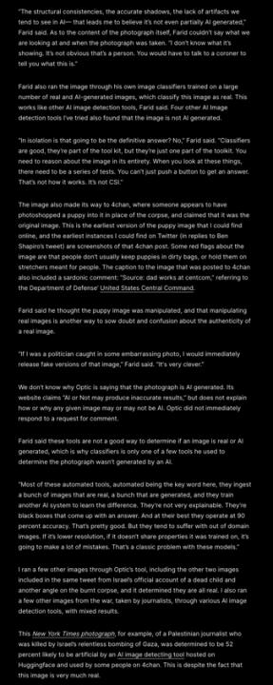

Slide 52
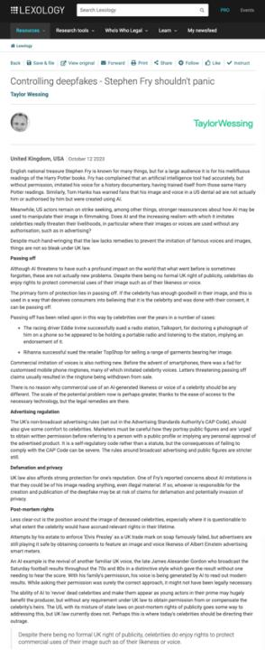

Slide 53
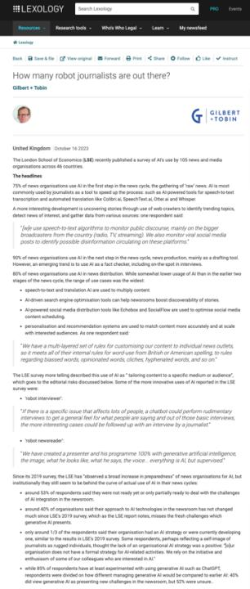

Slide 54
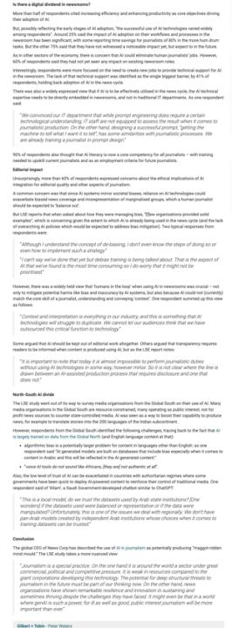

Slide 55
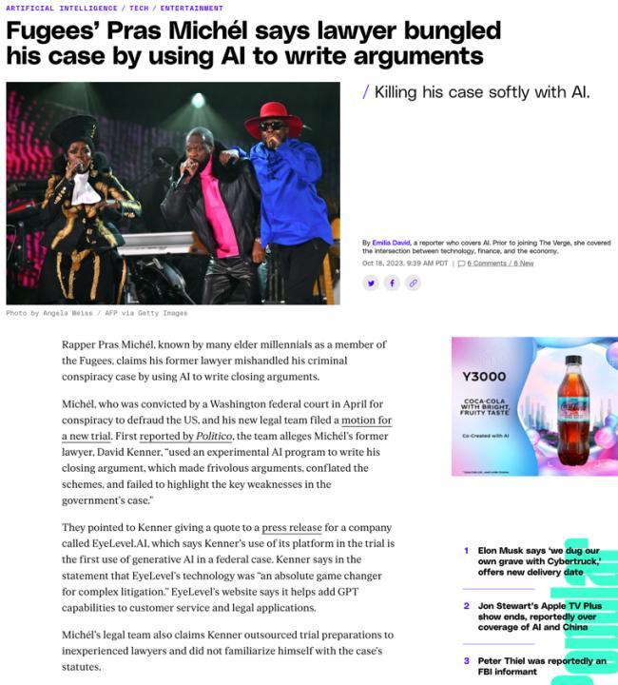

Slide 56
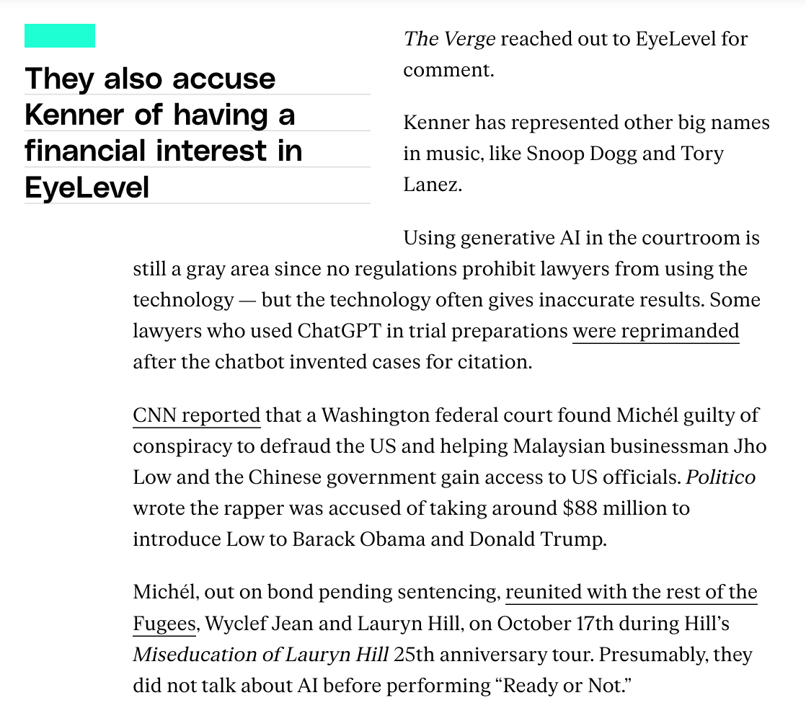

Slide 57
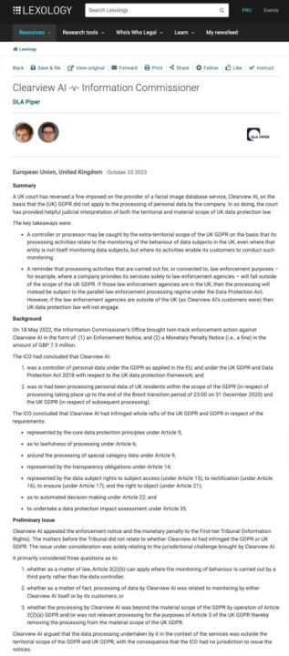

Slide 58
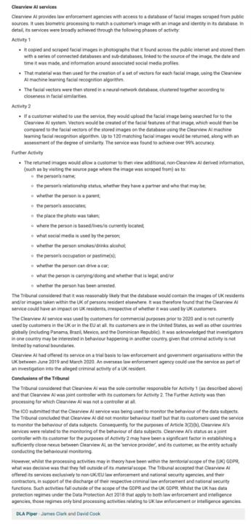

Slide 59
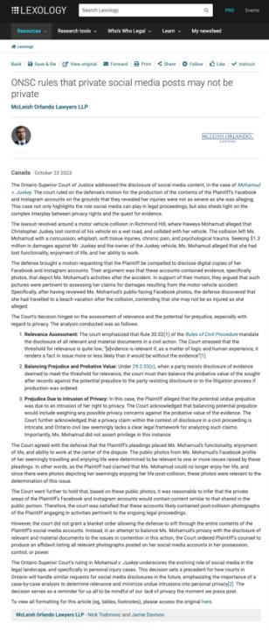

Slide 60
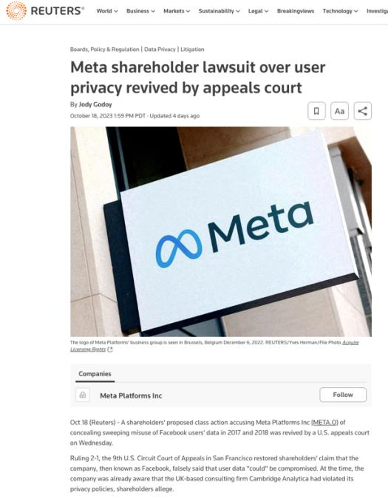

Slide 61
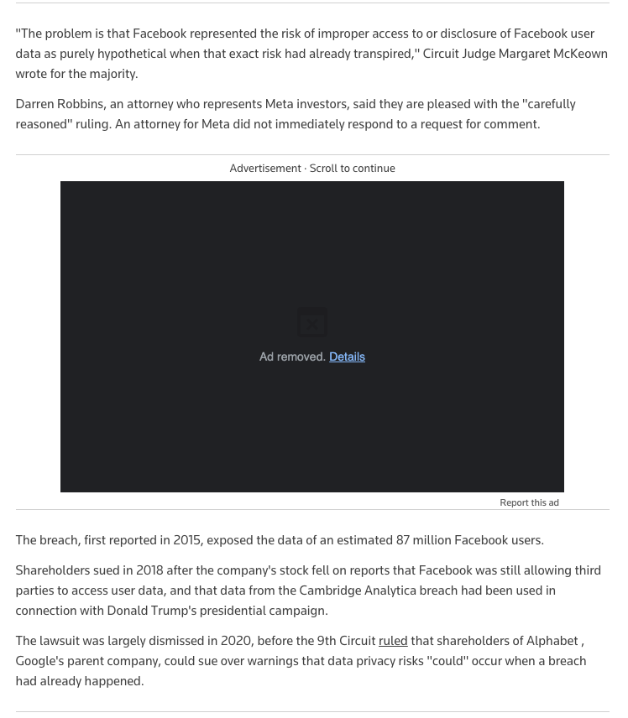

Slide 62
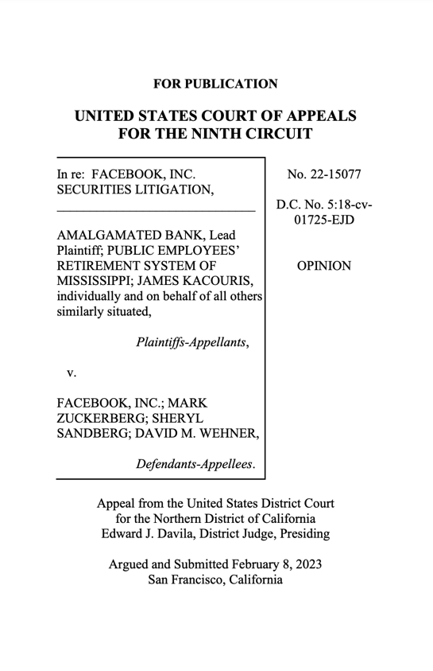

Slide 95
QUESTIONS
THOUGHTS
DISCUSSION

Slide 96
Follow-ups

Slide 108
A THEORY

Slide 109
A Theory of Future Media?…

Slide 110
Sub Nom:
THE END OF
ENTERTAINMENT
(as we know it)

Slide 111
Perspective

Slide 112
Aligning Vectors

Slide 113
Vectors 1:
A. Everyone is a creator.
B. Everyone is a story.

Slide 114
Vectors 2:
A. We are not the same.
B. We are diverse.
C. We interpret the same things differently.

Slide 115
Post-Structuralism encourages/reinforces/represents the value of human agency, choice, & creativity.
Rene Magritte
“Not to be
Reproduced”
1937

Slide 116
Vector 3:
Why We Engage With Media

Slide 117
Sub-Theory:
Self narrative enabled by
media & entertainment
(raw materials already workshopped)
Perhaps an antidote to the “realist”
view of life which can be bleak.

Slide 120
Vectors 4:
A. Technology Controls Images.
B. Technology Images Control.

Slide 121
Form Over Substance?
Or an Additional Form of Substance?

Slide 122
McLuhan – sort of…
“We become what we behold. We shape our tools and then our tools shape us.”
From an article by Father John Culkin about McLuhan: Culkin, J.M. (1967, March 18). “A schoolman’s guide to Marshall McLuhan”. Saturday Review, pp. 51-53, 71-72

Slide 123
“Technology is a useful servant but a dangerous master.”
Christian Lous Lange, Noble Peace Prize (1921)

Slide 124
“…there is a delicate balance between appropriating new technologies and being appropriated by them.”

Slide 125
Controller as both Metaphor & Reality

Slide 126
Who/What is
Controlling Who?
Neo – The Matrix

Slide 127
The illusion of choice…

Slide 129
What we can’t see, can hurt us.

Slide 130
Vector 5:
Digital

Slide 131
Is there an inherent limitation to the completely binary language of only 1’s & 0’s?

Slide 132
Technology is (very) Structuralist

Slide 133
Polarization?

Slide 134
The Metaverse = Life Through Digital Lenses

Slide 137
Dark Patterns

Slide 138
& sometimes there are no words other than “sick & evil”…

Slide 139
Vector 6:
A.I.

Slide 140
A.I. Metaphor For A.I.
A.I. as Constructed Reality/Distorted Mirror

Slide 141
WE TRUST
FORM OVER SUBSTANCE?

Slide 142
“Hallucinations”
=
Anthropomorphizing

Slide 143
What A.I. is missing
Compassion
Critical thinking
Ability to generate new
(circuitous analysis of refracted
and reflected data)

Slide 145
But the Wizard will probably
still be human for now…

Slide 146
Vectors 7:
A. Everything is Entertainment.
B. We Are Each Others Entertainment.

Slide 149
Vector 8:
MEdia

Slide 150
What if an algorithm knew…
My favorite type of movie (romantic comedy)
My favorite stars (Anna Kendrick + “young” John Cusack)
My favorite screen writer (Adam Sorkin)
My favorite plot trope (time travel that teaches life lessons)
Plot points & dialogue that I laugh at
Plot points & dialogue that I cry at
Favorite music (Springsteen + The Clash)
My personality profile (in detail)
My personal history & biographical details (Dad passed of cancer; mom of Alzheimer’s; Parents both Holocaust survivors from Poland)
And everything else ascertainable about me including from publicly posted lectures on Allard Law course websites .

Slide 151
Fictional Storytelling uniquely tailored to me: At the extreme an algorithmically directed “The Truman Show”

Slide 152
Been done?

Slide 153
ABOUT TO ARRIVE ?

Slide 155
THE END OF
ENTERTAINMENT
(as we know it)

Slide 156
Conclusion 1
Extreme Social Media:
We will be each be
& have the tools to be
the source of our own
and each others
entertainment “content”.

Slide 157
Conclusion 2
Extreme Social Media:
Future “content” will be
individual IMAGE-ings created by us
consciously or subconsciously
through A.I. tools that defy boundaries,
targeted consciously or subconsciously
at audiences of ourselves or each other .

Slide 161
QUESTIONS?
THOUGHTS?
DISCUSSION?

Slide 164
A MATTER OF PERSPECTIVE

Slide 165
Perspective

Slide 167
Always include a cat picture

Slide 168
In learning you will teach
And in teaching you will learn
Phil Collins' Son of Man (1999)

