Slide 1
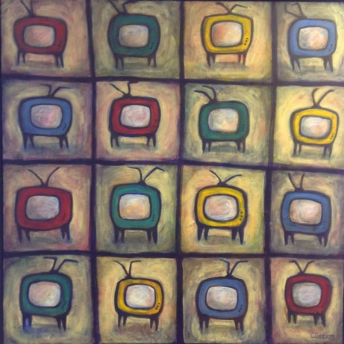
Presentations + Prof. Bakan
Talk 10
Communications Law
Allard School of Law, UBC
Fall 2023
Jon Festinger K.C.
Allard Law of Law, UBC
QMUL School of Law (CCLS)
Of Counsel, Chandler, Fogden, Lyman
https://commlaw.allard.ubc.ca/

Slide 2
Permission to Record?

Slide 3
Special Guest Speaker

Slide 4
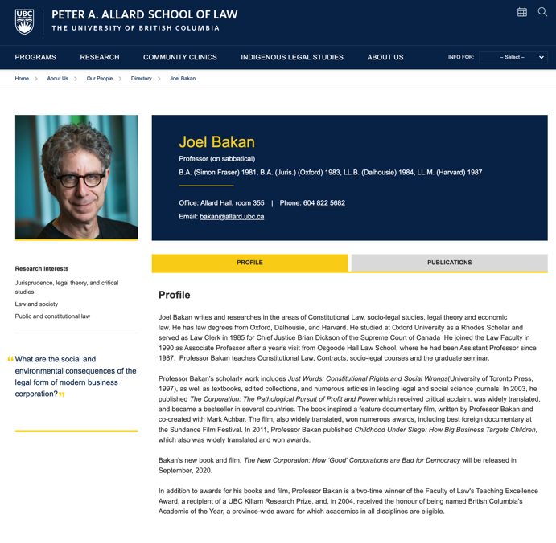

Slide 5
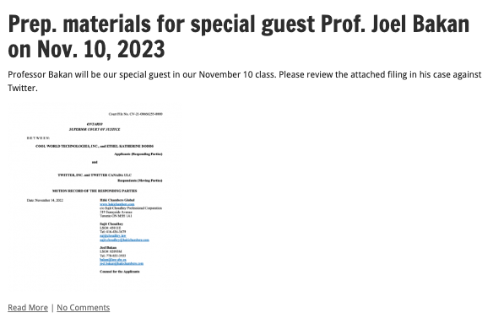

Slide 6
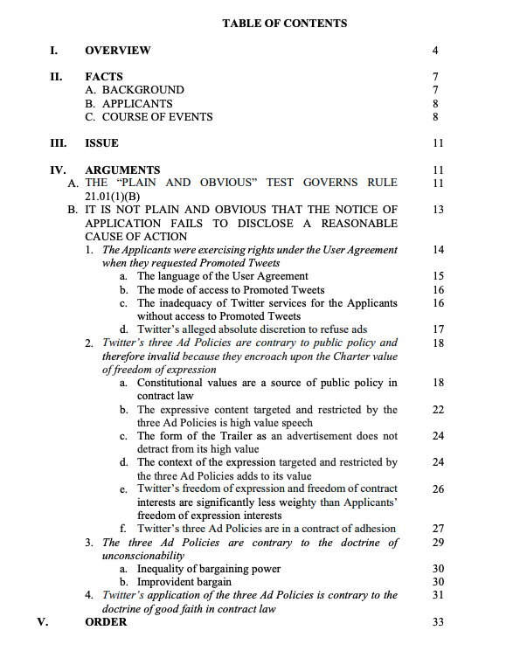

Slide 7
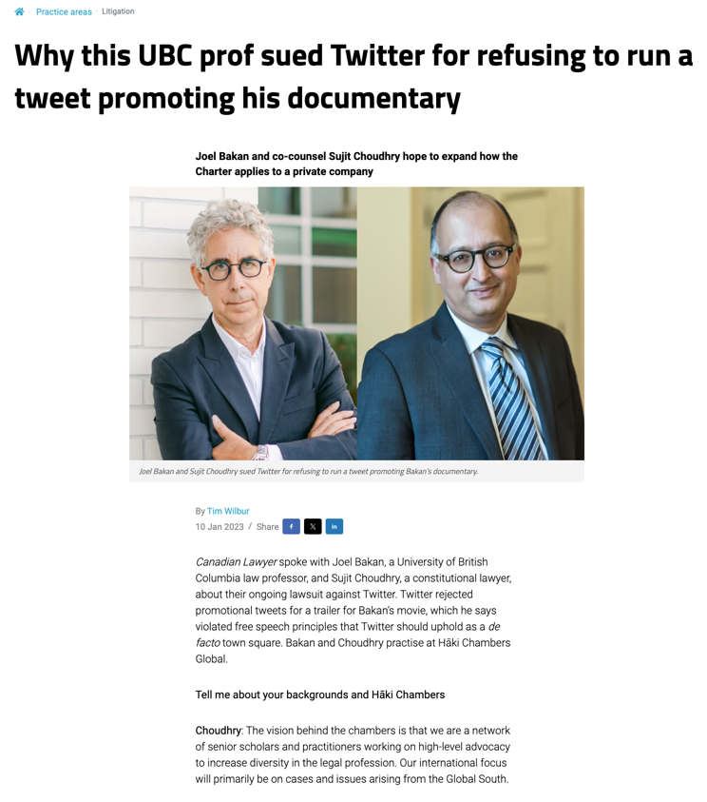

Slide 8
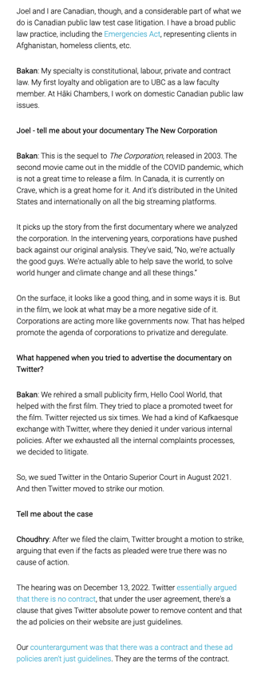
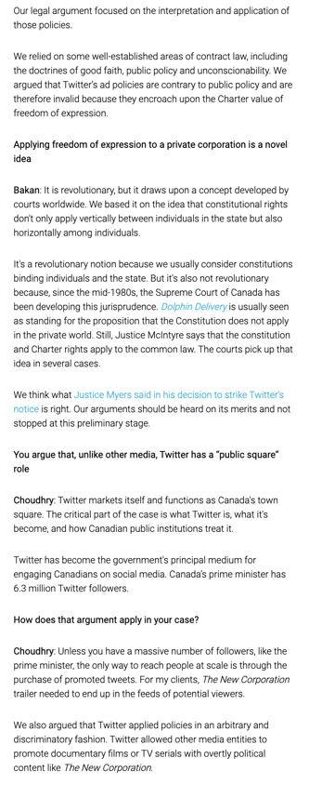

Slide 9
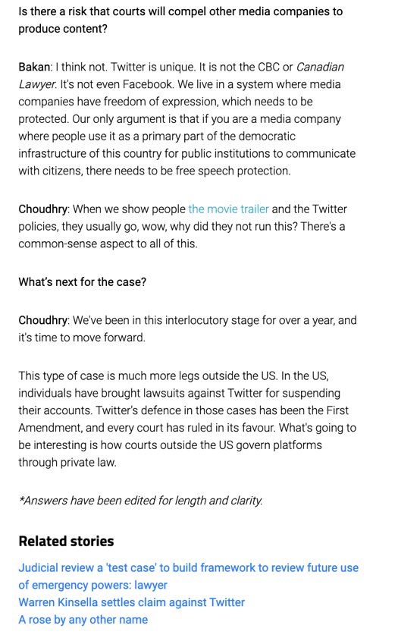

Slide 10
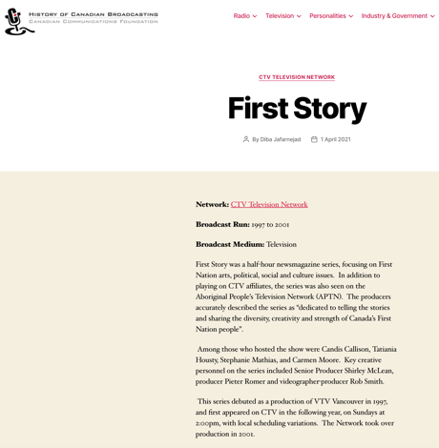
I would like to acknowledge that we are situated on the
traditional, ancestral, unceded territory of the Musqueam people.

Slide 11
Logistics

Slide 12
NO CLASS
Friday, November 17, 2023

Slide 13
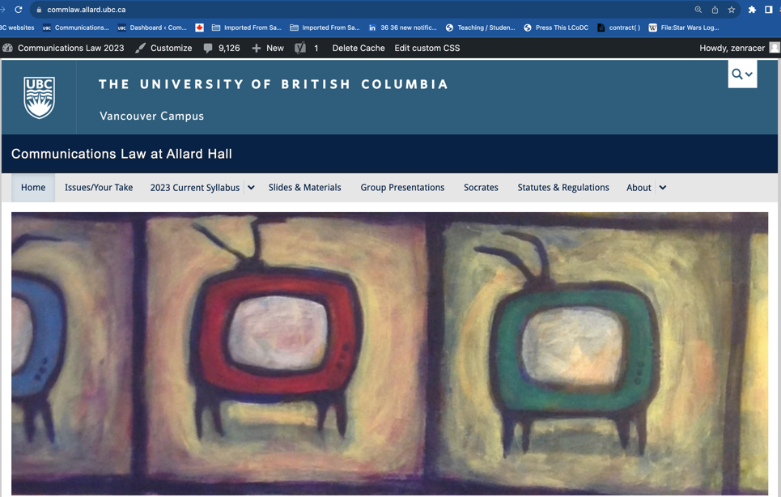
https://commlaw.allard.ubc.ca/

Slide 14
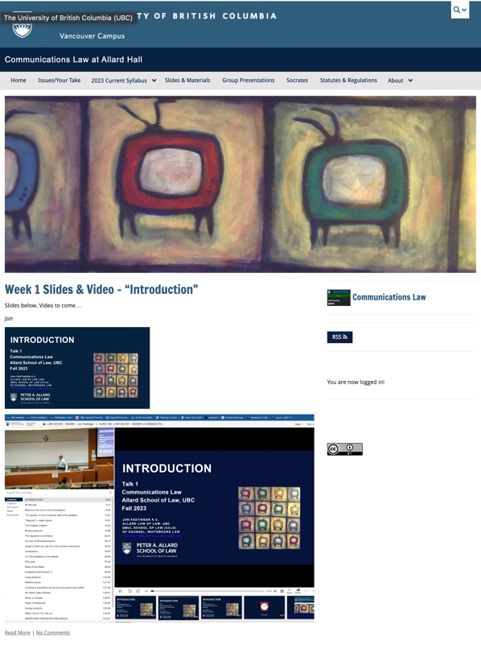

Slide 15
For full privileges on the website
1. Please create an account at http://cms.ubc.ca/ using your CWL.
2. Once you create an account and sign in at http://cms.ubc.ca/ you can click your name in the top right. Half-way down the following page will be your WordPress email address.
3. Send me your WordPress email address at jfestinger@telus.net or at jon.Festinger@ubc.ca
4. Then, I will invite you to participate with authoring privileges via your WordPress email address.

Slide 16
Why post?
Engaging and engaging others is the key.
Because you don’t love speaking up in class.
Because you just saw something, and you’ll never remember it unless you post it now.
Please sign your name to your post

Slide 17
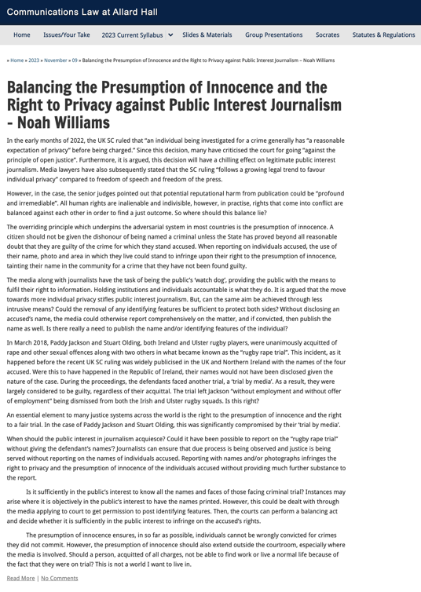

Slide 18
Please sign your posts

Slide 19
“Living” Syllabus

Slide 20
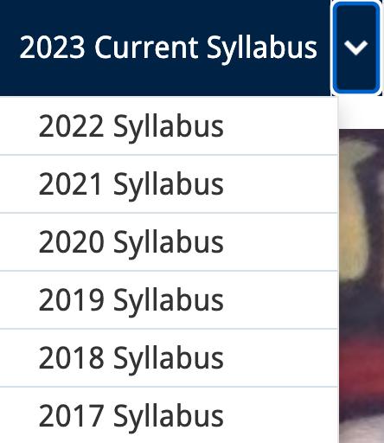
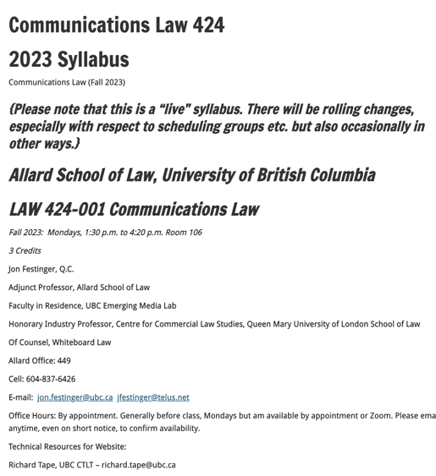

Slide 21
Website issues…

Slide 22
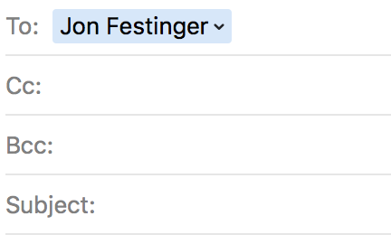
Anything & everything can be
done via email if you prefer

Slide 23
Notes on Grades
Scale-down tendency (ok, after 30 years it’s more than a tendency…)
Paper is 60%. Participation is 40%. In-class, website, email, presentations, anything you want to do (within reason)…
Presentations: Group or Individual. Engaging your classmates is the key.
Presentation and paper can be related

Slide 24
Paper Confessional (or what I learned one winter holiday)
Legal/normative reasoning/argument including footnote/bibliography support & Contribution/Move forward → 60%
Presentation including layout, headings, grammar, language/writing skills, “tightness” → 25%
Topic/Originality/Degree of Difficultly → 15%
THIS IS NOT A RUBRIC. IT IS A SELF ASSESSMENT.

Slide 25
Will read: drafts…outlines…synopsis……abstracts…etc.
As late as I can…
Due last day of exams by 4:00 PM.
Send in papers by email. Make sure you get acknowledgment of receipt.

Slide 26
Grades (primarily)
Paper → Quality
Participation → Effort

Slide 27
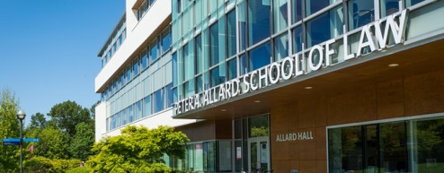
Office “Hours”: You Tell me
Room 449
Email me jon.Festinger@ubc.ca jfestinger@telus.net
Text:
c. 604-837-6426

Slide 28
QUESTIONS
THOUGHTS
DISCUSSION

Slide 29
Group
Presentations

Slide 30
Laura Burke
Alirod Ameri

Slide 31
Jay Kim

Slide 32
QUESTIONS
THOUGHTS
DISCUSSION

Slide 34
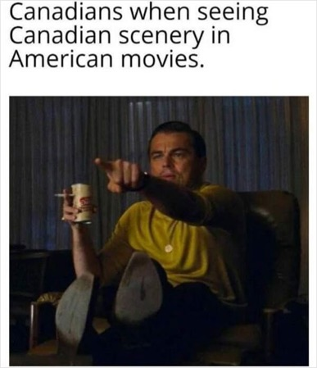
Canadian Content & The Law

Slide 35
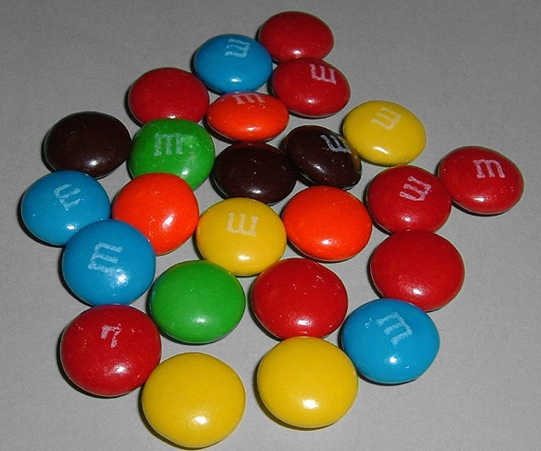
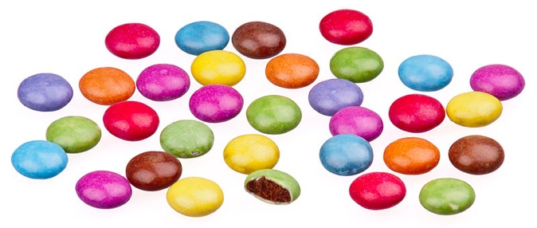
A MATTER OF PERSPECTIVE

Slide 36
Perspective

Slide 38
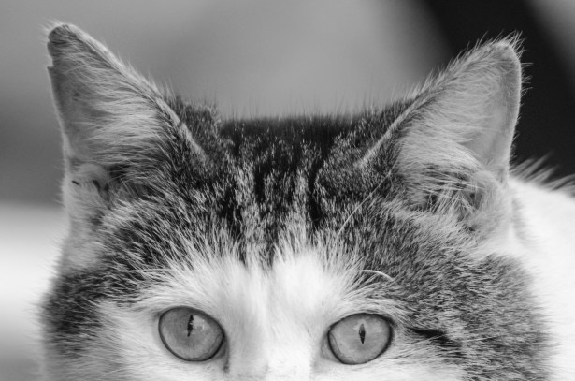
Always include a cat picture

Slide 39
In learning you will teach
And in teaching you will learn
Phil Collins' Son of Man (1999)

