Slide 1
Data tracking by private companies
Jas Sahota & Claire Guatto
Communications Law – November 3, 2023

Slide 2
Agenda
01
Data tracking & Cookies
How cookies work
02
Practical example
Indigo + Class exercise
03
Real-time bidding
How targeted ads work
04
Risks of tracking technology
Case studies demonstrating real-life impact

Slide 3
What is online data tracking?
The collection of data from web users by private companies.
Enables them to gain knowledge of users’ online behaviour to target their services accordingly.
IP address
Cookies
Pixel tags
Notes:
We will focus on data collection by private non-democratically accountable institutions, using cookies as an example.

Slide 4
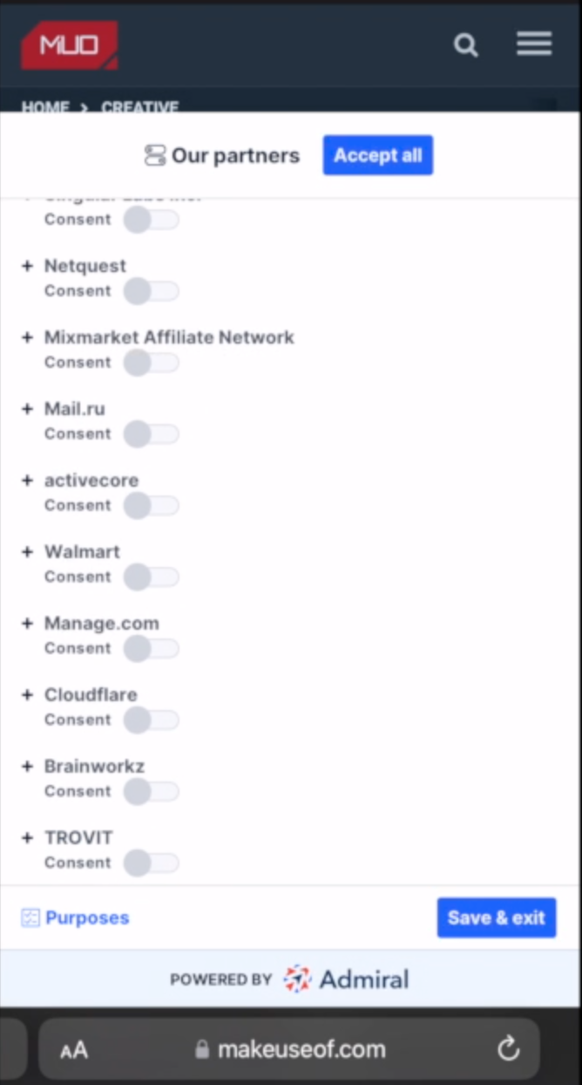
What are internet cookies?
Small files placed on a user’s device when they visit a website.
Collects data to track web activity and identify user preferences.
Generate targeted ads
based on user preferences
Purpose
‘essential’ vs ‘non-essential’
Active time
‘session’ vs ‘permanent’ cookies
Notes:
Cookies are placed on a user’s technological device by a web browser. Cookies are text files containing small pieces of user data sent to your browser by any website you visit. These work on tracking your activities and preferences, aiming to make the whole experience more fulfilling for both the site and the user.
Session: expire when a browsing session ends, i.e. web page is closed.
‘Permanent cookies’ are deleted per a specific expiration date or after a specific period of time.
Give examples of diff types on a website – functional, strictly necessary – functional ones may benefit users.

Slide 5
How is personal data protected?
PIPEDA
Federal privacy law
Governs how private businesses handle personal information
Applies to cross-border transfers
Data retention – ‘long enough to allow the individual access to the information’
Protection of children
Excludes solely artistic, journalistic and literary purposes
PIPA
Provincial privacy law
Governs how personal information is handled within BC (for commercial use or otherwise)
Notes:
Any website that uses cookies to track or collect personal data must comply with all the cookie laws that are relevant in the jurisdiction the website operates within. A cookie law compels websites to inform any visitor of the usage of cookies and grant their consent to use cookies before browsing the site.
PIPEDA = Personal Information Protection and Electronic Documents Act → federal privacy law for private-sector organizations. It sets out the ground rules for how businesses must handle personal information in the course of their commercial activity.
PIPA = Personal Information Protection Act.
Data retention under PIPEDA, organizations must retain personal information that has been used to make a decision about an individual long enough to allow the individual access to the information after the decision has been made.
PIPA and PIPEDA do not define 'child' or 'children' or require organizations or public bodies to make efforts to verify that parents or guardians have provided consent on behalf of children.

Slide 6
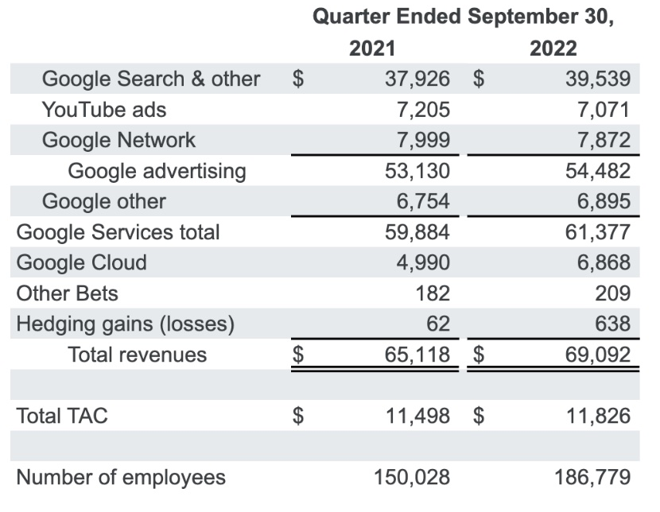
Why should we care about data tracking?
Intrusive cookies
Can track in-depth data without consent
Targeted ads
Almost 79% of Google’s revenue last year was from ads

Slide 7
CLASS EXERCISE
Indigo Website: https://www.indigo.ca/en-ca/

Slide 8
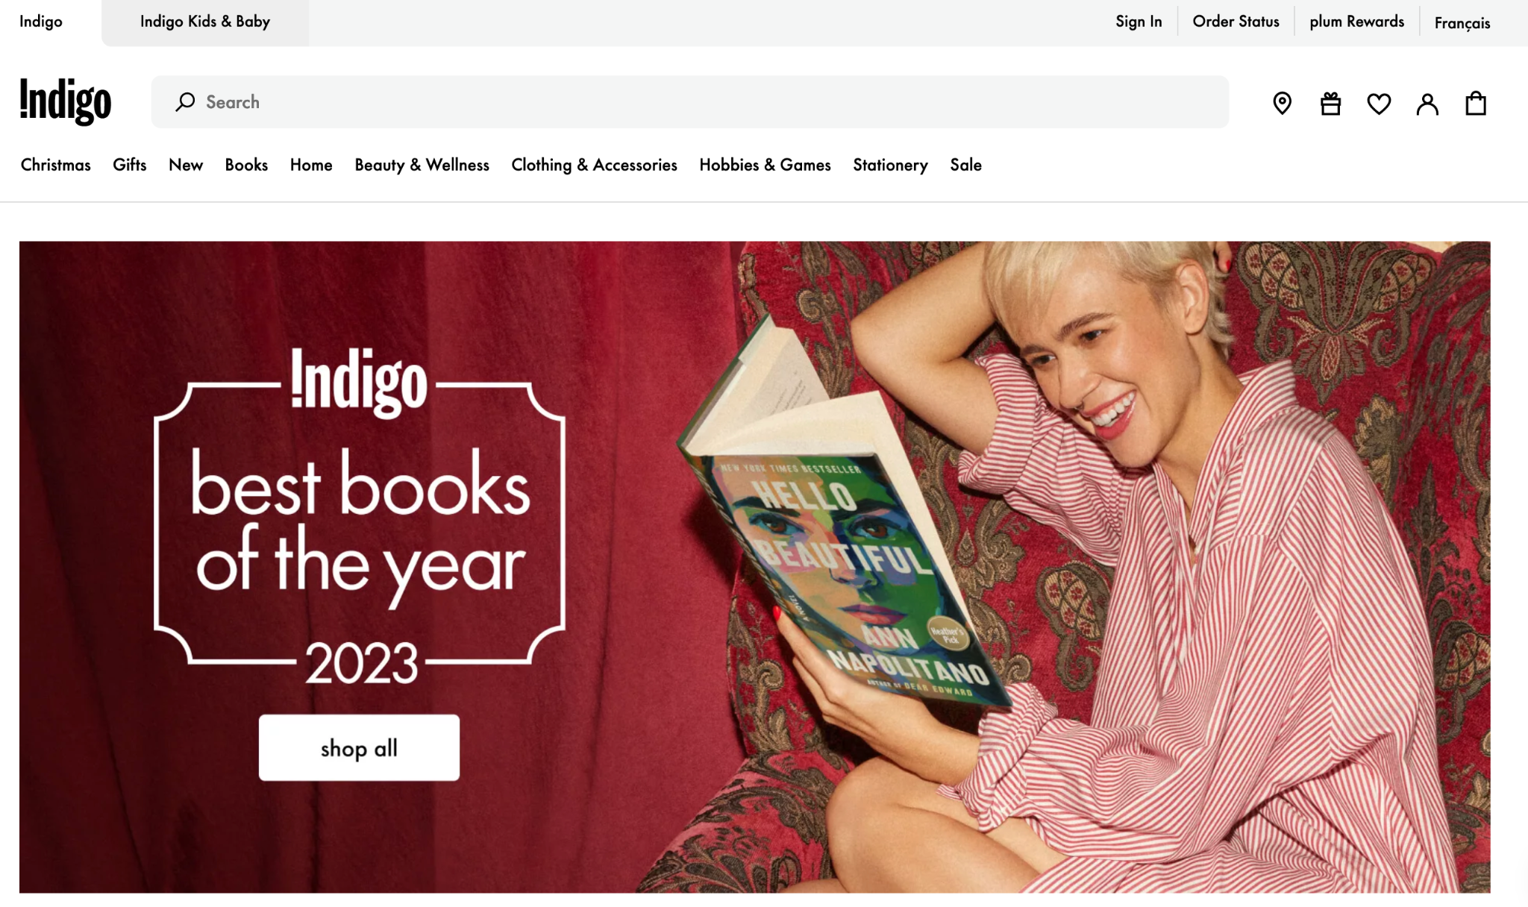
Practical Example: Indigo
01
What information is Indigo collecting?
02
Where is Indigo collecting information from?
03
What is Indigo doing with this information?

Slide 9
What information is Indigo collecting?
01
Basic identifying information
Address, social media, signature
02
Lifestyle & personal interest information
Profession, hobbies, life events
03
Geolocation data
Precise, mobile-based
04
Demographic data
Marital status, household information
05
Internet or other network activity
Browsing activity, search history

Slide 10
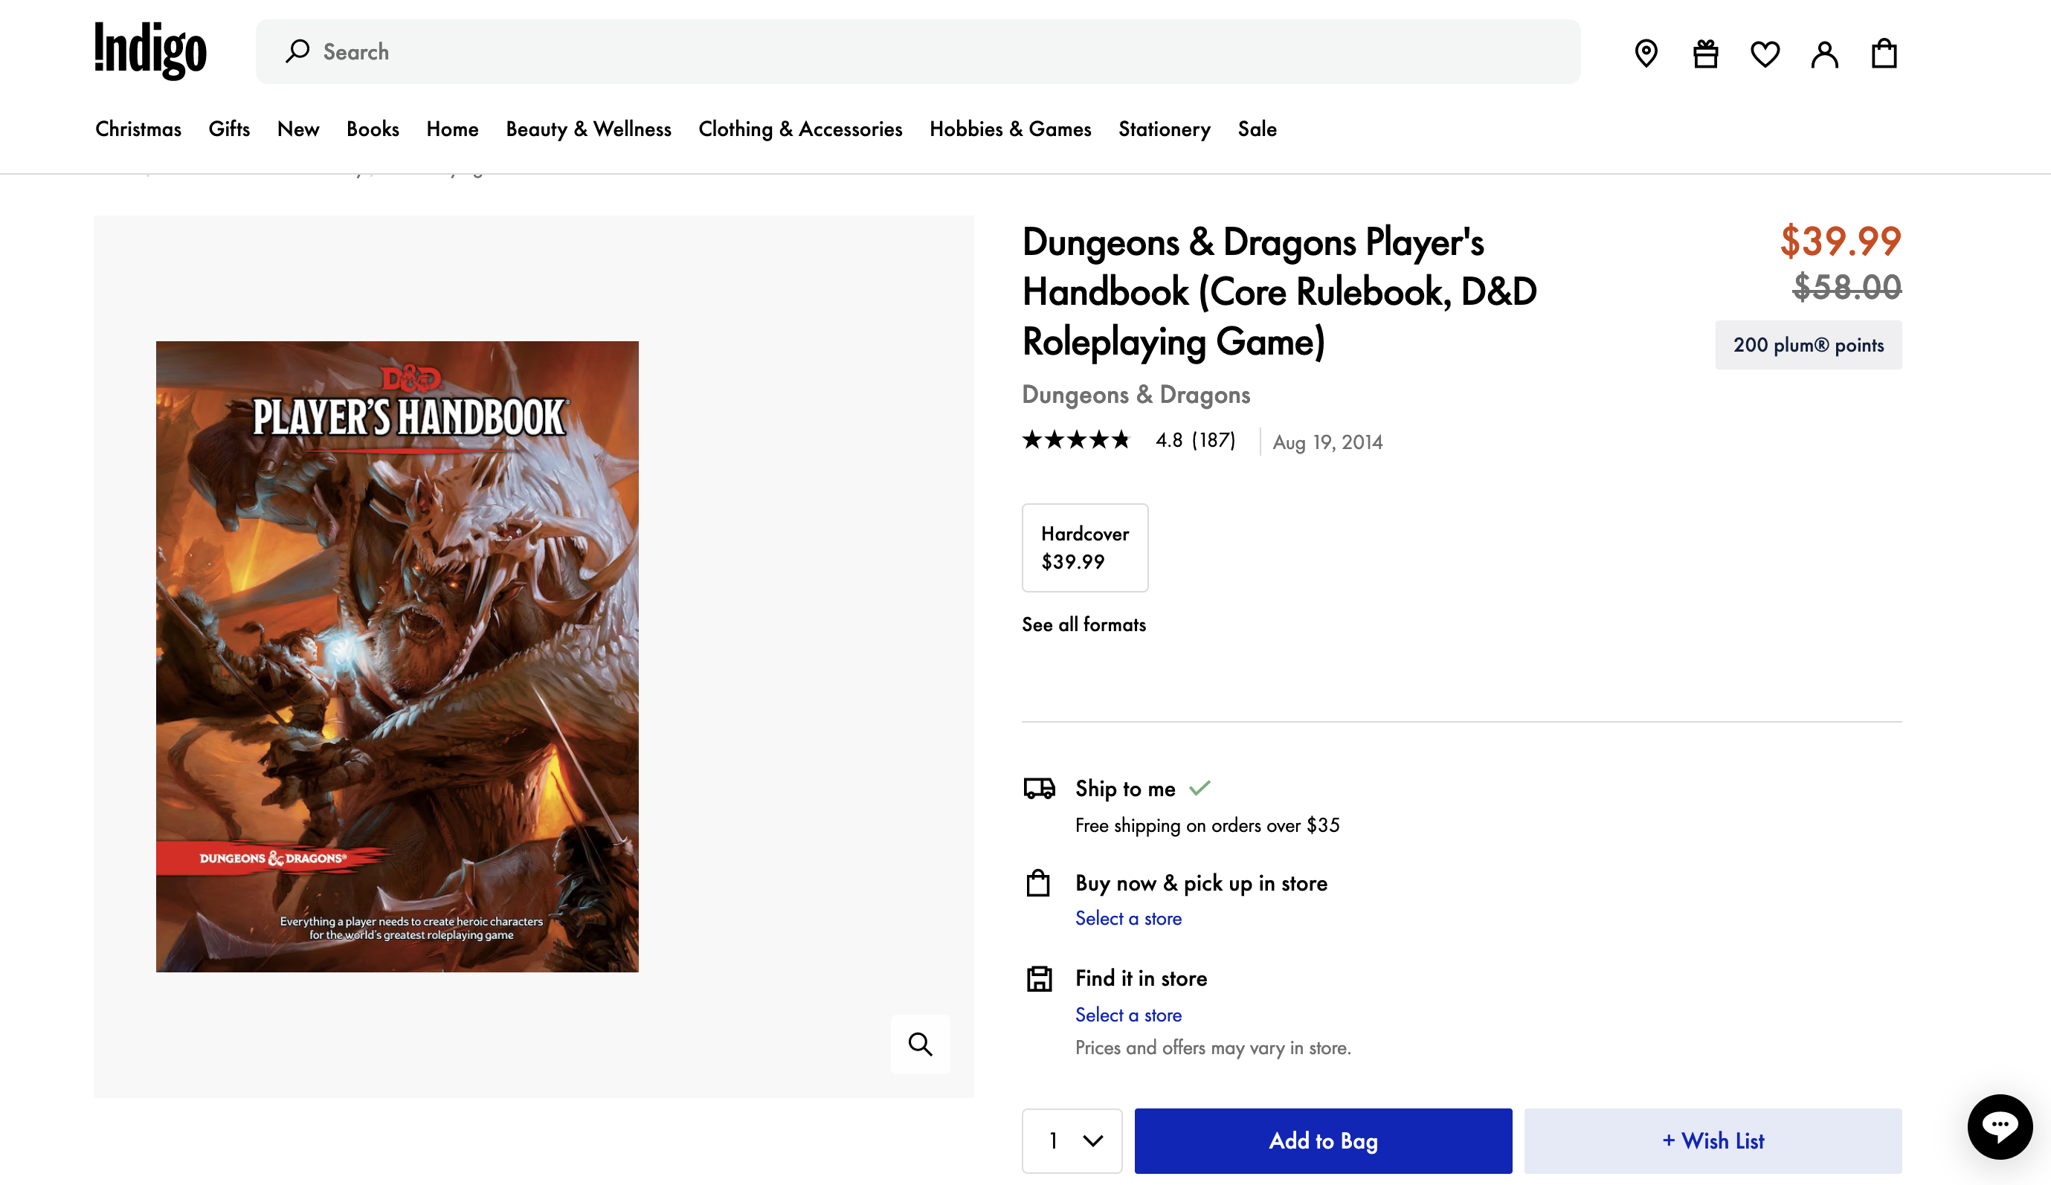
How is Indigo getting your
information?
Notes:
Activity on their sites/interactions with them, and your activity outside of Indigo.
Consent based.

Slide 11
What is Indigo doing with this information?
Customized Promotions
Special Offers
Targeted Advertising
Internal Record Keeping
Analyse Customer Behaviour
Provide a Better Experience
Advertising
Marketing Purposes
Business Transactions
Service Providers
Analysing
Sharing
Notes:
Legitimate interest, as Jas mentioned, per PIPEDA. Genuine commercial aims.
Also, targeted advertising

Slide 12
1. We Watch a Video
11. YouTube loads the Winning Ad on my Video
2. On YouTube
10. The Winning Party’s Ad Goes to the Ad Space
3. Which Hosts an Ad
4. The Ad Space is Placed on Auction
9. A Winning Bid is Chosen
5. Ad Sellers Access My Data (stored in a third-party database)
8. The Bid Listener Considers Each Ad Seller’s Bids
7. The Ad Seller’s Algorithm Creates Their Bid and sends it to the Bid Listener
6. An Algorithmic Process Compares My Data to Available Ads

Slide 13
Risks of online data tracking
Users’ lack of awareness
Abuse of power by companies
Profit-driven companies
Extent of consent
Questionable ethics
Economic incentive to exploit data

Slide 14
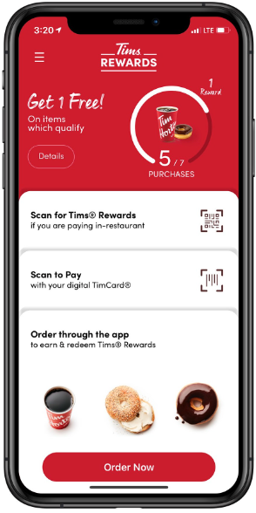
Case Study 1: Tim Hortons (June 2022)
Location tracking of customers through app
Customers tracked even when app was not in use or outside Canada
Method of tracking competitors
Notes:
Office of the Privacy Commissioner of Canada underscored how easily people can be identified by their movements.
Location data is highly sensitive because it can be used to infer where people live and work, reveal trips to medical clinics. It can be used to make deductions about religious beliefs, sexual preferences, social political affiliations and more.

Slide 15
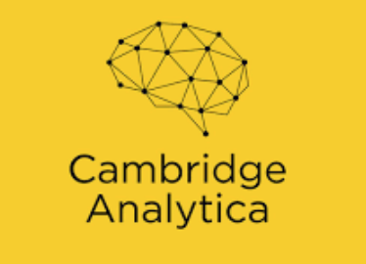
Case Study 2: Cambridge Analytica
Data harvesting
Psychological profile
Potential impact
Worked with Facebook, political campaigns
Data harvested to create user profile
May have impacted voting outcome
90m+ affected
Targeted political ads
Consent obtained from few users
User profiles used to target ads
Notes:
Data harvesting company that worked with Facebook, 2016 Trump Campaign, 2016 Leave EU Brexit Campaign
Harvested data of Facebook users and their networks to create a psychological profile of the user
Over 90 million profiles, but very few people had consented and each person who consented was told they were consenting to ‘academic use’ of their data
Used user profiles to deliver targeted political ads
Mass data collection and highly personalized psychological profiles enabled the spread of highly effective targeting of political ads, which may have swayed voters.
The campaigns may have changed the results of the Brexit referendum and the 2016 US Presidential Election

Slide 16
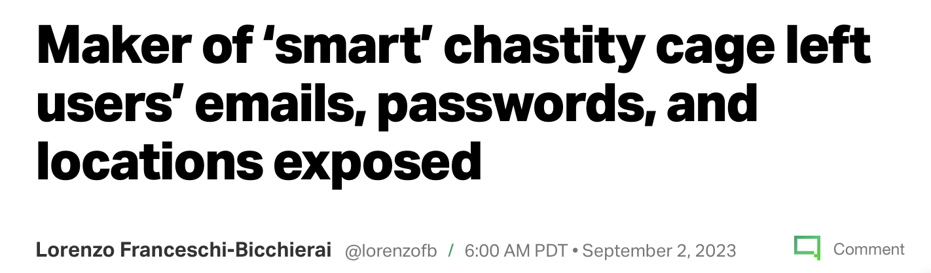
Key Takeaways
Advertising funds the internet
Consumer benefit – There may be legitimate commercial reasons and consumer benefits to mass data processing.
Limited control – We have very little control over our personal information.
Manipulation of consumer behaviour – RTB makes manipulation through targeted advertising easier than ever.
Notes:
Limited control - consent

Slide 17
Bibliography
Legislation
Personal Information Protection and Electronic Documents Act, S.C. 2000, c.5
Personal Information Protection Act, [SBC 2003], Ch 63
Office of the Privacy Commissioner of Canada, PIPEDA Legislation and Related Regulations, (2018) online: <https://www.priv.gc.ca/en/privacy-topics/privacy-laws-in-canada/the-personal-information-protection-and-electronic-documents-act-pipeda/r_o_p/>
Government Sources
Weinan Zhang, Shuai Yuan, Jung Wang, “Optimal Real Time Bidding for Display Advertising” (2014) 1077-1086 Association for Computing Machinery, Proceedings of the 20th ACM SIGKDD International Conference on Knowledge Discovery and Data Mining, online: https://doi.org/10.1145/2623330.2623633
Alex Hern, “Cambridge Analytica: How did it turn clicks into votes?” (6 May 2018), The Guardian online: https://www.theguardian.com/news/2018/may/06/cambridge-analytica-how-turn-clicks-into-votes-christopher-wylie
Academic Articles
News Articles

Slide 18
Bibliography
News Articles
Jane Wakefield, “Your Data and How It’s Used to Gain Your Vote” (27 Nov 2020), BBC News online: https://www.theguardian.com/news/2018/may/06/cambridge-analytica-how-turn-clicks-into-votes-christopher-wylie
Scott Detrow, “What Did Cambridge Analytica Do During the 2016 Election?” (20 March 2018), NPR online: https://www.theguardian.com/news/2018/may/06/cambridge-analytica-how-turn-clicks-into-votes-christopher-wylie
Online Sources
Alphabet, “Alphabet Announces Third Quarter 2022 Results”, (25 Oct 2022), online: https://abc.xyz/assets/investor/static/pdf/2022Q3_alphabet_earnings_release.pdf?cache=4156e7f
Alphabet, “Cookie Matching”, online: https://developers.google.com/authorized-buyers/rtb/cookie-guide
David Mitby, “More Effective Media Buying on Apps” (1 May 2023), Google Ads & Commerce Blog, online: https://blog.google/products/ads-commerce/more-effective-media-buying-on-apps/

Slide 19
Bibliography
Online Sources
Martina Bretous, “A Plain English Guide to Real Time Bidding” (21 February 2022), Hubspot online: https://blog.hubspot.com/marketing/real-time-bidding
Jeff Beckman, “2023’s Google Ads Statistics: Don’t Miss Out!” (31 October 2023) Tech Report online: https://techreport.com/statistics/google-ads-statistics/

