Slide 1
Demystifying Canada’s “Censorship Law”:
The Online Undertakings Registration Regulations
LAW424 Communications Law Presentation
By Jay Kim

Slide 2
Introduction
On April 27, 2023, the Online Streaming Act (aka Bill C-11) received royal assent.
Since then, the CRTC has engaged in public consultations to formulate policies that will protect and promote Canadian content.
On September 29, 2023, the CRTC announced the implementation of the Online Undertakings Registration Regulations, which require online streaming services to register with and provide information to the CRTC.

Slide 5
What does it actually entail?

Slide 6
What does it actually entail?
With the introduction of the Regulations, two policies came into effect:
(1) “Operators of online undertakings” (i.e. online streaming services) must register with the CRTC and provide basic information by November 28, 2023.
(2) Operators must comply with conditions set out by the CRTC to operate in Canada, effective immediately.

Slide 7
What does it actually entail?
The Regulations set out a Criteria for who must register:
(a) operate in Canada;
(b) offer broadcasting content; AND
(c) earn $10 million or more in annual broadcasting revenues.

Slide 8
What does it actually entail?
Who is captured by the Regulations?
Operators that provide broadcasting content, which the CRTC defines as “audio or audiovisual programs that are intended to inform, enlighten or entertain”
For example:
Streaming services
Social media
Subscription television services available online
Radio stations that livestream over the Internet
Podcasts (free or paid subscription)
Unique transactions that allow the user to stream or download content

Slide 9
What does it actually entail?
What activities are exempt from the Regulations?
Regarding the revenue threshold, revenue generated from the following are exempted:
(a) providing video game services;
(b) providing audiobook services; and
(c) broadcasting activities by traditional services exempt from holding a license

Slide 10
What does it actually entail?
What information do Operators have to provide?
(a) the online undertaking’s name;
(b) the operator’s name, mailing address, phone number and email address;
(c) if different than the contact information filed under paragraph (b), contact information for a contact person for the operator, such as their name, title, mailing address, phone number and email address;
(d) the place where the operator of the online undertaking is incorporated* or otherwise formed, if any, and the location of its head office; and
(e) the broadcasting services offered by the online undertaking.

Slide 11
What does it actually entail?
What are the conditions that Operators have to comply with?
(1) Operators must provide the CRTC with information regarding their content and subscribership.
(2) Operators must make content available in a way that is not tied to a specific mobile or Internet service (e.g. Rogers + Sportsnet NHL package).

Slide 12
What are people saying about it?

Slide 13
What are people saying about it? – Apologist Perspectives
The CRTC
Downplays severity of registration regime → “collects basic information, is only required once, and can be completed in just a few steps”
Published “Myths and Facts” page to inform and reassure the public

Slide 14
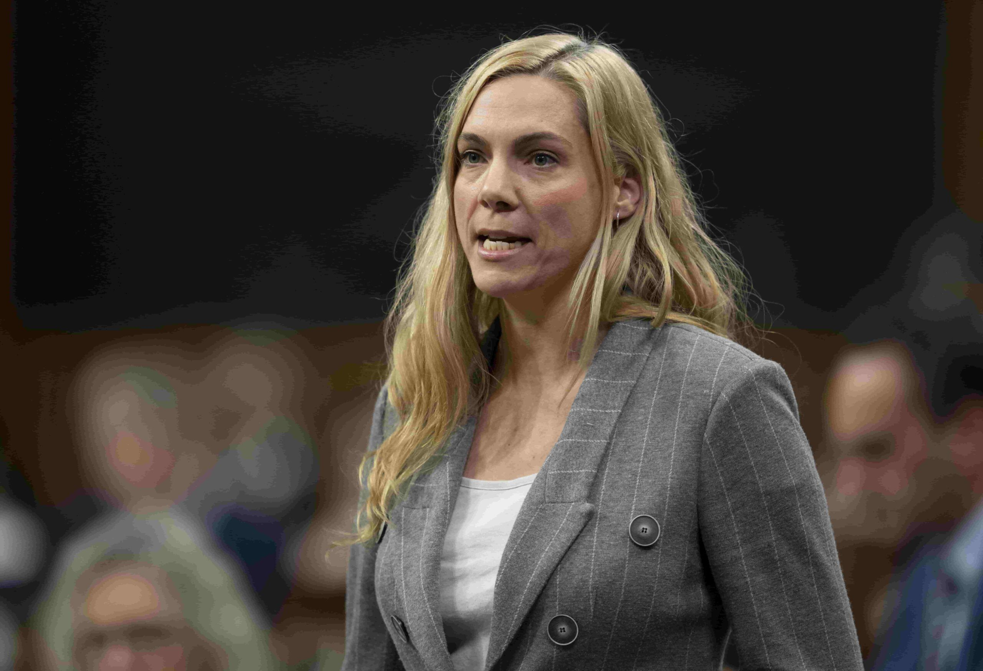
What are people saying about it? – Apologist Perspectives
The Government
Senator Marc Gold (Liberal) → the Act “will not interfere with or stifle the expression of Canadian voices”
Pascale St-Onge (Minister of Canadian Heritage)
“This Commission is directed not to impose regulatory requirements on online undertakings in respect of the programs of social media creators, including podcasts.”
“We have been clear all along that this Act is about platforms – not content uploaded and created by users and creators.”

Slide 15
What are people saying about it? – Apologist Perspectives
CTV News
“The law is not concerned with social media users – not even those who criticize the prime minister.”
Reiterates that the Act is aimed at regulating corporations (i.e. online streaming services), not individuals (i.e. content creators)
The Verge

Slide 16
What are people saying about it? – Critical Perspectives
Brian Lilley (Toronto Sun)
Rejects the argument that the Act only affects large corporations, not individuals
Content creators depend on platforms to get their message out to the public
Any rules imposed on platforms will apply to creators who use those services
Any fees imposed on platforms will eventually be passed down to individual creators
“Saying you won’t regulate an individual podcaster, just the platforms they stream on, is like saying you won’t regulate individual drivers, just the highways they drive on. The result is the same.”

Slide 17
What are people saying about it? – Critical Perspectives
Peter Menzies (Epoch Times)
History of the CRTC foreshadows where the Act and its Regulations are headed
CRTC has capacity for censorship and it will step in when it feels the need
Licences set out what types of programs are transmitted, when and in what proportion
Programs are governed under a subjective standard
Previously sanctioned operators for racial and homophobic slurs
“Self-regulation” by the CBSC
“Unspoken but deeply embedded mutual understanding between the regulator and broadcasting companies”
“The scope of opinions, the range of perspectives, and the manner in which they are expressed are carefully and meticulously curated.”

Slide 18
What are people saying about it? – Critical Perspectives
Jesse Brown (Canadaland)
The Act and the Regulations are not about censorship, but about getting corporations to pay into the Canadian content industry.
If they contribute, they can get funding from government for producing Canadian content.
But just like Bill C-18 and Meta, what happens if a foreign corporation says “it’s not worth the effort”?
It will have trickle-down effect on smaller players like Canadaland that rely on the bigger platforms to deliver their content to the public.
“This really is a battle between Canadian telecom giants and American web giants, and small Canadian successful content creators are the roadkill caught in the middle of this.”

Slide 19
What are people saying about it? – Critical Perspectives
Michael Geist (University of Ottawa)
Outlines 4 causes for concern:
(1) CRTC rejected most requests to exclude non-conventional video and audio streaming services – Why are some services captured, but others are not?
(2) CRTC claims that registration requires disclosure of de minimis information – Then how can these information also be considered essential to future regulatory activities?
(3) Policy implies that services that generate a certain threshold of revenue must register with the government – Why should anyone be subject to government interference to freedom of expression?
(4) CRTC suggests that registration is the entry point to more regulation – Then what’s next?
“Bill C-11 was never just about the ‘web giants’.”

Slide 20
What’s next?

Slide 21
What’s next?
In the near future…
These policies are the result of feedback from public consultations with stakeholders.
The CRTC revealed that “a third consultation is ongoing”, which “considers contributions traditional broadcasters and online streaming services will need to make to support Canadian and Indigenous content.”
A 3-week public proceeding will commence on November 20, 2023 and the CRTC has invited 129 intervenors to present on various issues.

Slide 22
What’s next?
Looking further ahead…
The public consultations are part of Phase 1, which is about laying the foundations of the online undertakings regulatory regime.
1st consultation: Registration Requirement
2nd consultation: Exemption Orders and Basic Conditions of Service
3rd consultation: Contributions
Phase 2 is building the regulatory framework (started: summer 2023).
Currently, closed for comments
Drafting regulations and policies - e.g. definitions and proposed broadcasting fees
Phase 3 is implementing the regulatory regime (target start: late 2024).

Slide 23
My Takeaways
(1) The 3rd consultation is about “contributions” that the CRTC will demand from operators. This inevitably involves money. If foreign web giants decide to play along, how long before they pass off those fees/costs to Canadian creators and consumers? Otherwise, what incentive is there for them to engage with the Canadian market? There will be an inevitable financial consequence to the CRTC’s regulation.

Slide 24
My Takeaways
(2) The CRTC is expanding Canada’s broadcasting regime to include online streaming services because of pressure from Canada’s telecom giants like Bell and Rogers. They feel threatened by the changing landscape and want foreign competitors to pay into the system. Is the regime really protecting the interests of Canadian creators and consumers? Or is it actually just protecting the interests of Canadian oligarchical media giants?

Slide 25
My Takeaways
(3) If the “registry” and the conditions are just the starting point, what other policies will follow? How long before the CRTC begins to impose conditions on content creators just as it imposes programming conditions on broadcasting licenses? What will that mean for freedom of expression in Canada’s online landscape? – Not only for creators who will be limited in what they can express, but also for consumers who will be limited in what is available for them to consume.

Slide 26
References
Amrita Khalid, “Canada isn’t trying to silence podcasters: The reaction to a CRTC registration requirement may be overblown” online (Oct. 5, 2023) The Verge <https://www.theverge.com/2023/10/5/23905644/canada-podcast-platform-registration-requirement>.
Brian Lilley, “Yes, the CRTC’s podcast registry could lead to censorship” online: (Oct. 2, 2023) Toronto Sun <https://torontosun.com/opinion/columnists/yes-the-crtcs-podcast-registry-could-lead-to-censorship>.
Canadian Press, “Confusing claims about the online streaming law abound. How does it really work?” online: (Oct. 7, 2023) CTV News <https://www.ctvnews.ca/politics/confusing-claims-about-the-online-streaming-law-abound-how-does-it-really-work-1.6593409.>.
Canadian Radio-television and Telecommunications Commission, Broadcasting Regulatory Policy CRTC 2023-329 and Broadcasting Order CRTC 2023-330 (Sep. 29, 2023).
Canadian Radio-television and Telecommunications Commission, “Myths and Facts about Bill C-11, the Online Streaming Act” (May 12, 2023) <https://crtc.gc.ca/eng/industr/modern/myth.htm>.
Canadian Radio-television and Telecommunications Commission, “Registration for online streaming services” (Sep. 29, 2023) <https://crtc.gc.ca/eng/industr/modern/registr.htm>.
Elianna Lev, “New CRTC rules: ‘Potentially ruinous consequences to all podcasting in Canada’ Jesse Brown warns” online: (Oct. 4, 2023) Yahoo News Canada <https://ca.news.yahoo.com/crtc-rules-podcasting-jesse-brown-canadaland-112611249.html>.
Government of Canada, “CRTC takes major step forward to modernize Canada’s broadcasting framework”, online: (Sep. 29, 2023) <https://www.canada.ca/en/radio-television-telecommunications/news/2023/09/crtc-takes-major-step-forward-to-modernize-canadas-broadcasting-framework.html>.
Michael Geist, “What the CRTC’s New Registration Requirements Mean for Regulating Everything from Online News Services to Podcast Providers” online: (Oct. 2, 2023) <https://www.michaelgeist.ca/2023/10/crtcregistrationregs/>.
Peter Menzies, “CRTC’s Podcast Rules Mean the Days of Enjoying a Free and Open Internet Are Over” online: (Oct. 10, 2023) Epoch Times <https://www.theepochtimes.com/opinion/peter-menzies-crtcs-podcast-rules-mean-the-days-of-enjoying-a-free-and-open-internet-are-over-5506951>.

